Slide 1
Good Afternoon Welcome to Year 5!

Slide 2
Our Year 5 team Miss Reeve – Class Teacher Mr Fletcher – Teaching Assistant (mornings) Miss Smith – Tuesday and Thursday afternoons (French, Music, Re and PE) Mrs Wane – Maths and Better Reading (Monday, Thursday and Friday afternoons)

Slide 3
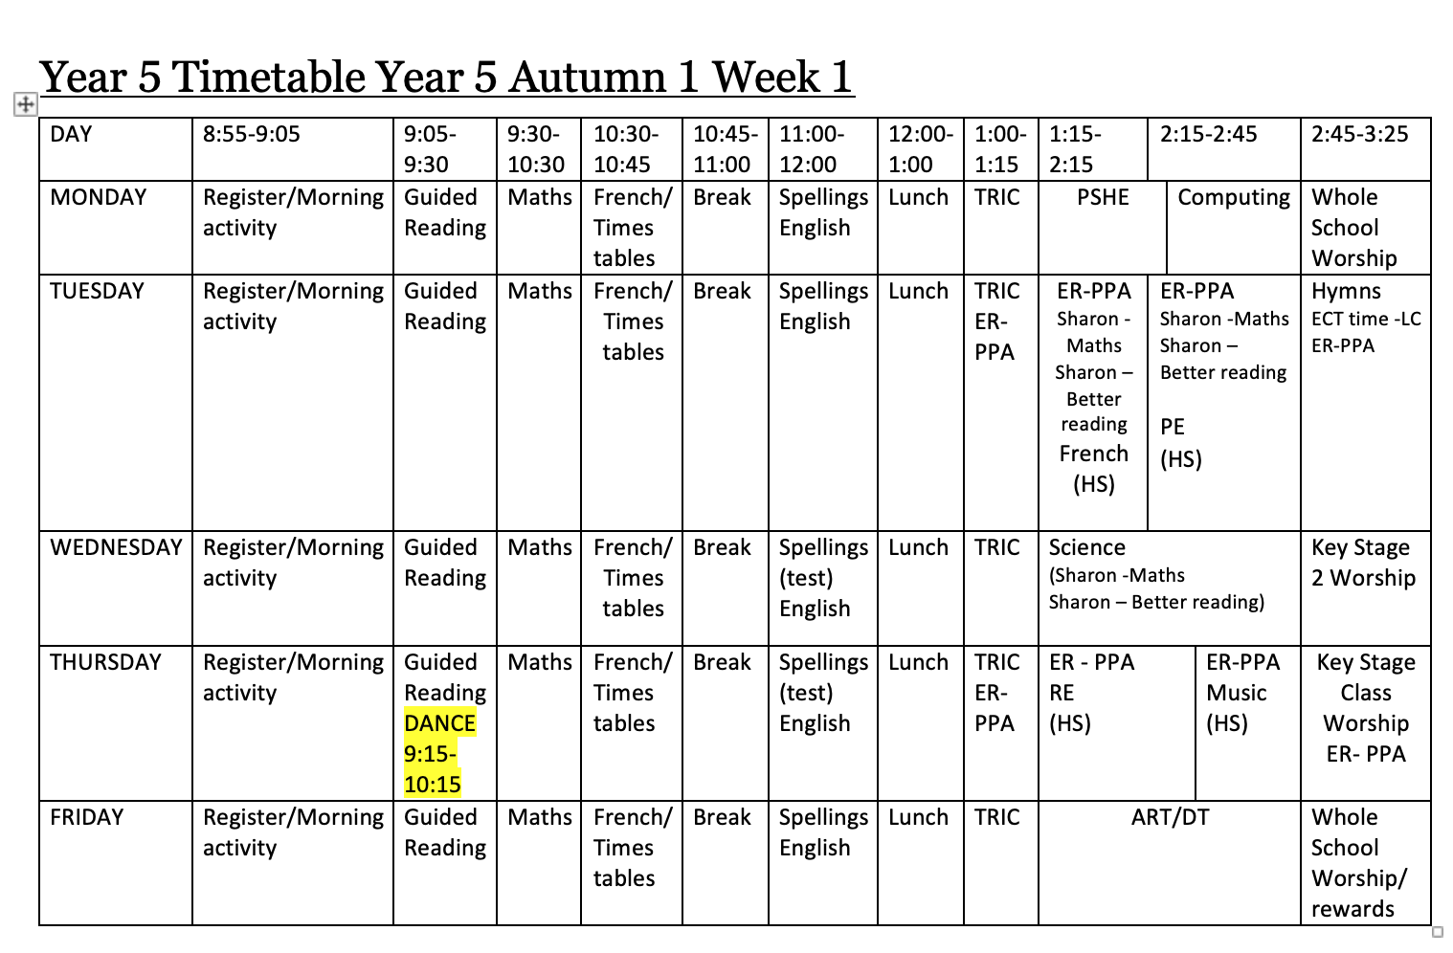

Slide 4
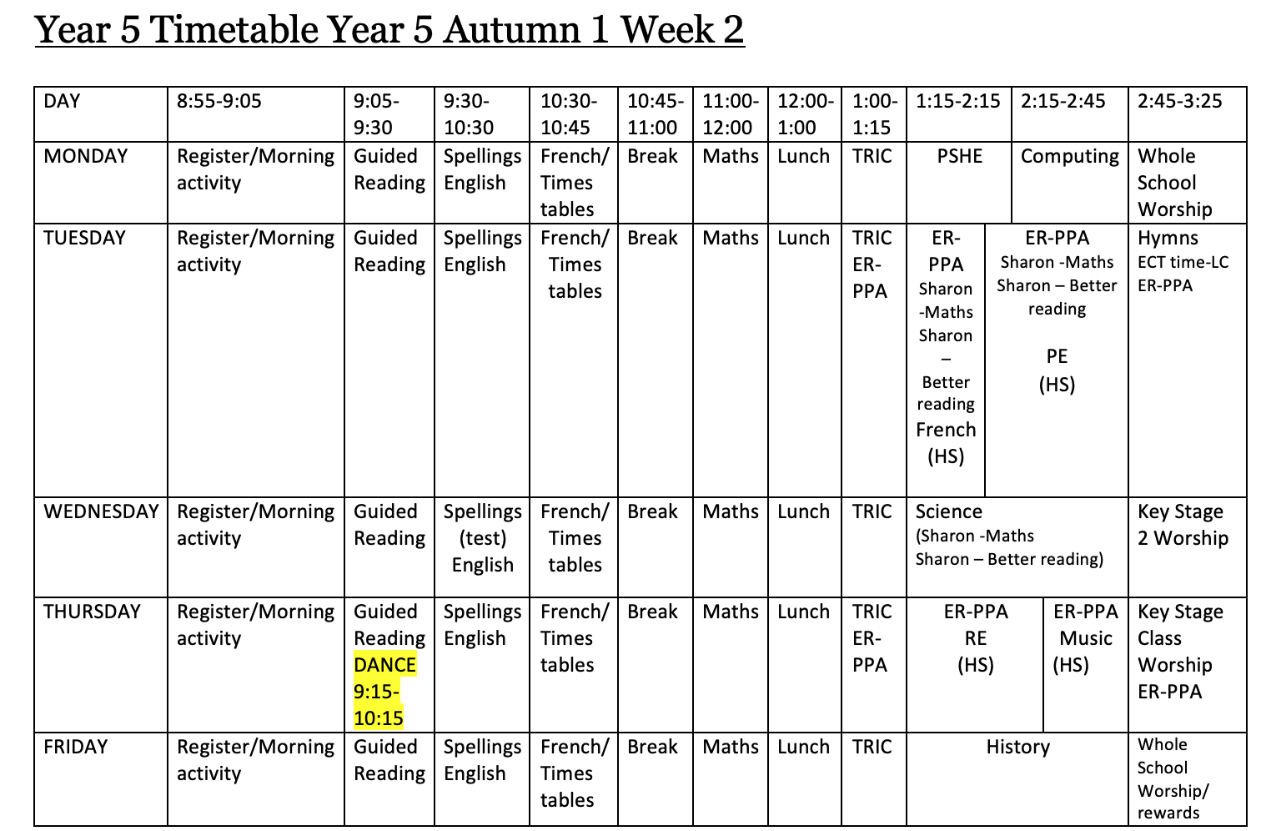

Slide 5
Curriculum
Curriculum overviews are available on the school website – under overview by year

Slide 6
Bespoke Curriculum
Rationale:
Let your light shine
5 Golden threads
3 Big ideas
Intent, Implementation, Impact

Slide 7
Uniform
Full school uniform must be worn on non PE days
No earrings
Appropriate hair accessories
Correct school shoes must be worn (no trainers or boots)
All uniform information is available on the school website under key information and policies

Slide 8
Uniform

Slide 9
The School Day
Doors open and the school bell will sound at 8:50am (children are not required to line up)
Doors will close at 8:55am and registration will start
All children arriving after 8:55am must sign in and enter through the main school entrance
The school day will end at 3:25pm

Slide 10
Where will Year 5 enter and exit school?
Year 5 will enter and exit school via the double doors under the canopy (the same door as last school year)

Slide 11
Home reading books and diaries
Reading diaries are used when the children read both inside and outside of school (including guided reading)
Ideally, every child should be reading with an adult at home every day – read, discuss the text/ answer questions, sign the diary

Slide 12
Home learning expectations
Recall times table fact (TT rockstars for example)
Learn spellings
Read daily
Mathletics
Alongside this all children are encouraged to spend their free time playing, engaging with their hobbies, spending time with friends and family etc.

Slide 13
Online Safety

Slide 14
Behaviour and expectations

Slide 15
Trips
As much notice as possible will be given
We are aiming to send out a plan in the next few weeks which will outline all class trip plans for the year

Slide 16
Healthy packed lunch

Slide 17
Mathletics/Spellings
Mathletics will be set every Tuesday and needs to be completed by the following Tuesday
Spellings will be sent home every Wednesday and tested each Wednesday

Slide 18
Contact
Email – e.reeve@grimsargh-st-michaels.lancs.sch.uk
Seesaw

Slide 19
Any Questions?

