Slide 2
DATE
L.O: To compare mass
Date
Underline
Miss a line
Title
Underline
Miss a line

Slide 4
Times tables practise

Slide 6
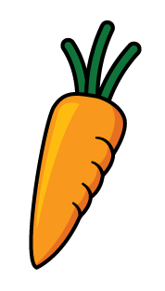
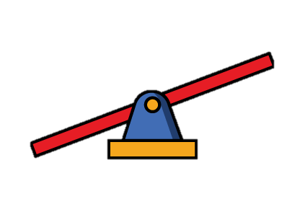
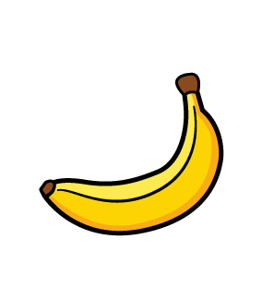
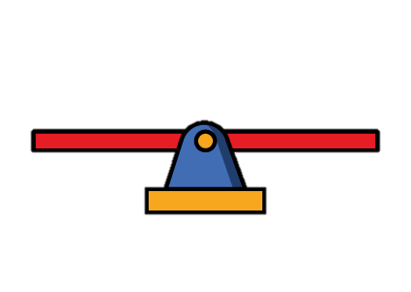
What do you notice?

Slide 7
What do you notice?
The banana is heavier than the carrot.
The carrot is lighter than the banana.
The scale is balanced.
The cuboid has a mass of 3 cubes.

Slide 9
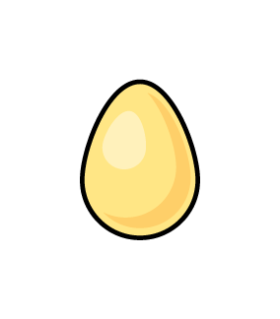
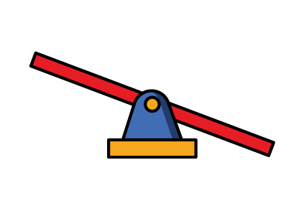
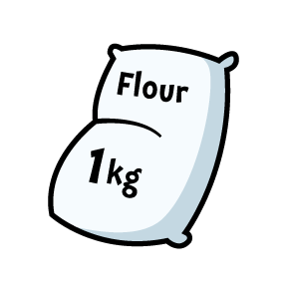
Lighter
Heavier
Notes:
Jack has built some towers using cubes. Let’s have a look.
How many towers has he built? Well there are 1, 2, 3, 4 towers
Jack hs built 4 towers
How many cubes are there in each tower? Well there are 1, 2, 3, 4, 5 cubes in each tower
So how many towers has Jack usef in total? Well there are 4 towers with 2 cubes in each tower, so Jack has used 2, 4, 6, 8 cubes
Did you see how I used my 2 times-table to help me then? Counting in 2s is rsally useful.
We can write this as a multiplication sentence. Something multiplied by something is equal to something.
Well Jack built 4 towers with 2 cubes in each tower and he used 8 cubes in total. So 4 multiplied by 2 is 8
OR
We can also write this as 2 multiplied by 4 is equal to 8

Slide 10
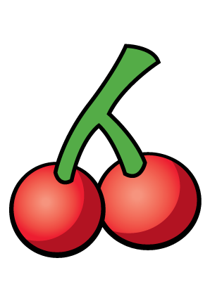
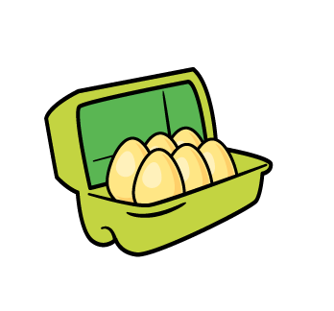
Lighter or heavier?
The eggs are heavier than the cherries.
The cherries are lighter than the eggs.
Notes:
Whitney has also been building towers using cubes. Let’s havwe a look.
Pause the video here and see if you can answer these questions.
How did you get on?
Did Whitney use more or less cubes than Jack? That’s right she used less cubes because she built less towers

Slide 11
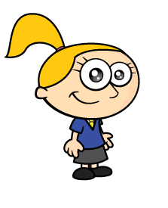
How many blocks will balance Eva?
Eva is heavier than 1 block.
Notes:
Whitney has also been building towers using cubes. Let’s havwe a look.
Pause the video here and see if you can answer these questions.
How did you get on?
Did Whitney use more or less cubes than Jack? That’s right she used less cubes because she built less towers

Slide 12
How many blocks will balance Eva?
Eva is heavier than 2 blocks.
Notes:
Whitney has also been building towers using cubes. Let’s havwe a look.
Pause the video here and see if you can answer these questions.
How did you get on?
Did Whitney use more or less cubes than Jack? That’s right she used less cubes because she built less towers

Slide 13
How many blocks will balance Eva?
Eva has a mass of 5 blocks.
Notes:
Whitney has also been building towers using cubes. Let’s havwe a look.
Pause the video here and see if you can answer these questions.
How did you get on?
Did Whitney use more or less cubes than Jack? That’s right she used less cubes because she built less towers

Slide 14
Have a think
15 blue cubes will balance Eva.
How many blue cubes will balance Eva?
Notes:
Whitney has also been building towers using cubes. Let’s havwe a look.
Pause the video here and see if you can answer these questions.
How did you get on?
Did Whitney use more or less cubes than Jack? That’s right she used less cubes because she built less towers

Slide 15
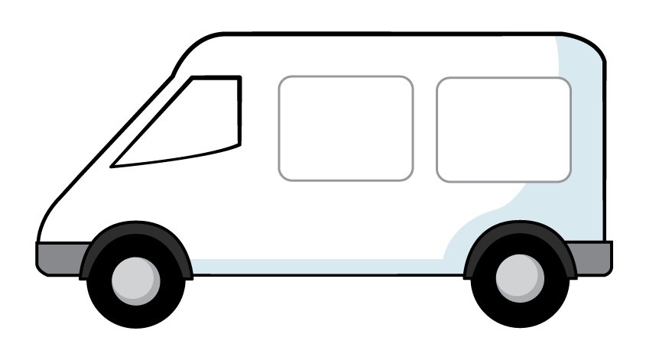
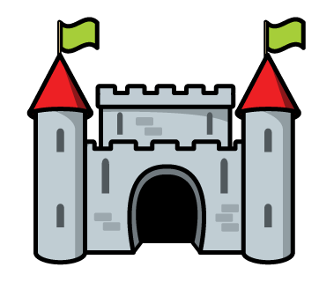
Which is heavier the van or the castle?
Have a think
The van has a mass of 3 cubes.
The castle has a mass of 6 cubes.
The castle is heavier than the van.
Notes:
Which object is heavier?

Slide 16
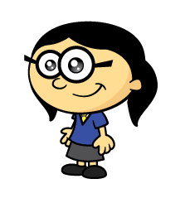
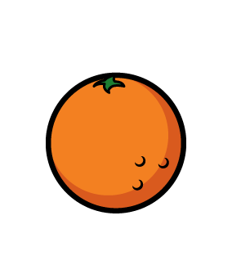
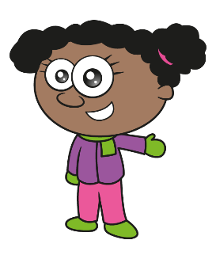
Which is heavier one orange or one apple?
One orange is heavier. It takes more apples to balance the oranges.
I think that one and a half apples would balance one orange.
Have a think
Notes:
Which object is heavier?

Slide 17
Have a go at the questions on the worksheet

