Slide 1
Hello Year 5
This week our artwork links to World Book Day
which is on Thursday 4th March.
I know you all love to read
and you will have a favourite book.
You will have a favourite author
and a favourite illustrator.

Slide 2
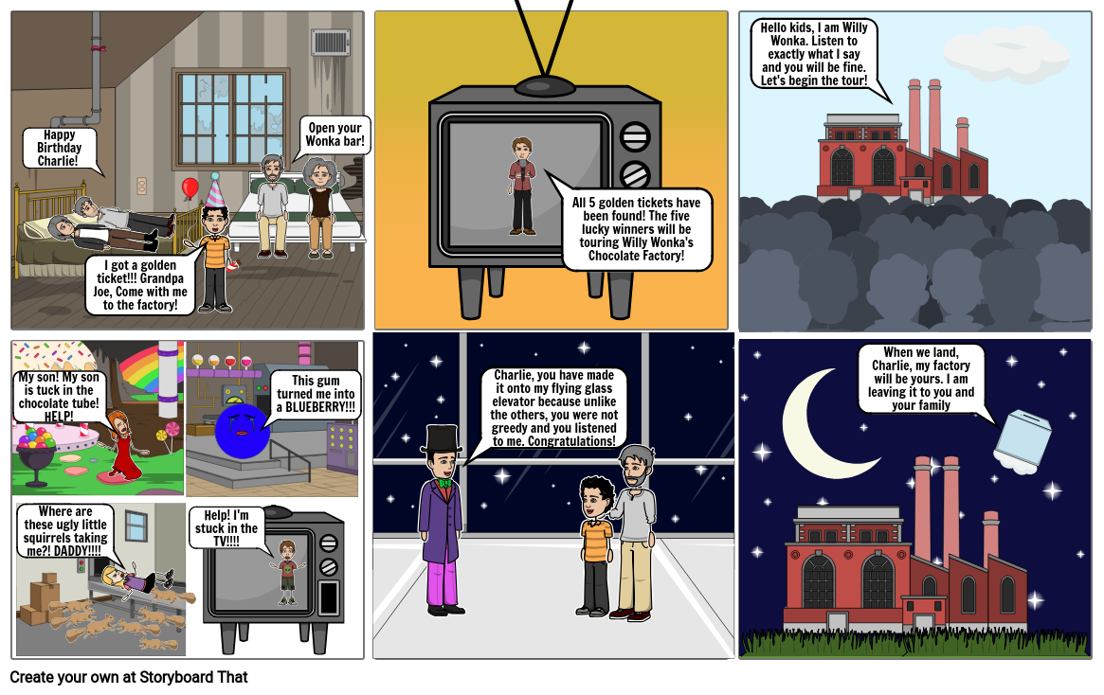
Think about your favourite book and draw a storyboard.
You can tell the story in pictures by sequencing the events from
start to end.
One of my favourite stories is
Charlie and the Chocolate Factory
by Roald Dahl.
Illustrated by Quentin Blake.
Here’s an example of
a storyboard

Slide 3
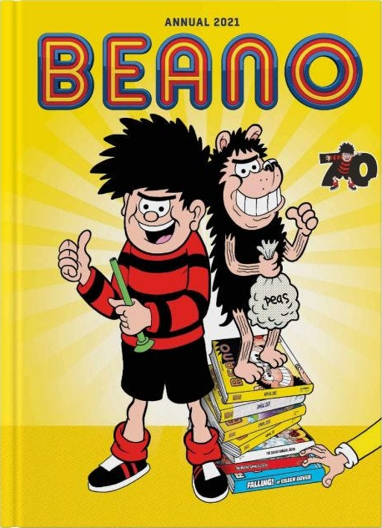
You can add speech bubbles or captions to explain each part of the storyboard.
You can draw in cartoon form.
You can colour using bright felt pens, pencil crayon or paint.
You can use as many pictures as you like, think about beginning, middle and end.
Make sure the storyboard is clear, easy to follow, and shows facial expressions and emotions.
Look at comics to help you decide on your style.
Choose a story you know well.
I’m looking forward to seeing your work.
Please send a photo via Seesaw
Thank you,
Mrs Coulston.

