Slide 1
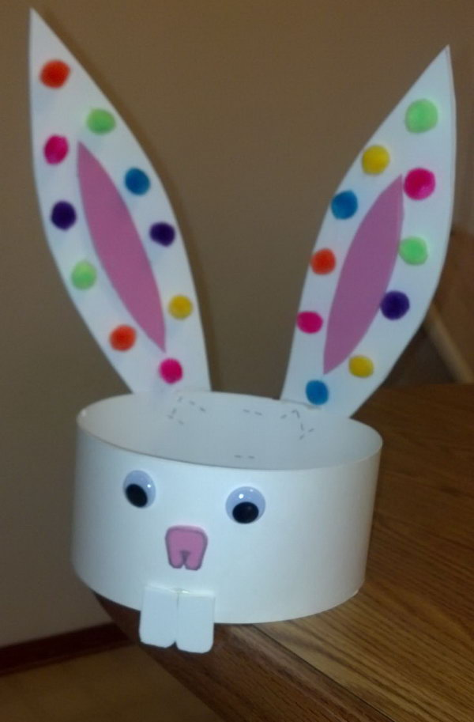
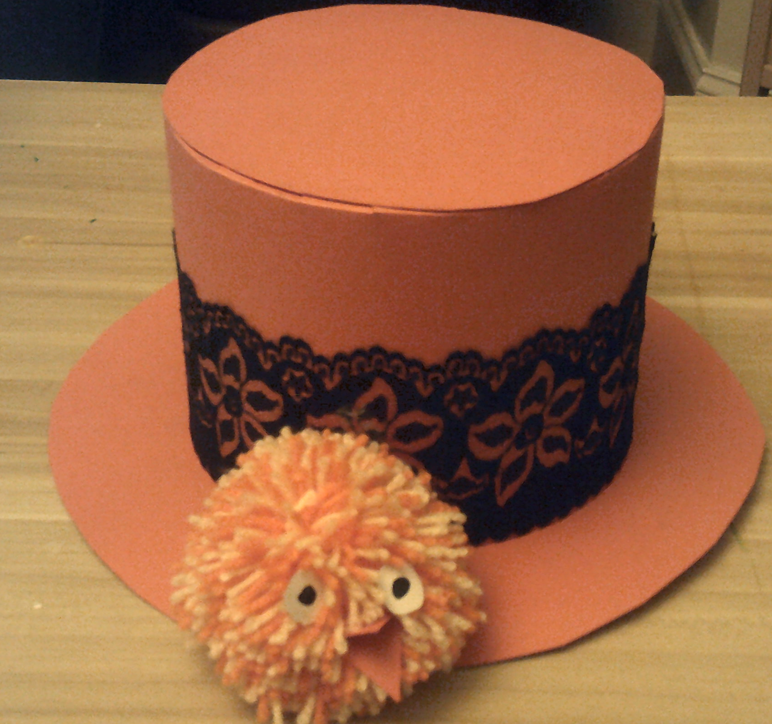
Hello Year 6
Get ahead make a hat!
Last week we investigated and learned skills that are useful when making a hat.
This week we will design and make a hat for Easter.
As you work remember the Design and Technology Golden Rule:
Product – Purpose – User.

Slide 2
Design
Begin to think about an Easter hat and how you can include your skills into a design.
This week we will make the hat following your design.
Sketch your ideas – look at hats you might have at home to help you with 3D shape.

Slide 3
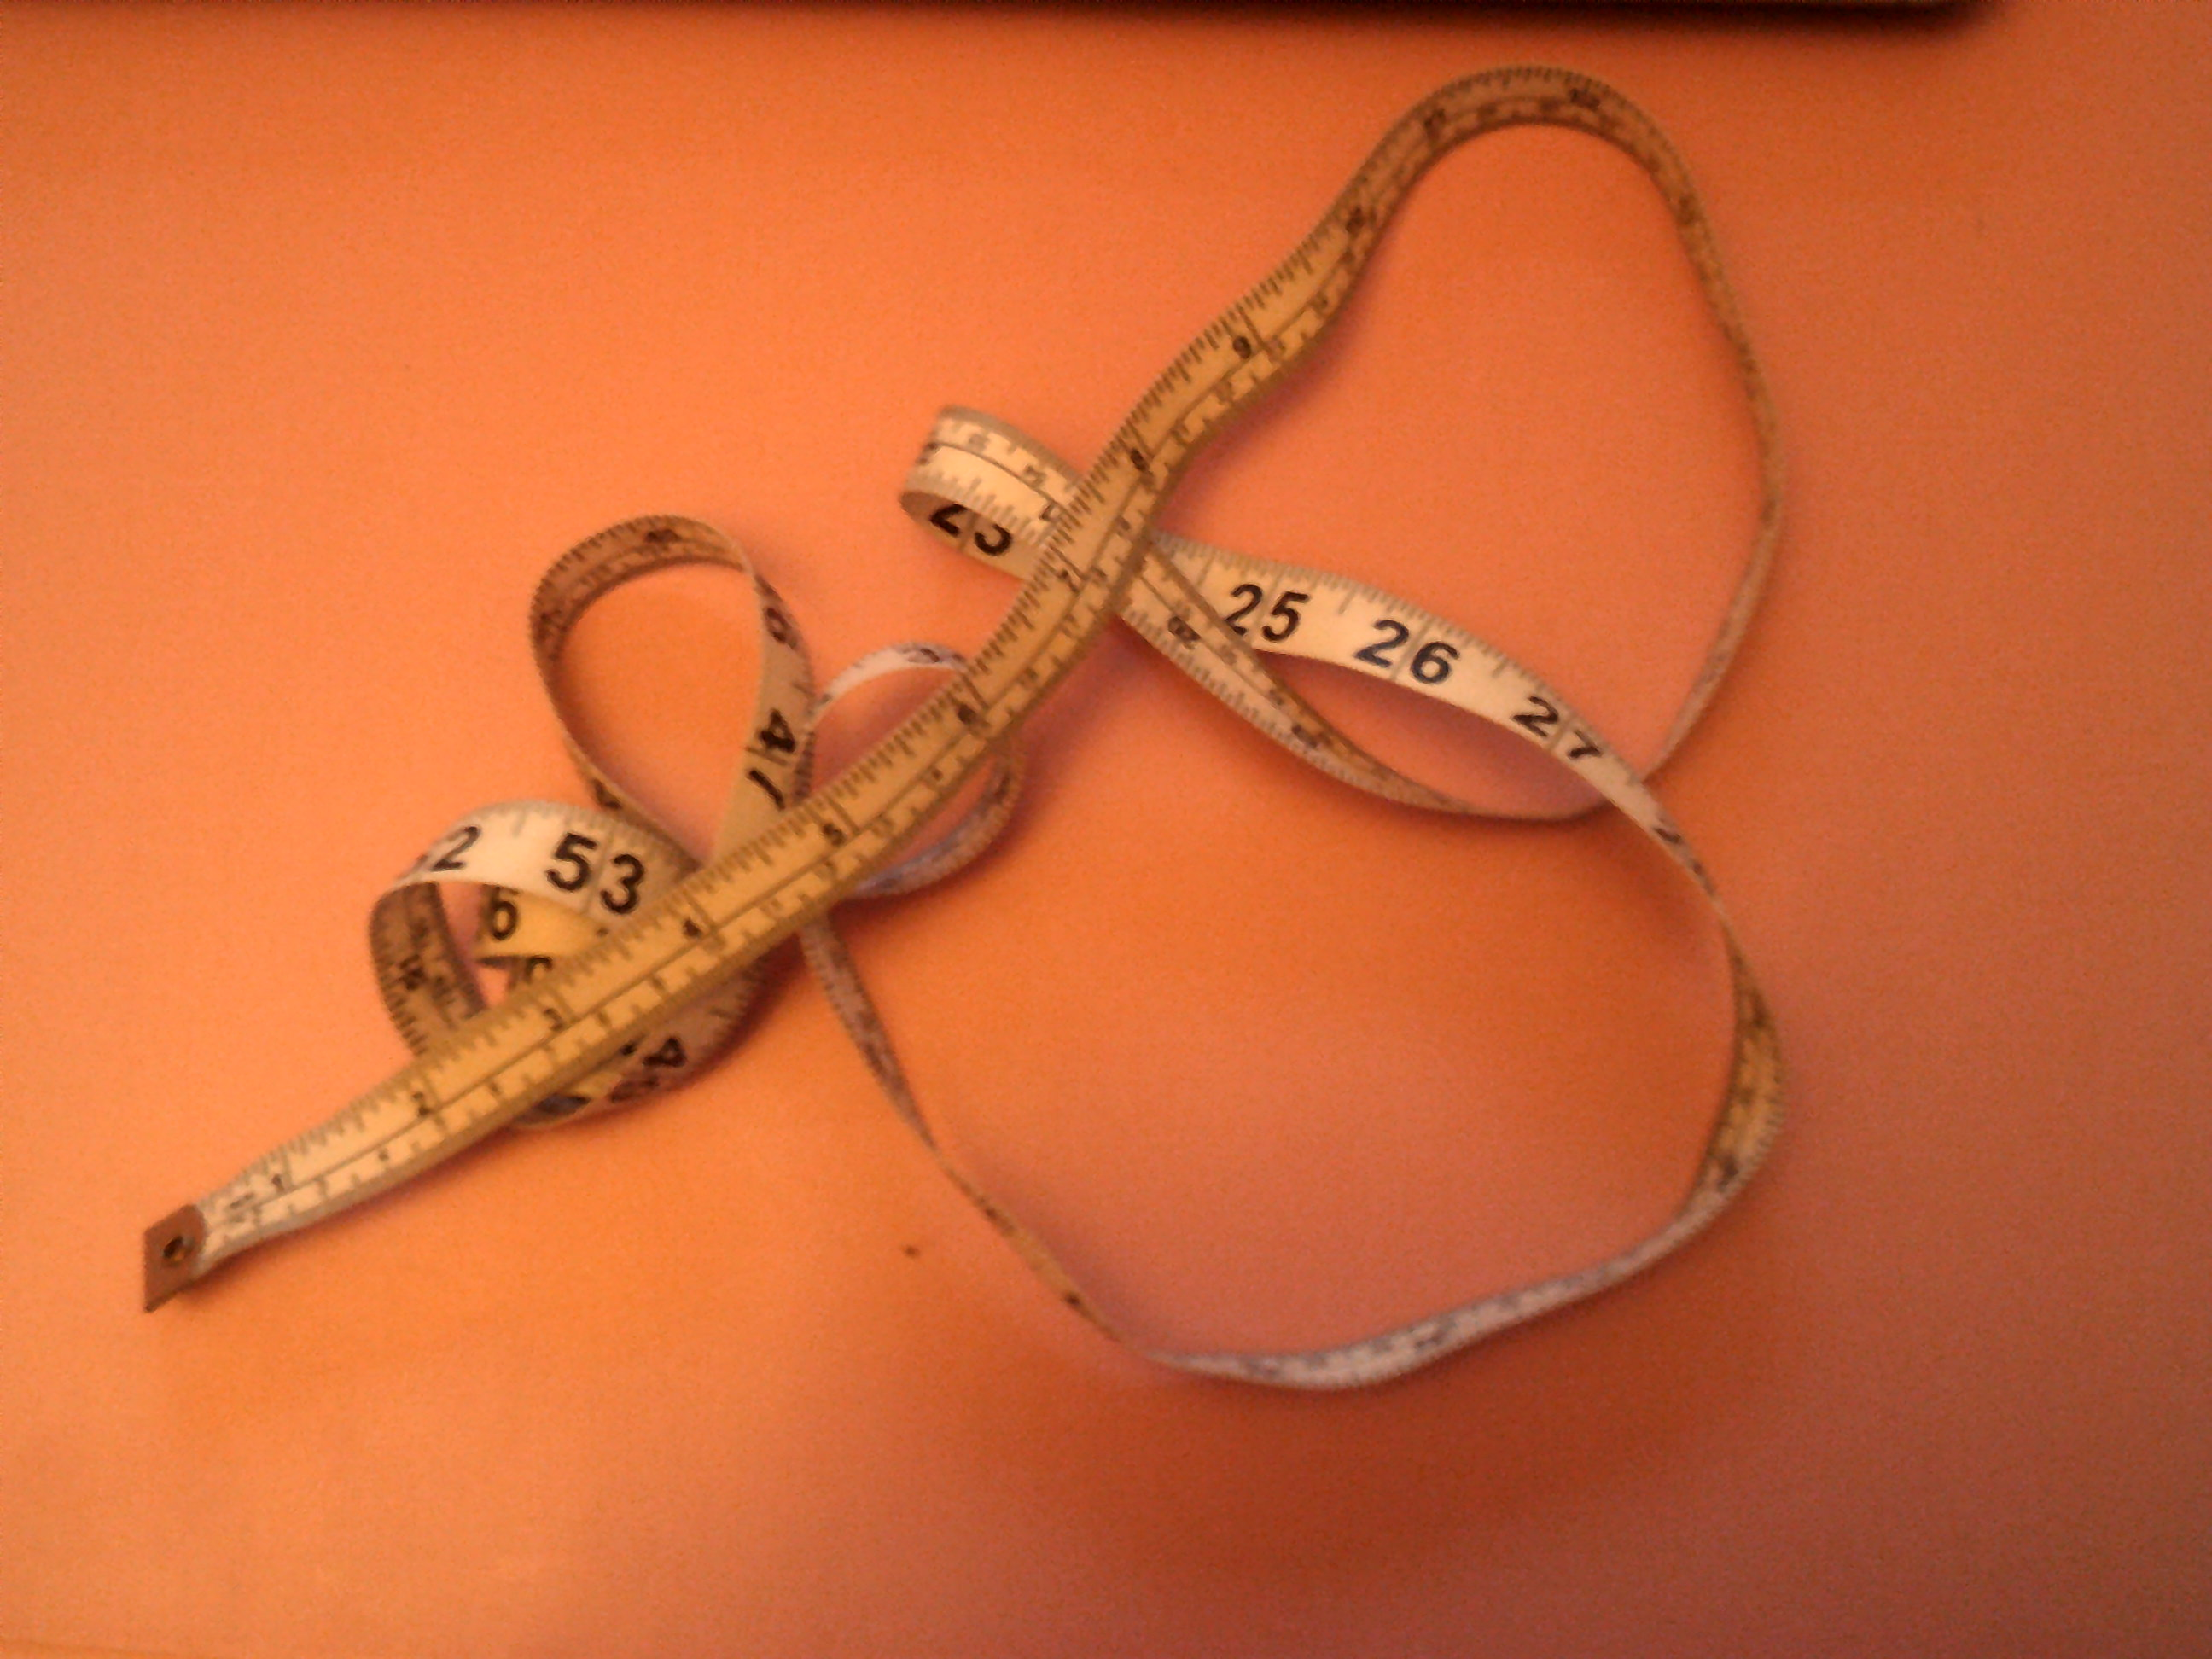
Measurements
Measure the circumference of your head – note down the measurement, you will need this so your hat will fit!
My head measures 56cm
Use a calculator to work out the diameter of a circle; use the formula
D = C ÷ ∏
D = 56cm ÷ 3.142
D = 17.8 cm (18 cm)
Halve the Diameter to find the Radius
R = 18 ÷ 2 = 9cm

Slide 4
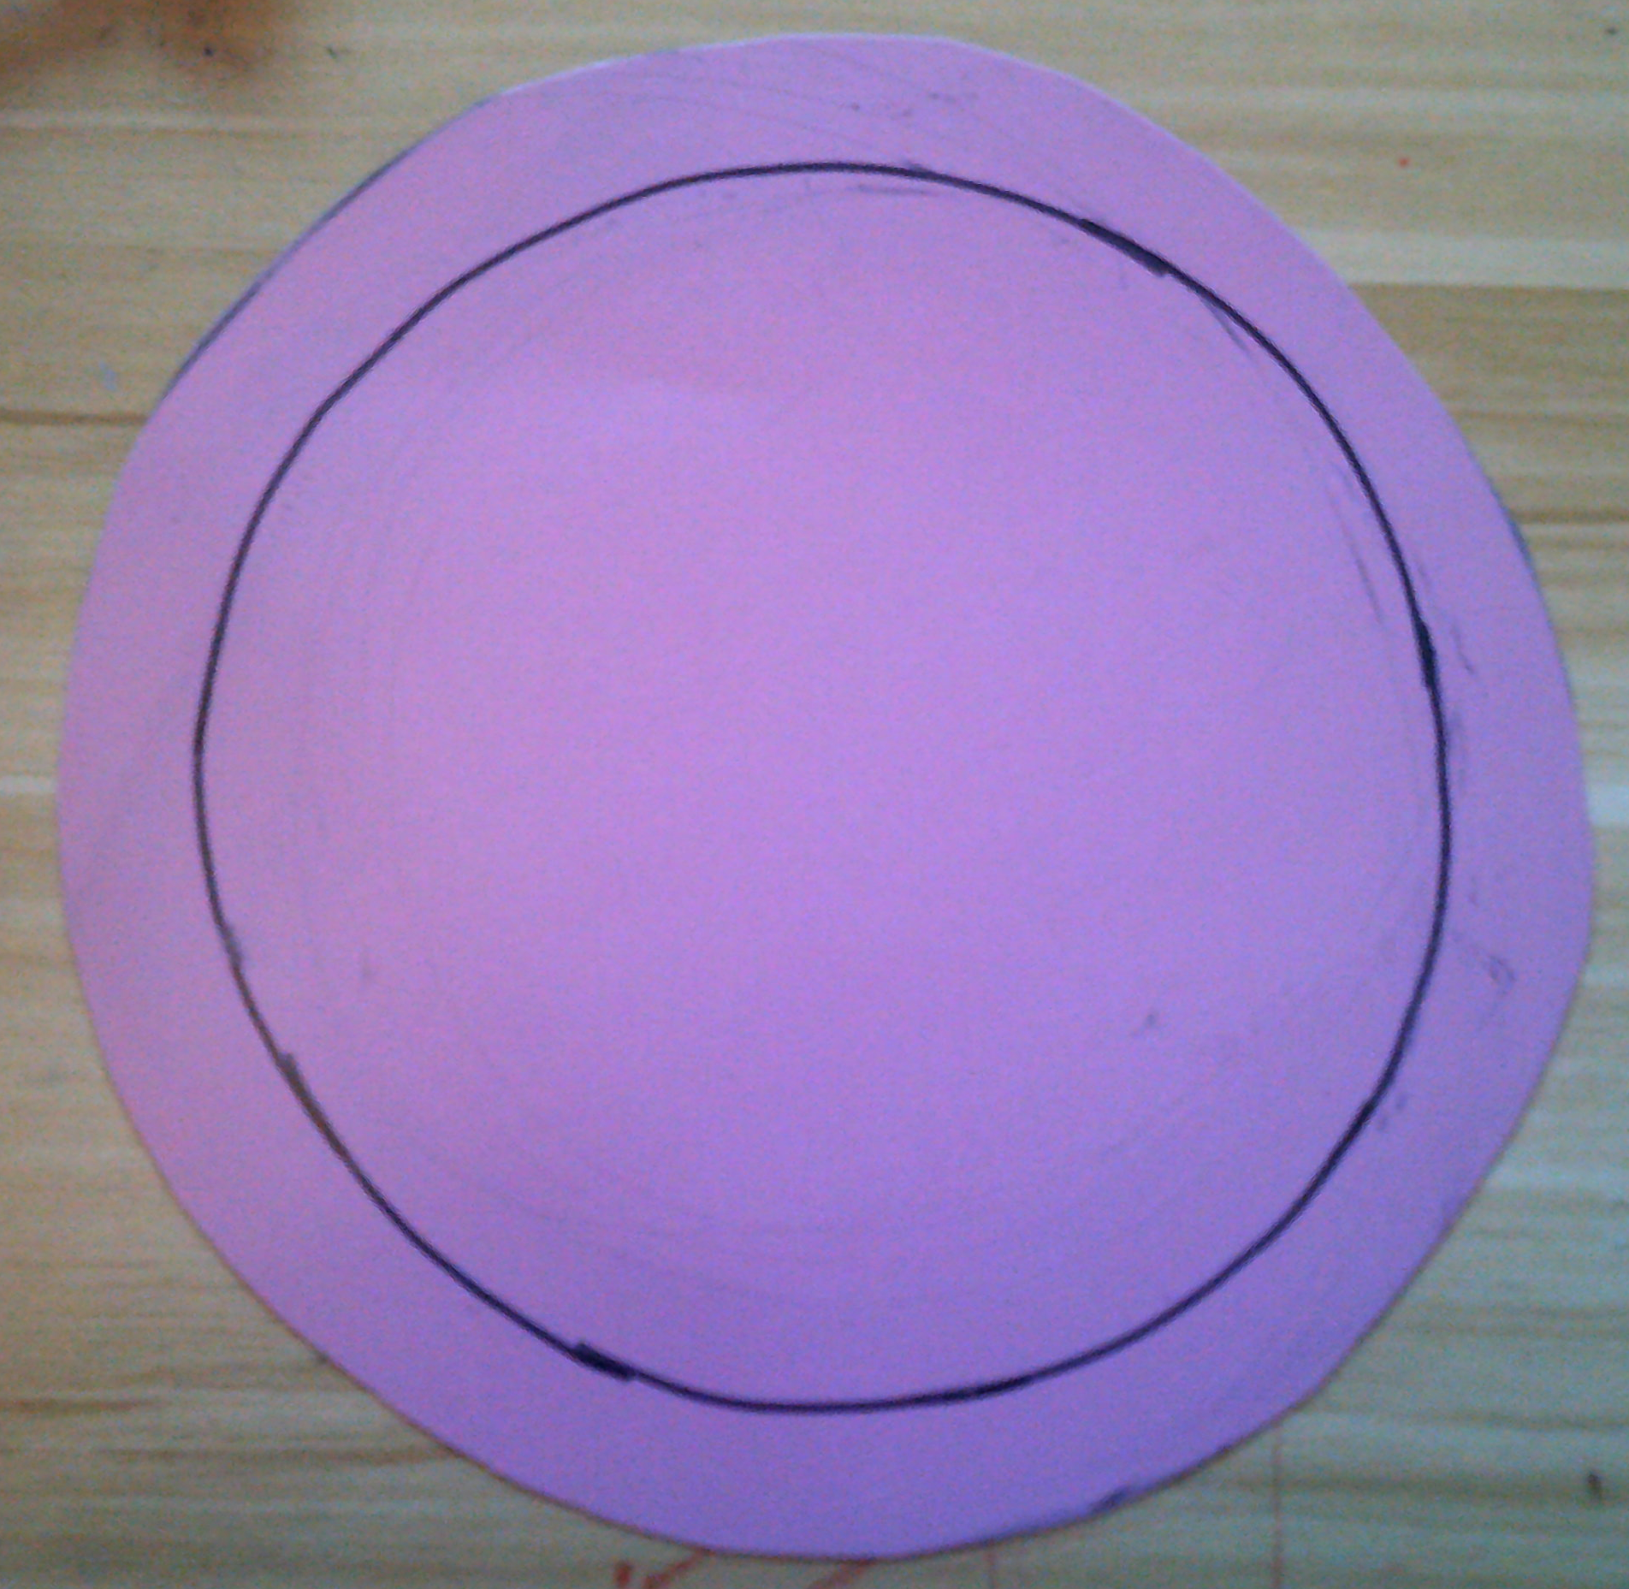
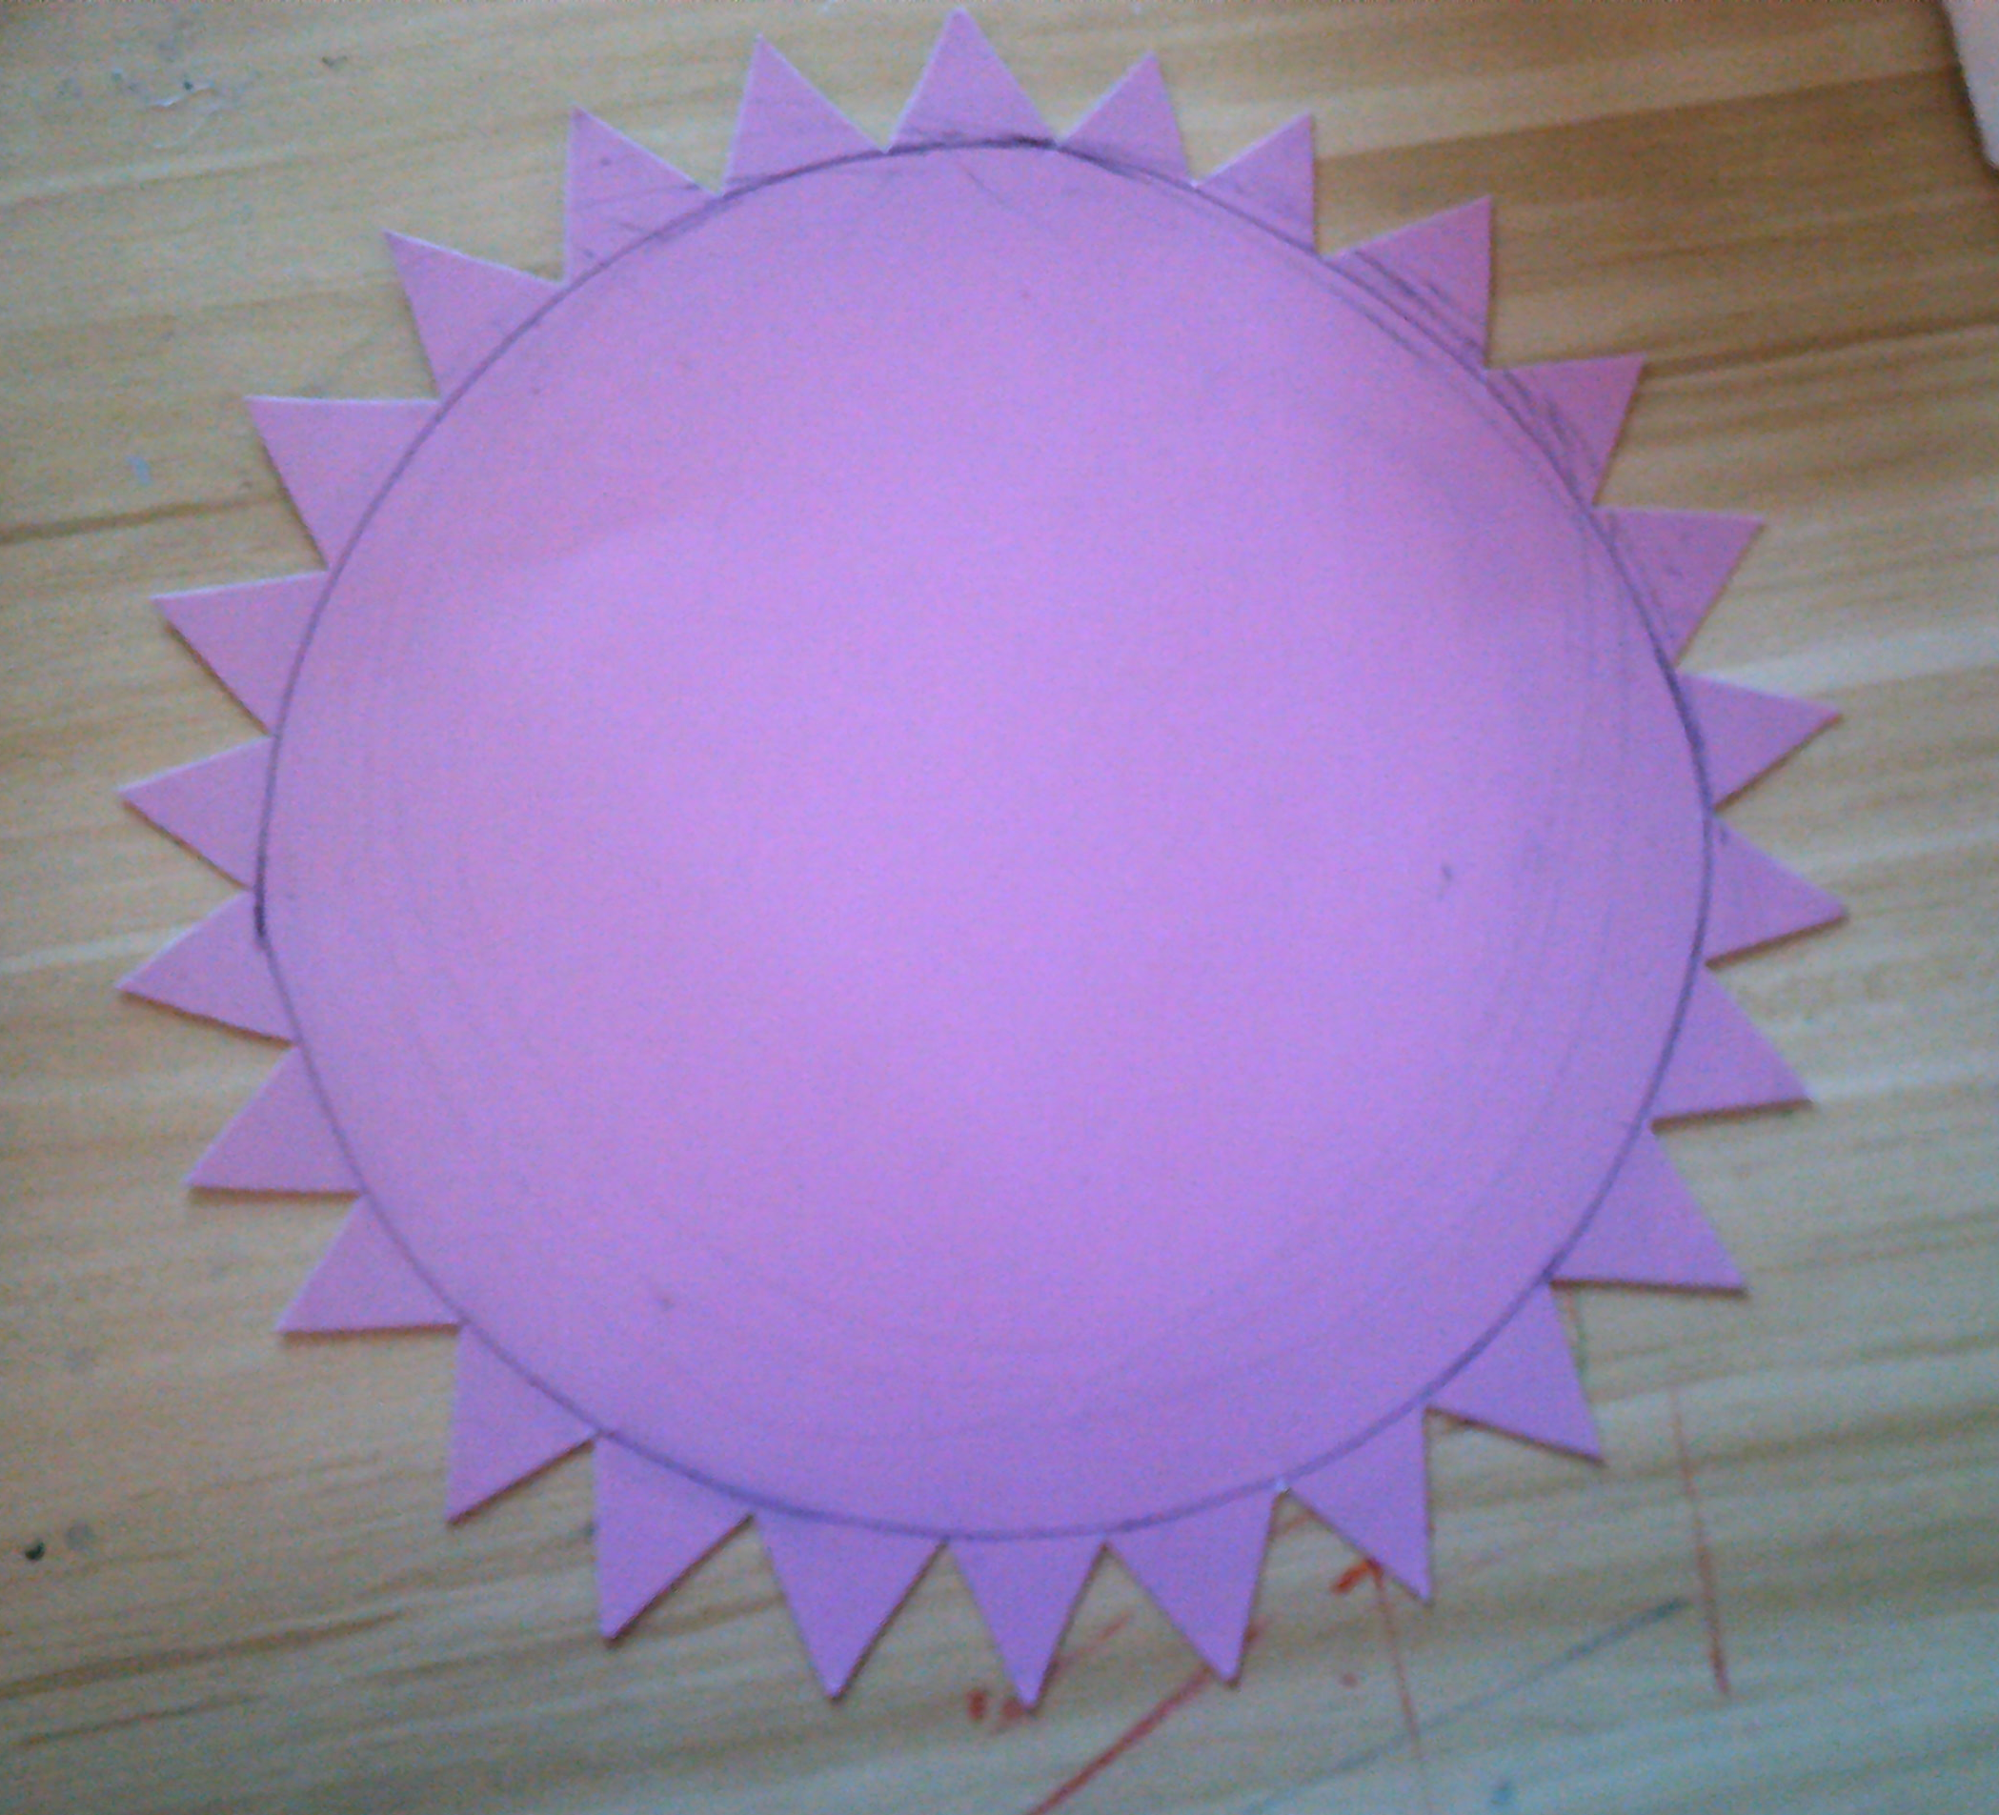
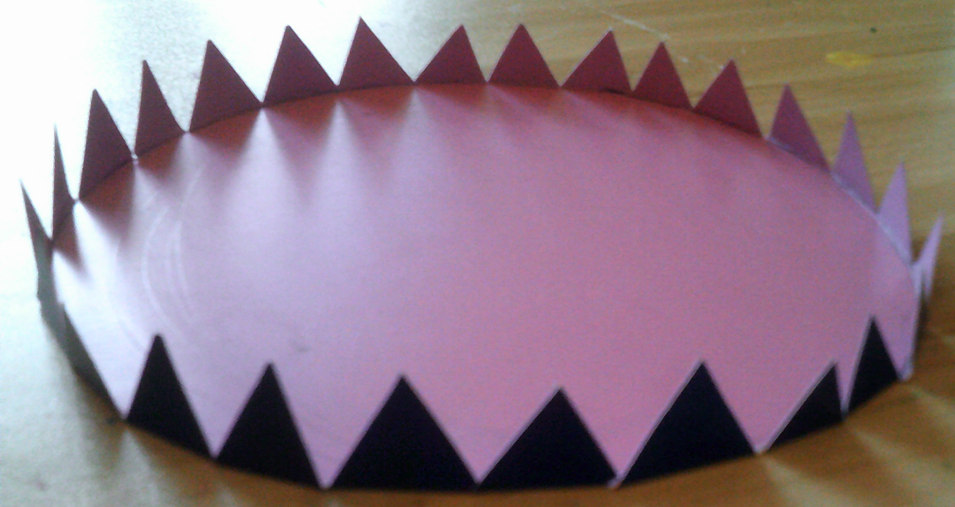
Make the hat top
Add 2cm (seam allowance) to your radius measurement.
Draw a circle on the reverse side of your card using a compass.
Now draw a smaller circle inside 2cm smaller.
Cut out around the larger circle.
Now cut flanges from the outer circle to the inner circle.
I have used a triangle technique to make my flanges, this
decreases the amount of card to fold later.
Score along the inner line.
Use open scissors to scratch the line to help it fold easily.
Bend the flanges inwards. Perpendicular to the inner circle.

Slide 5
Body of hat
Measure a length of card 3cm longer than the circumference of your head
measurement, this will allow an overlap to glue together.
Measure the card 2cm wider than you want the height, seam allowance.
Draw a line across the card 2cm deep. Cut flanges across the edge of the card.
Use a ruler to help you to score along the top of the flanges on the ‘good side’ of your card.
Fold backwards perpendicular, to the rectangle.
This edge will eventually attach to the brim of your hat.

Slide 6
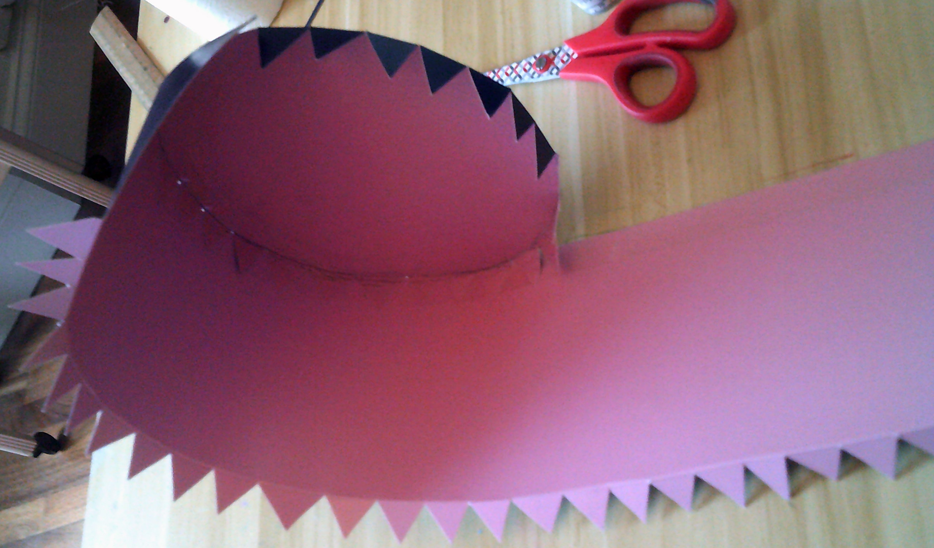
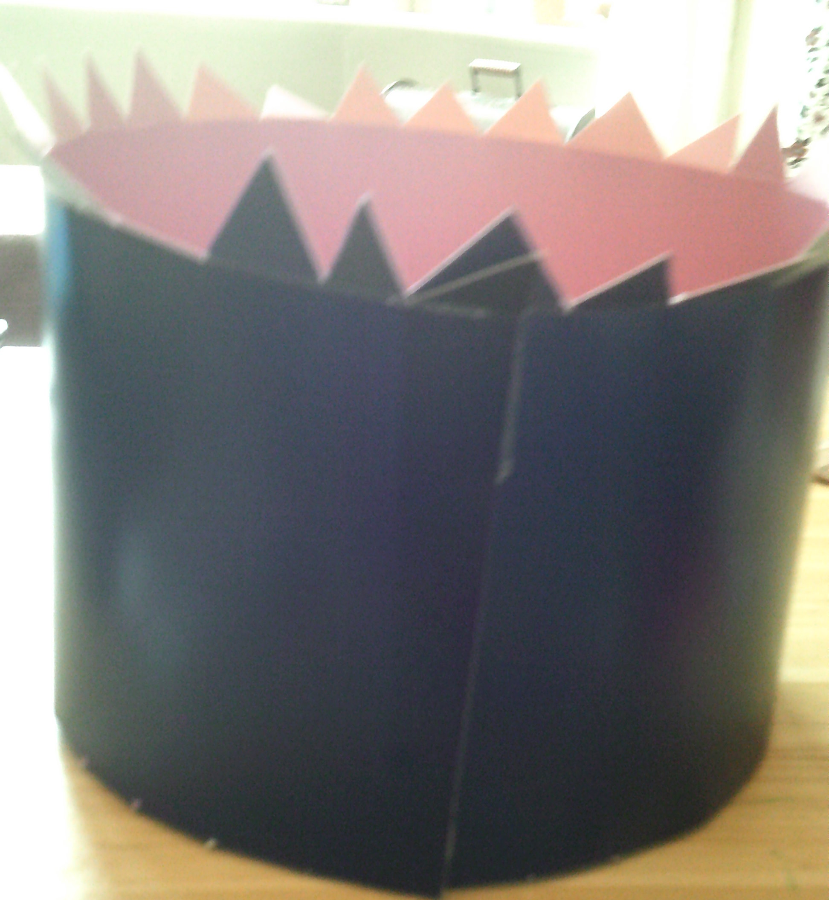
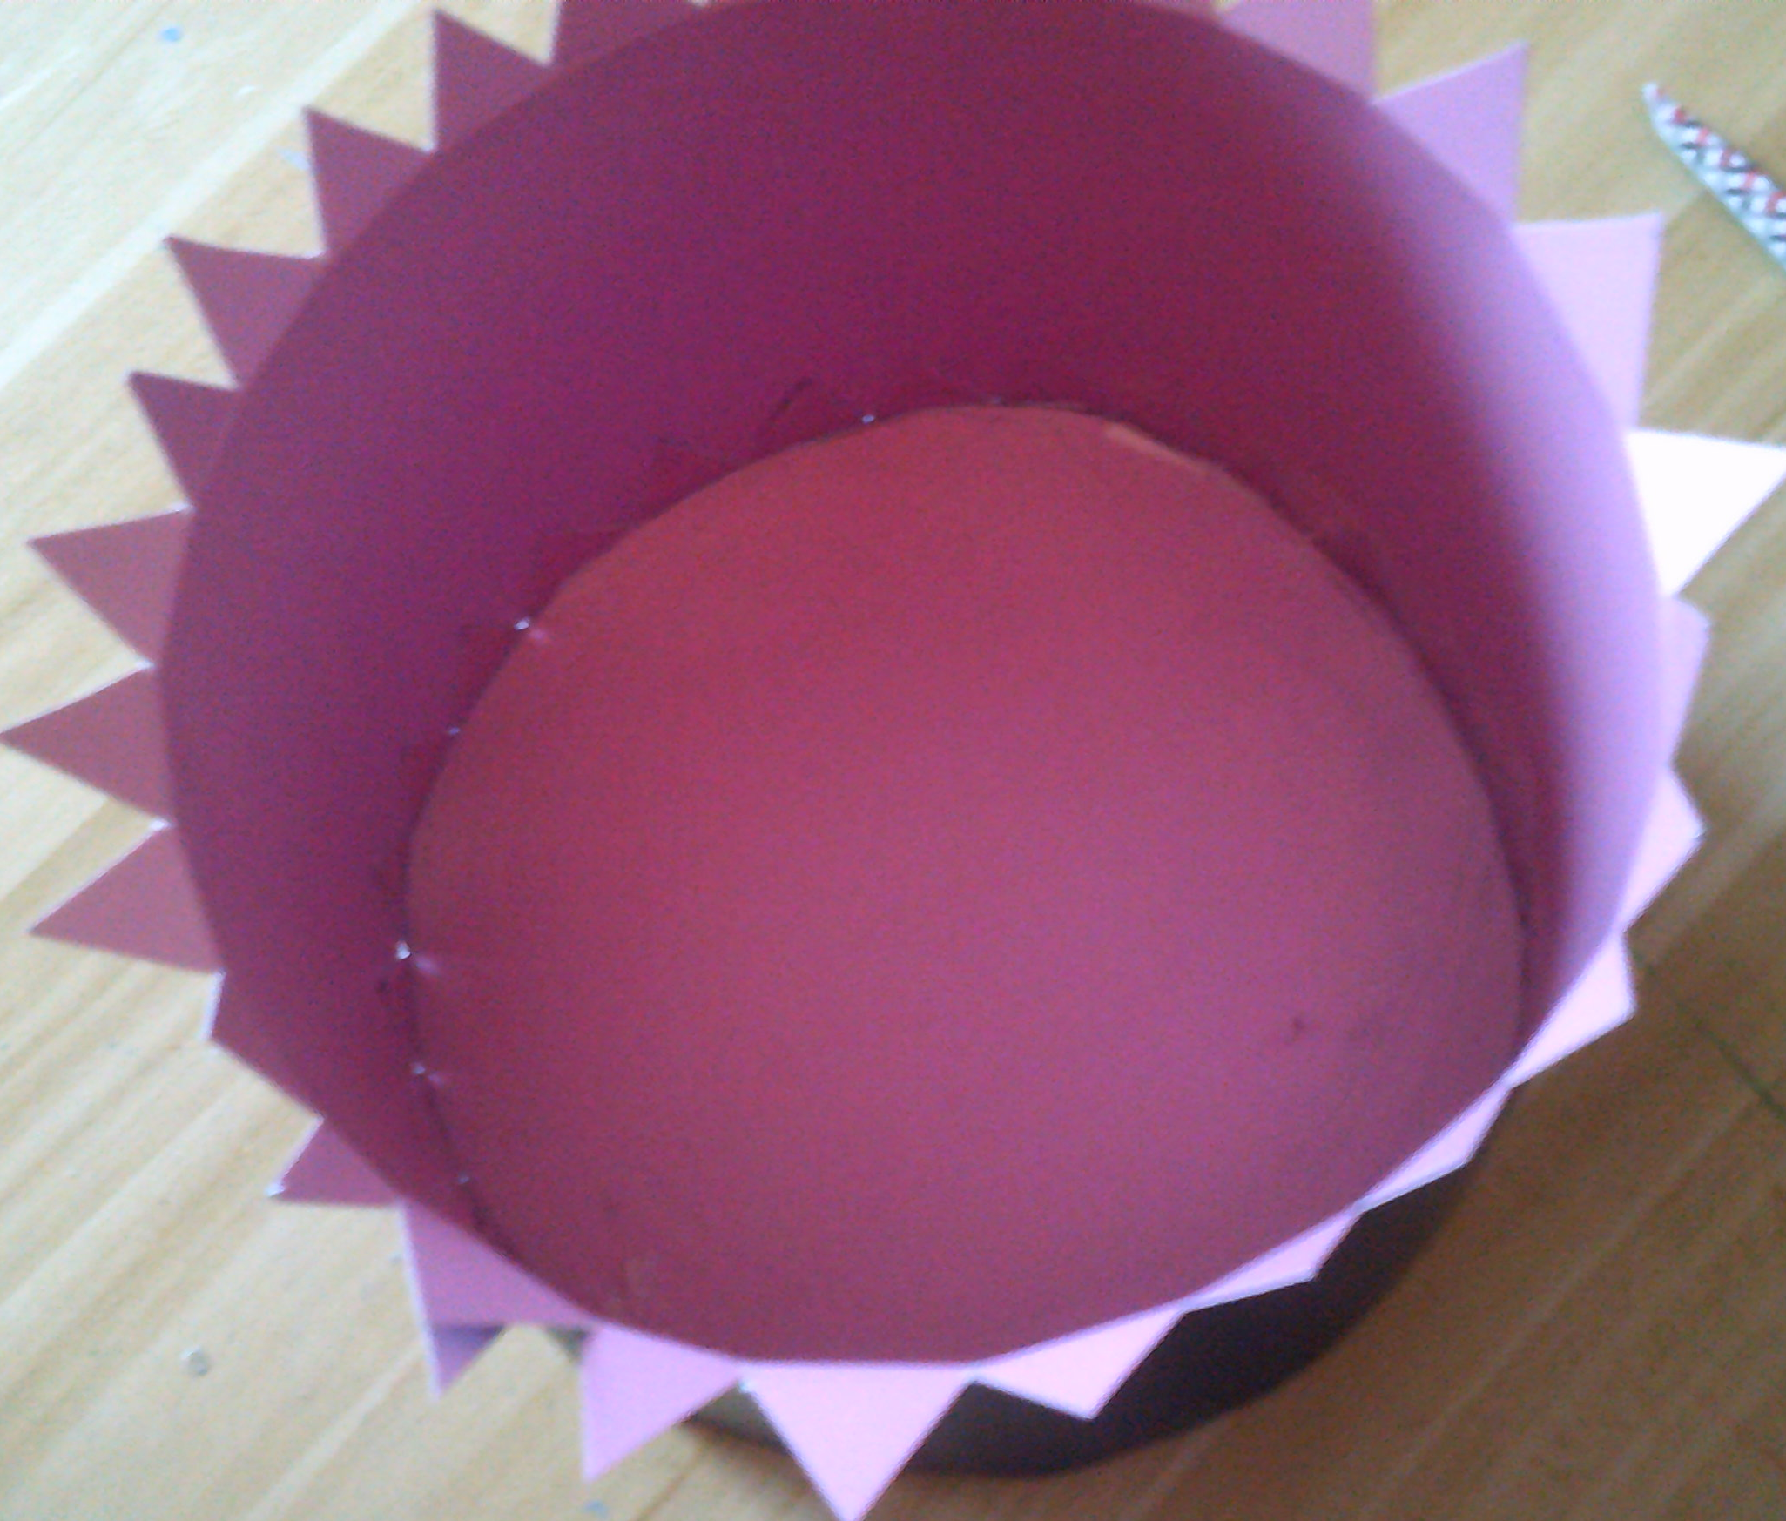
Assembly
Use glue or double sided tape to attach the side of the hat to the top.
Put a length of tape along the straight edge of the long rectangle.
Carefully roll the top of the hat onto the
tape, sticking each flange as you roll.
Do this slowly and secure each triangle as you
work.
Secure the ends of the
rectangle using tape or a staple
Use tape on the inside as extra
security of the flanges

Slide 7
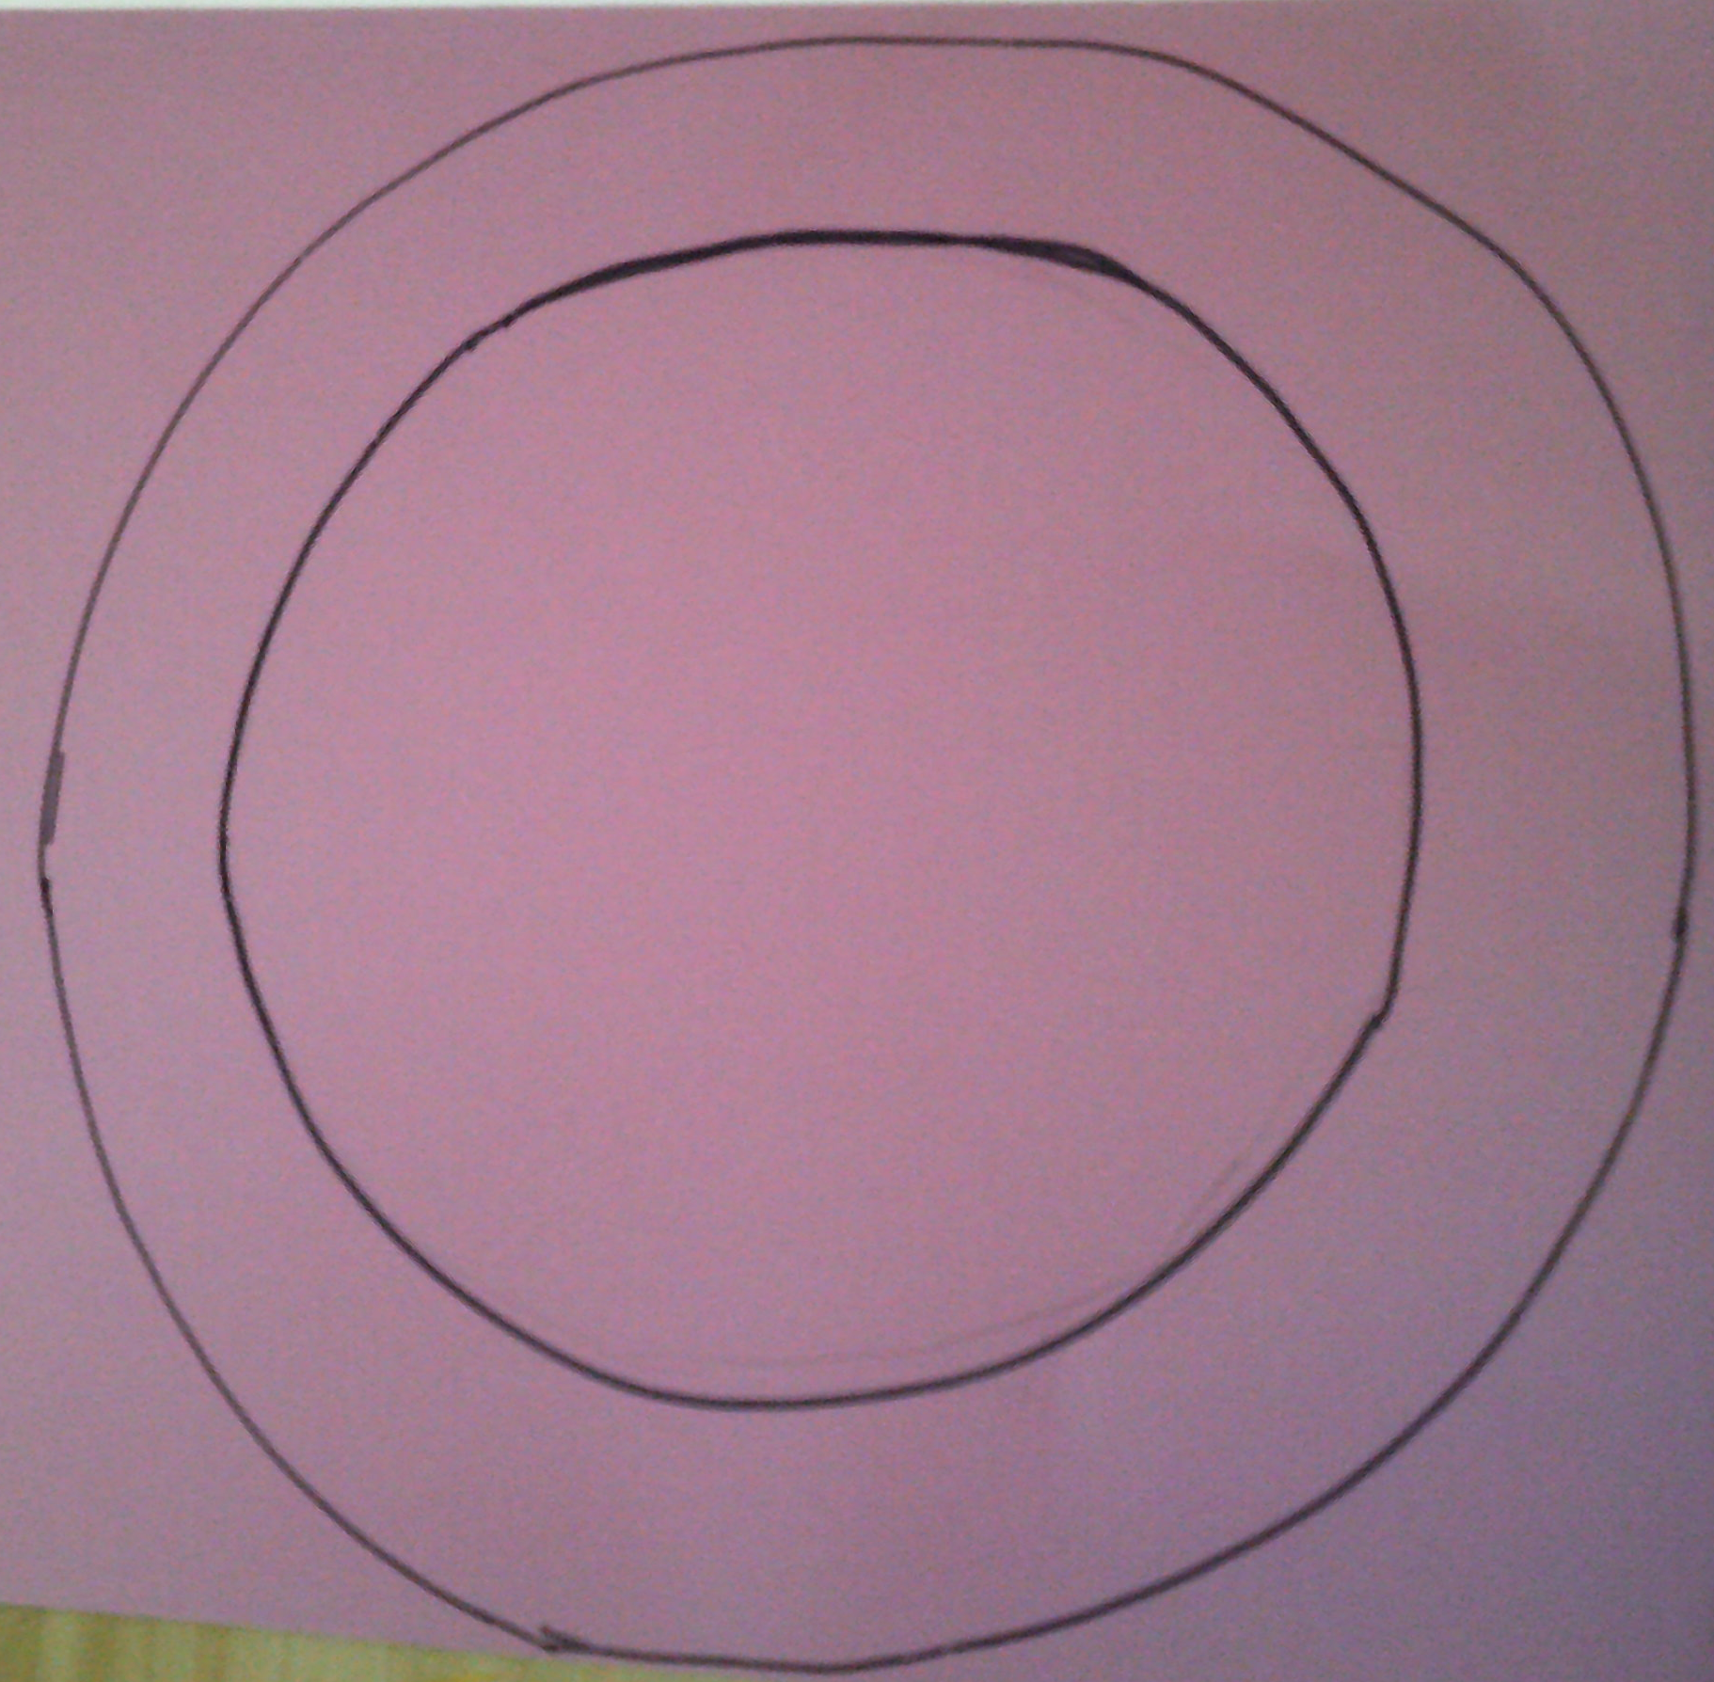
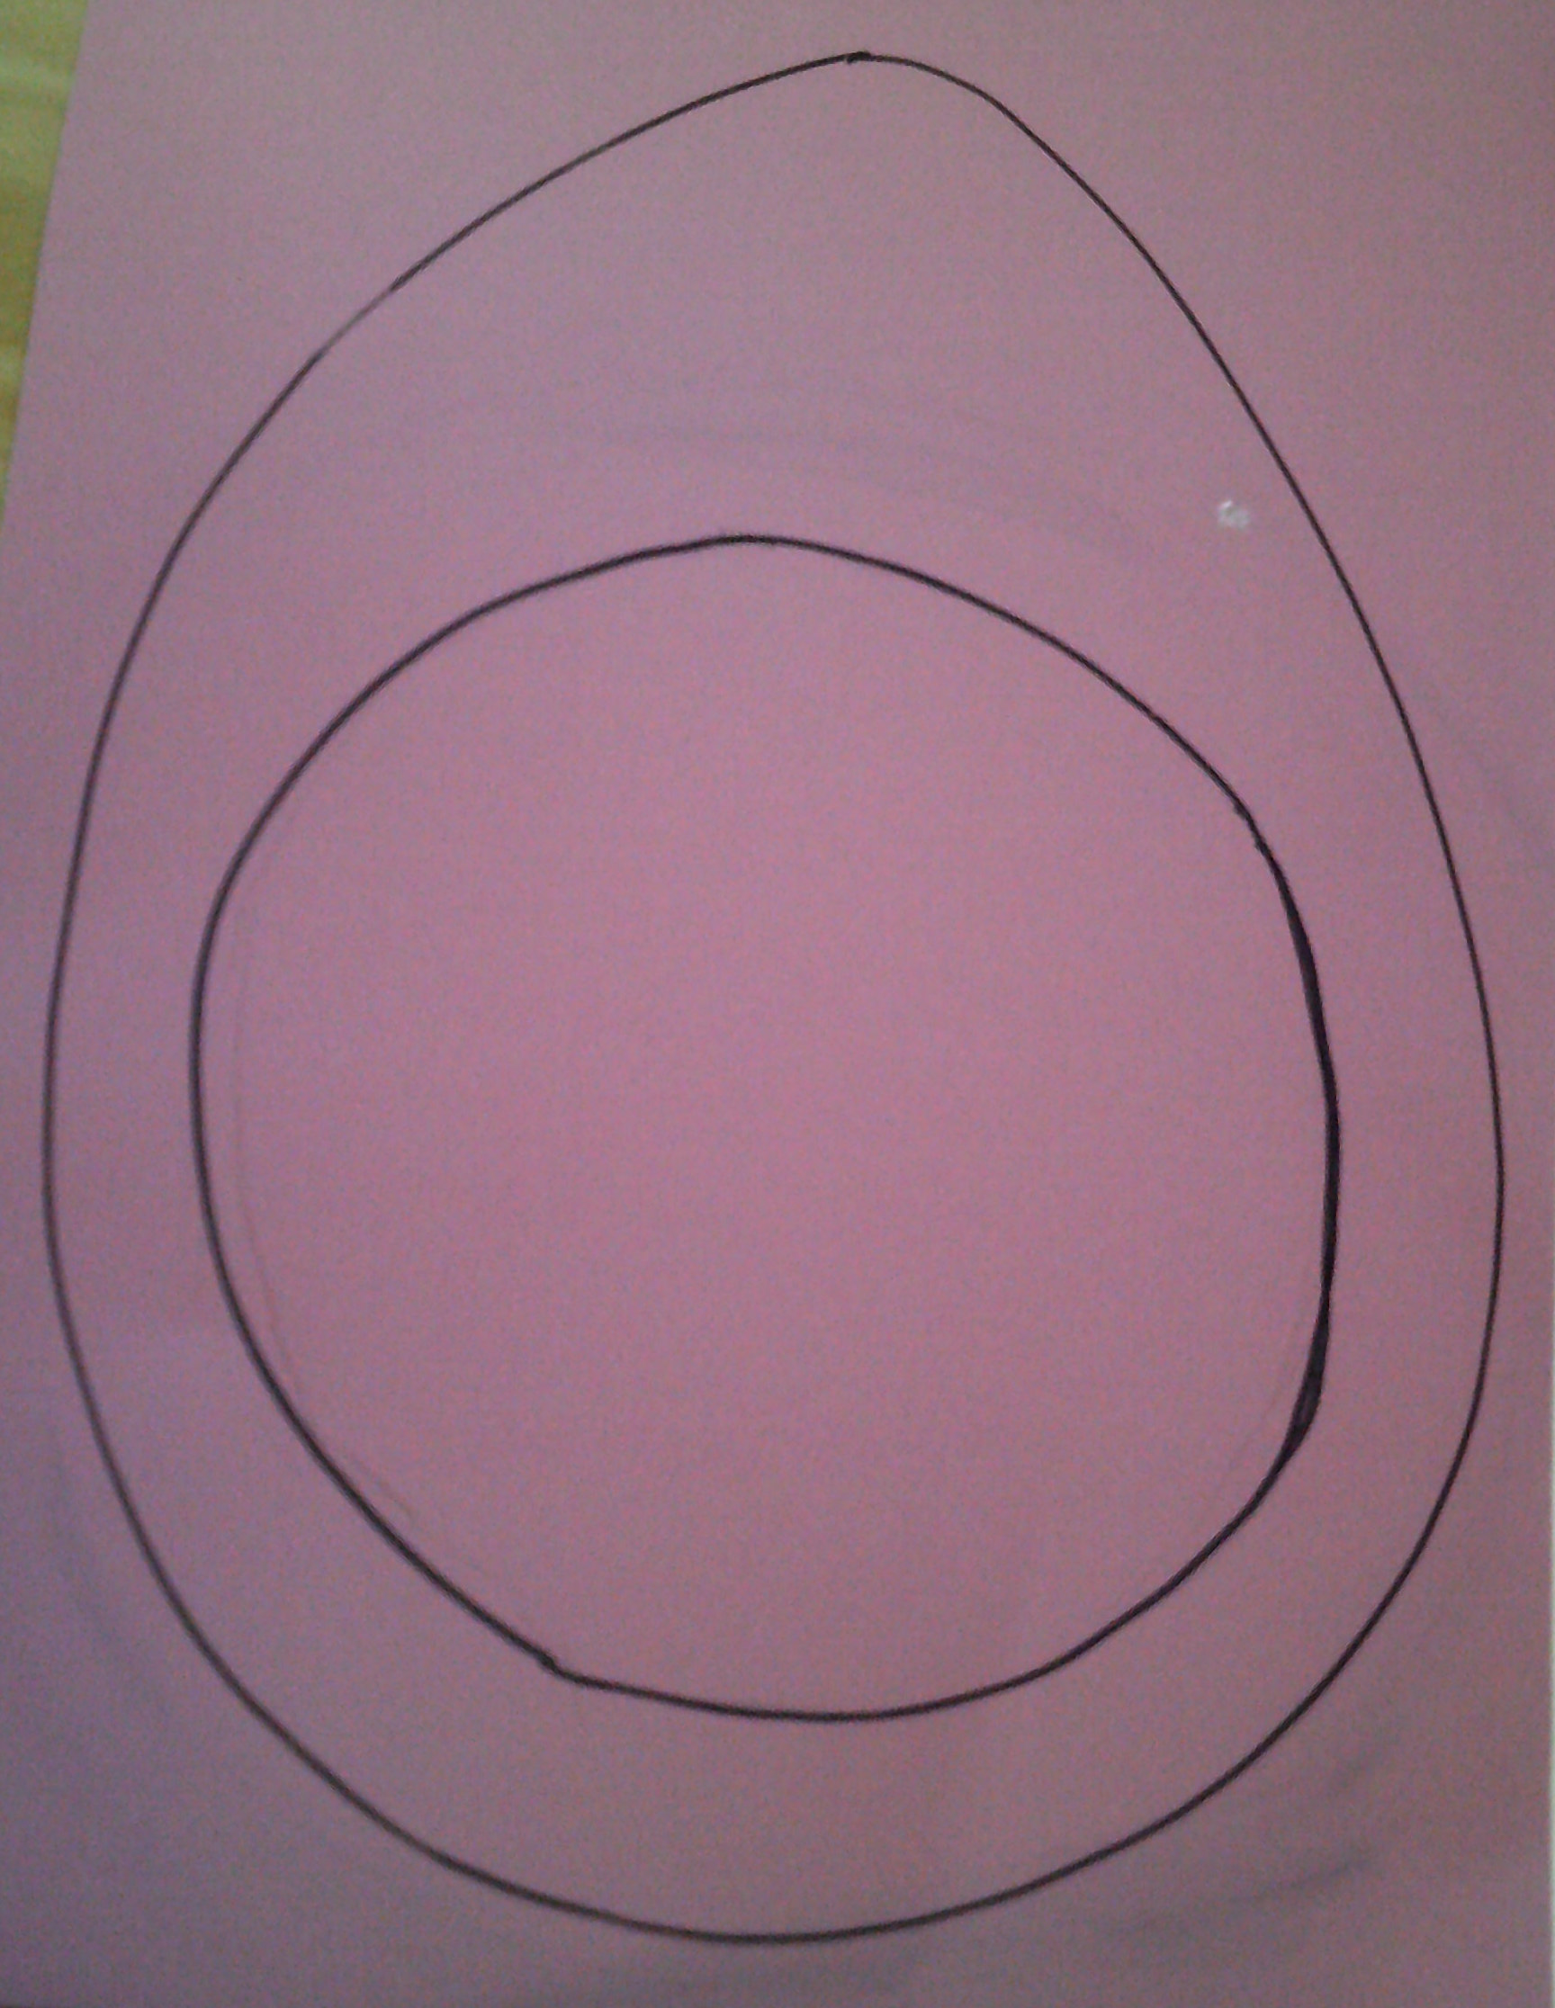
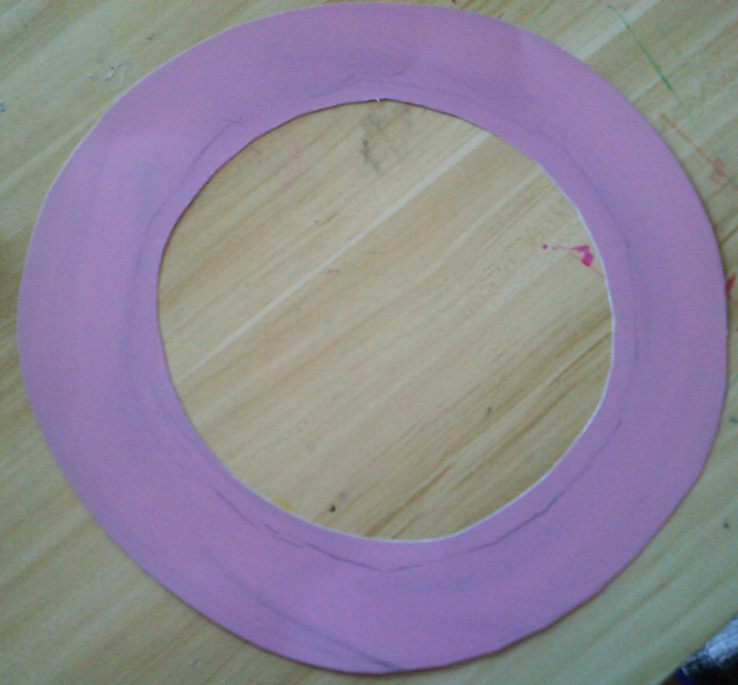
Prepare the brim
Draw around the top circle of the hat on a new piece of card.
Mark out the size of the brim you want to create around the inner circle and
draw an outer shape.
You can change the shape of
the brim at this point
Cut out the larger circle
Make a hole in the centre and cut out the inner circle
This is the brim – check it fits on your head!

Slide 8
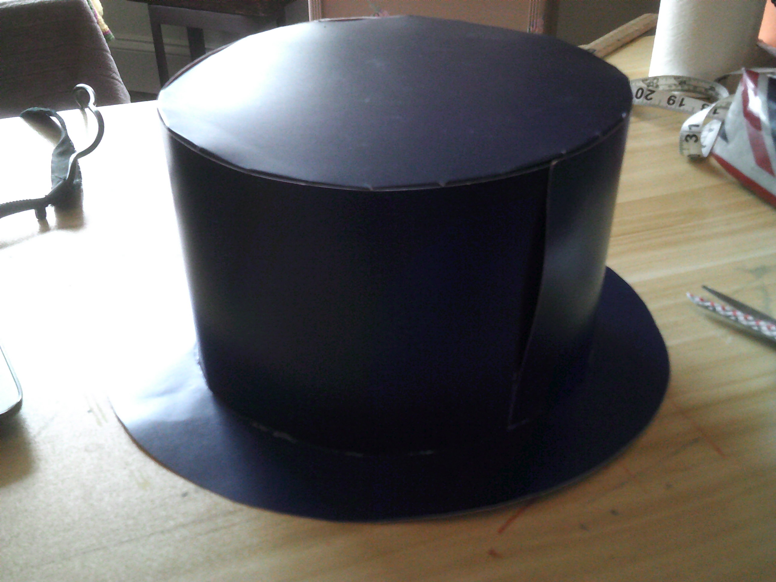
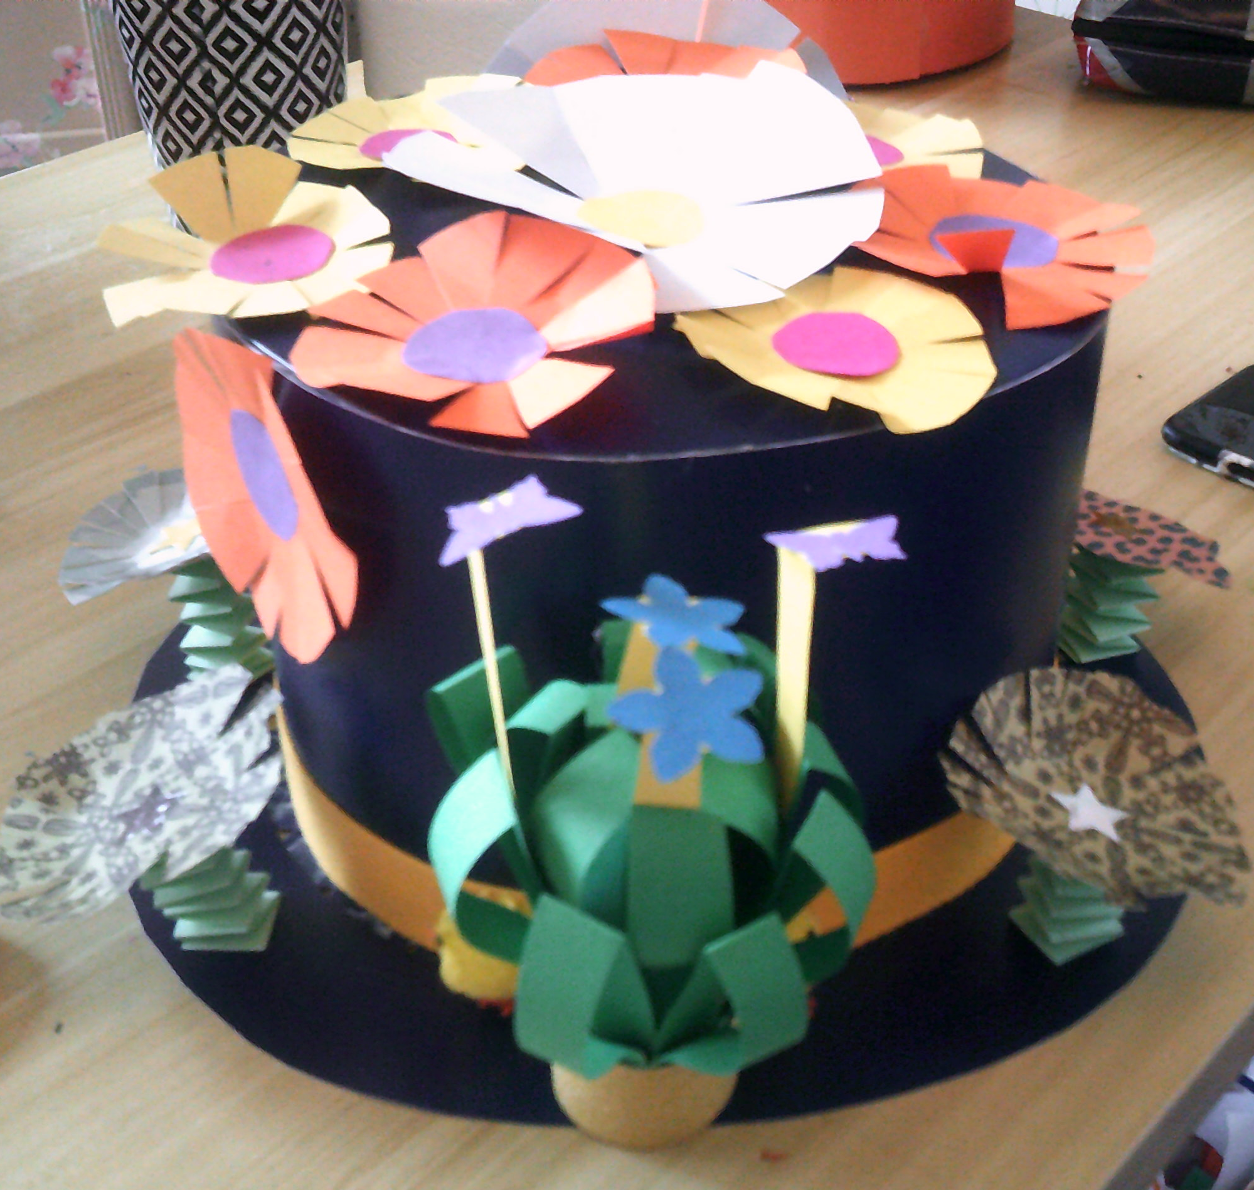
Make the hat
Drop the brim over the body of the hat.
Put a small amount of double sided tape or glue onto each flange.
Stick down the brim.
Look again at your design and add your Easter decorations.

Slide 9
Wearing an Easter bonnet or hat, is a continuous Christian tradition.
Worn to celebrate something new; Springtime, new life, the Resurrection of Jesus, a new beginning…
Enjoy wearing yours!
Please send a photo to me via Seesaw.
Thank you,
Mrs Coulston

