Slide 1
Tuesday 2nd March 2021
LO- To understand the early Islamic civilization in Baghdad

Slide 2
The Rise of the Islamic Empire
AD 637: Islam spreads to Persia, Palestine, Syria, Lebanon, Iraq and Egypt.
AD 752: Baghdad is built to be the capital of the Islamic Empire.
AD 936: Al-Zahrawi is born. He refines the science of surgery and invents many surgical instruments.
AD 1325: Ibn Battuta leaves Tangier on his 29 year journey.
Islamic Empire
5th century
15th century
Roman Empire
The Dark Ages
Northern Europe
For around a thousand years (around AD 700), a vast Islamic civilisation spread from Baghdad, through North Africa and into Spain. Whilst Northern Europe was involved in many wars across its various Christian kingdoms, for the countries of the Islamic Empire this period was one of general peace and had a huge emphasis on scientific and mathematical knowledge.

Slide 3
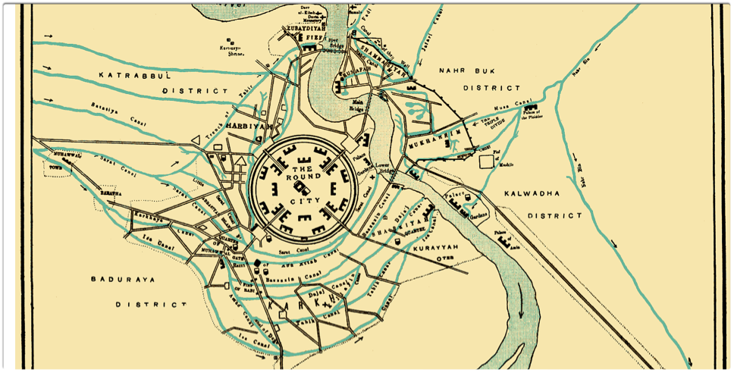
It was known as the round city.
Unlike Greek or Roman cities, which were designed as squares or rectangles

Slide 4
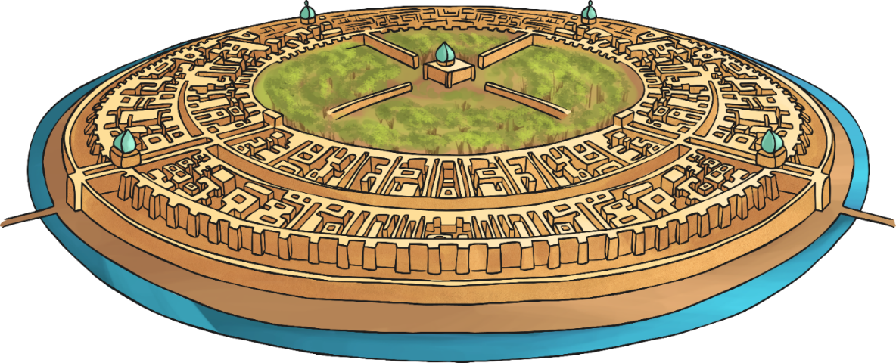
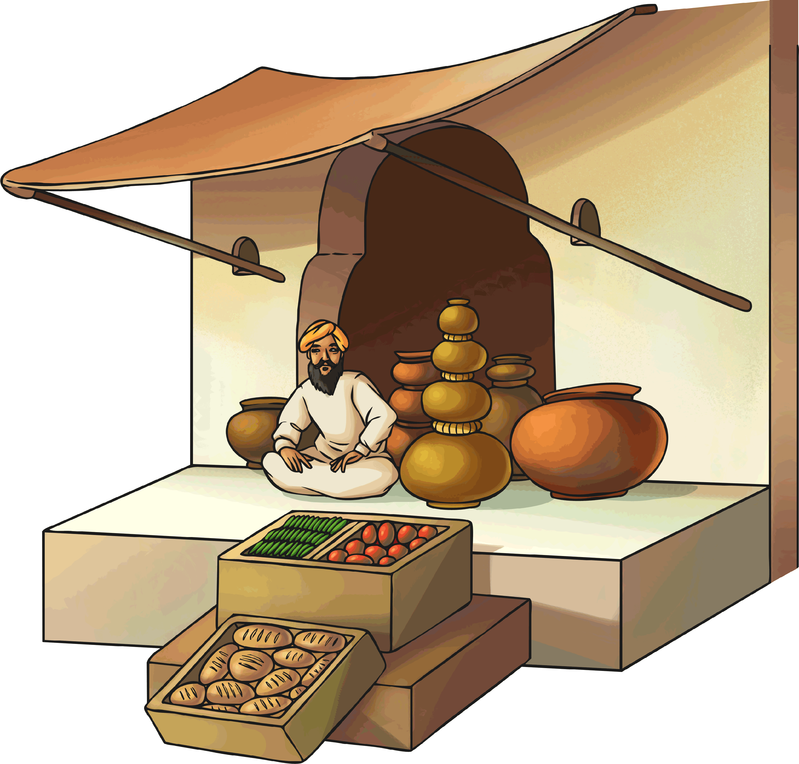
Baghdad in AD 900
Baghdad was built in AD 752 by Caliph Al-Mansur as the new capital of the Islamic Empire.
It was built in a circle, about 1km in diameter, with the mosque and guard headquarters in the centre. Houses were built around the city walls.
Baghdad’s location was perfect for the city to succeed. It was close to water and established trade routes.
Major roads crossed through the city, and many traders set up markets around the entrances.

Slide 5
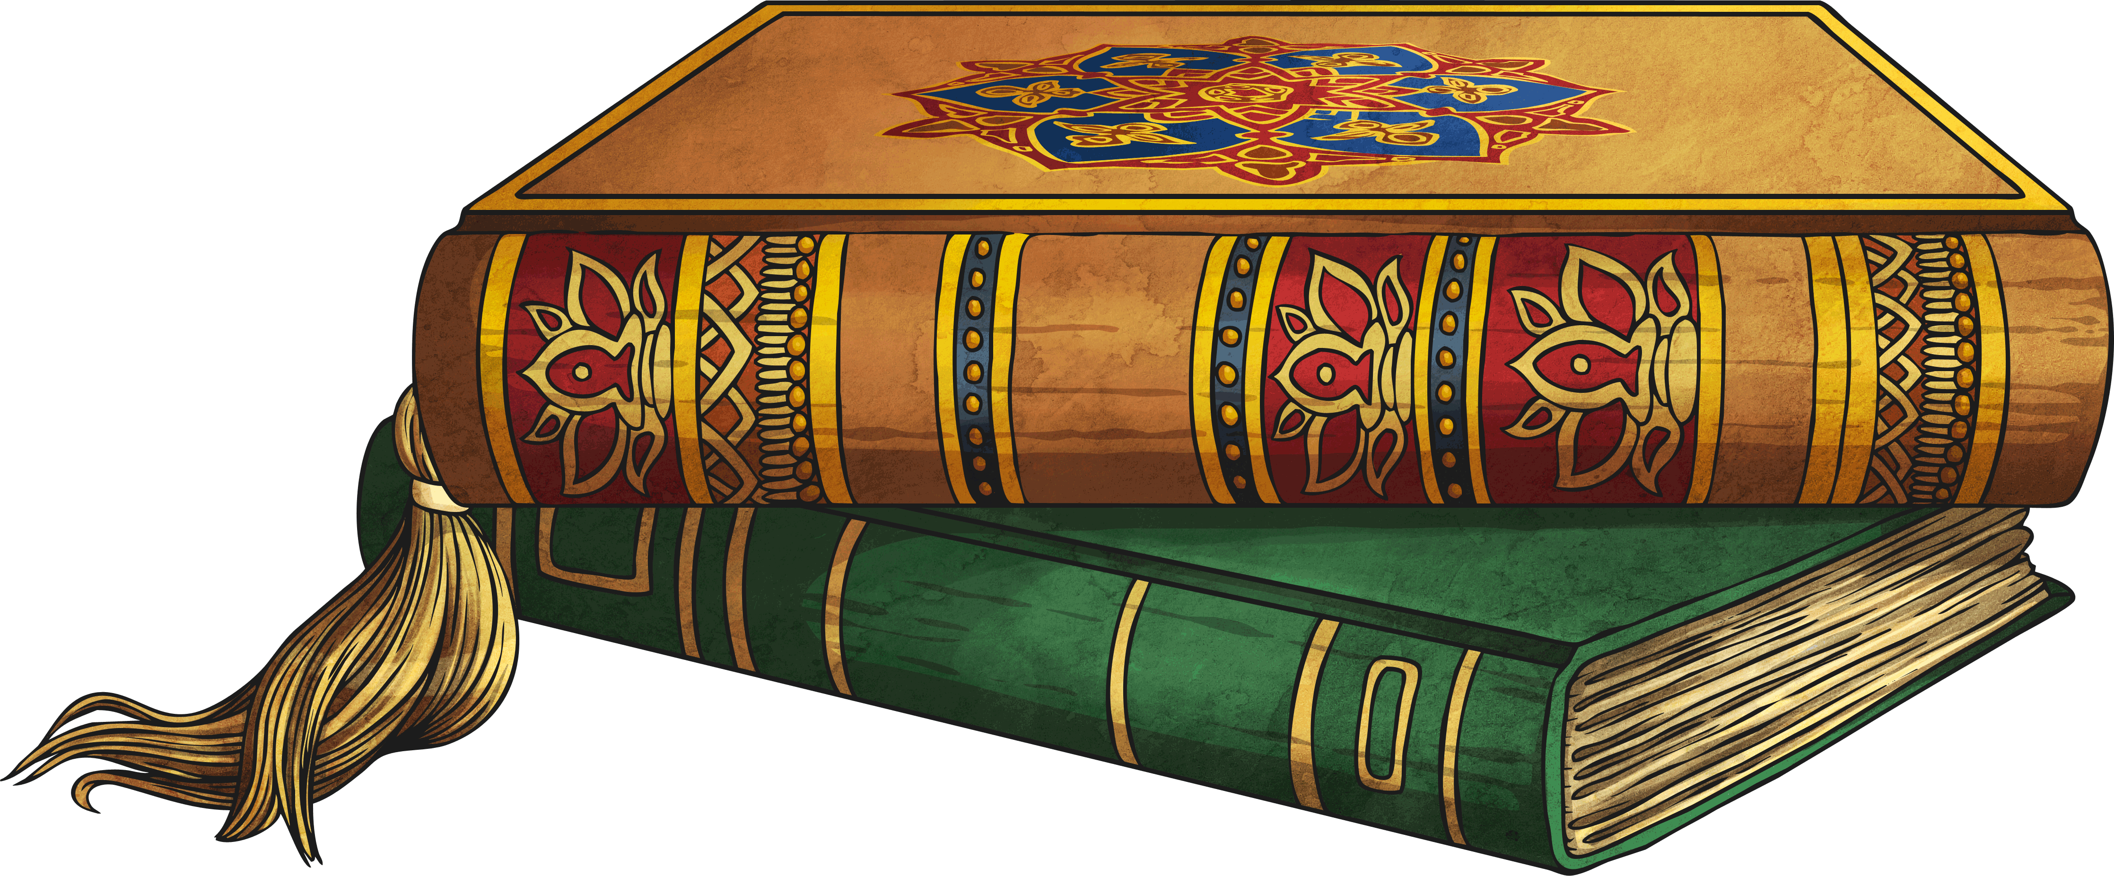
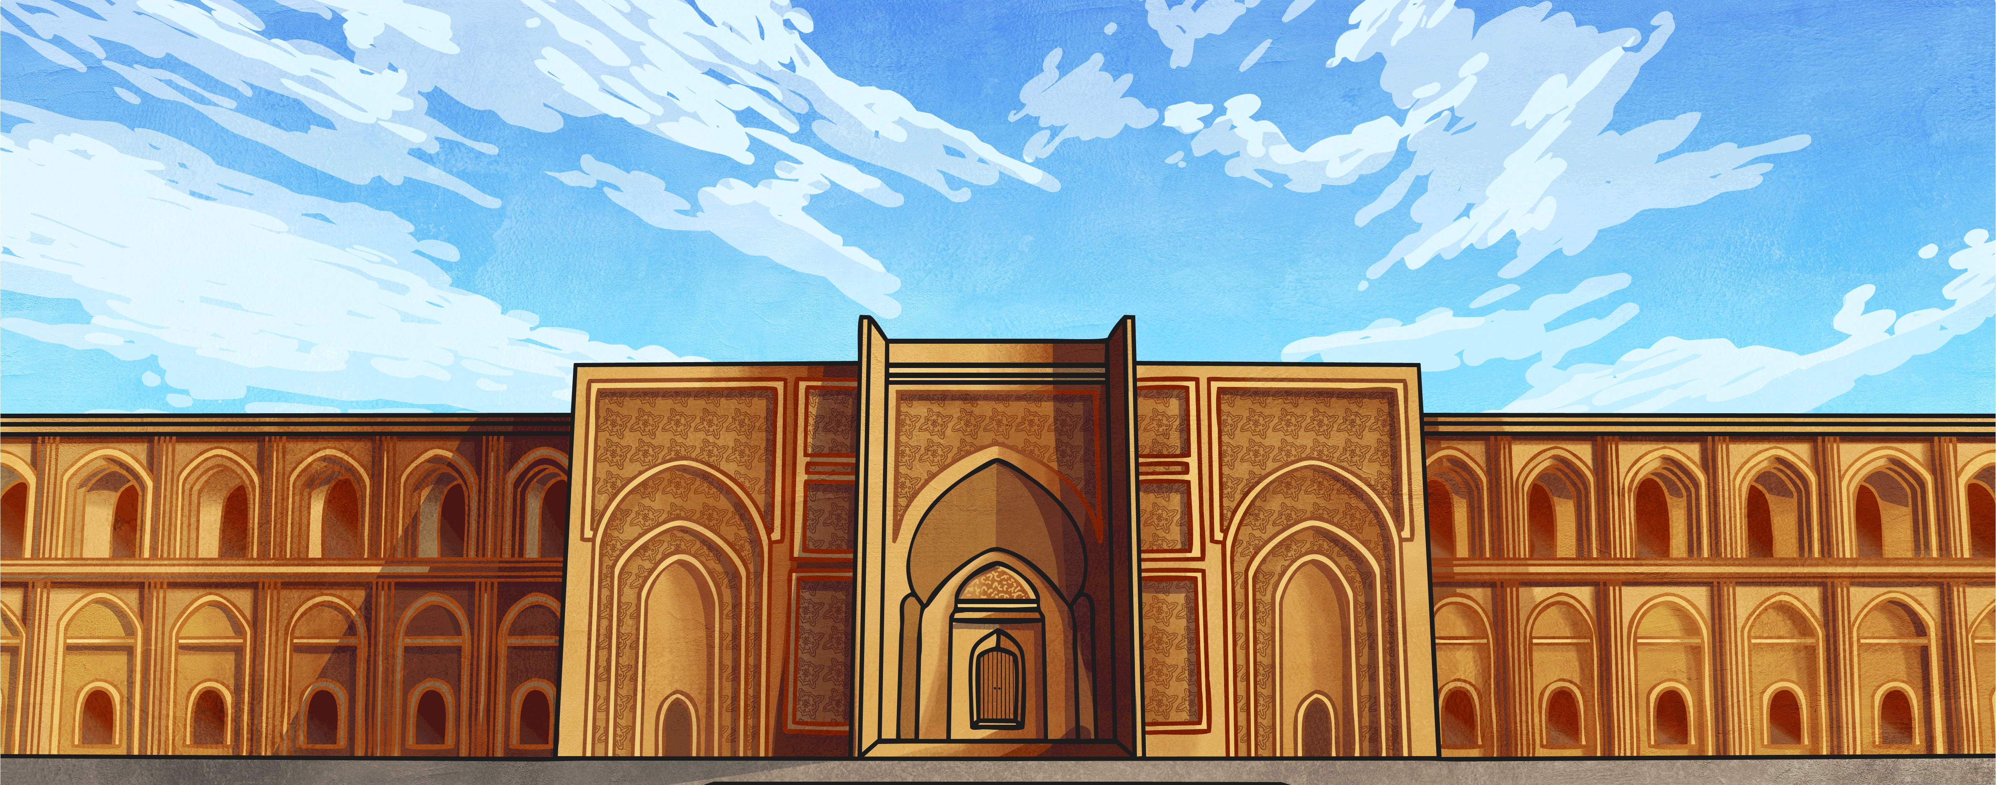
Baghdad in AD 900
Baghdad became known as the cultural and learning capital of the world. The world’s first universities and hospitals were built there.
A banking system was set up so that people could trade and encouraged more people to settle close to the city.
Over 1 million people lived in Baghdad.
The House of Wisdom was built in Baghdad as the centre of learning and knowledge. Many scholars travelled there.

Slide 6
The Islamic Empire and Europe
The Islamic Empire c. AD 1000 | Europe c. AD 1000
About one million people lived in Baghdad and its suburbs
About 20,000 people lived in London and its suburbs
Gathered and used books from the ancient Greeks/Romans
Ignored the writings of ancient Greeks and Romans
Millions of books and many thousands of readers.
Very few books and hardly any readers
Clean water and good drainage in cities
Unsafe water supplies and very little drainage in cities
Used advanced mathematics using Arabic numbers and zero
Very poor mathematics using Roman numerals and no zero
Religion tended to encourage scientific study
Religion tended to be more about faith than scientific study
General peace across a huge Islamic empire
Many wars between Christian kingdoms

Slide 7
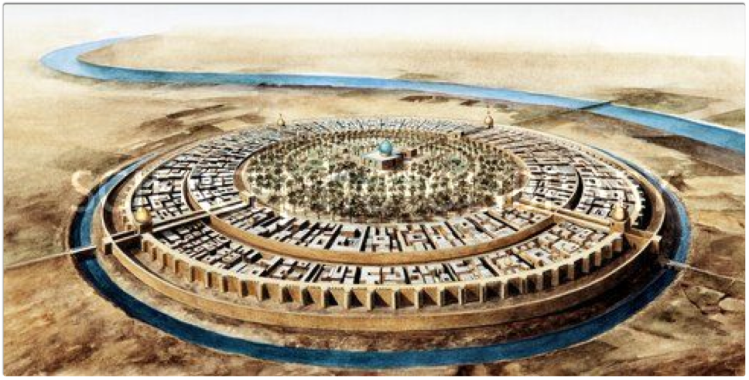
BAGHDAD C.900

Slide 8
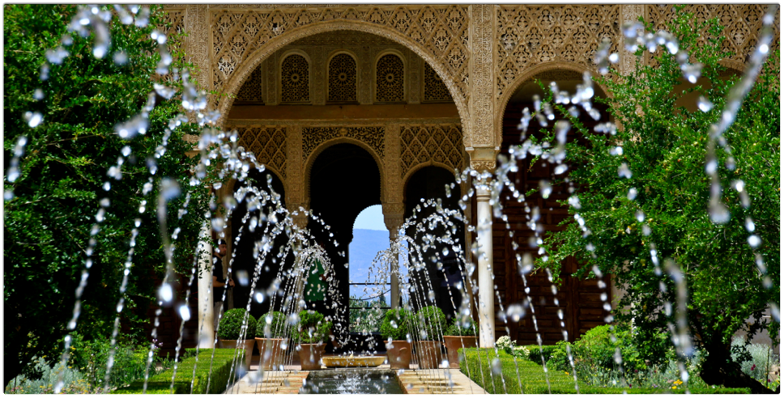
Within the city there were many parks, gardens, villas, and promenades.

Slide 9
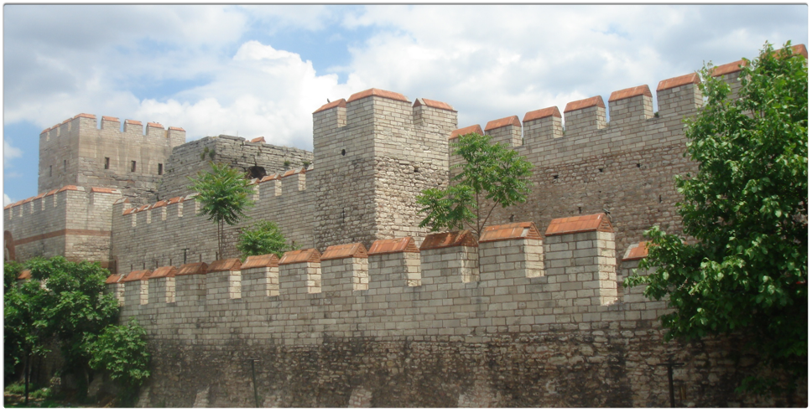
The city was surrounded by a 30m high wall - 44m thick at the bottom and 12m thick at the top - there were four gates.

Slide 10
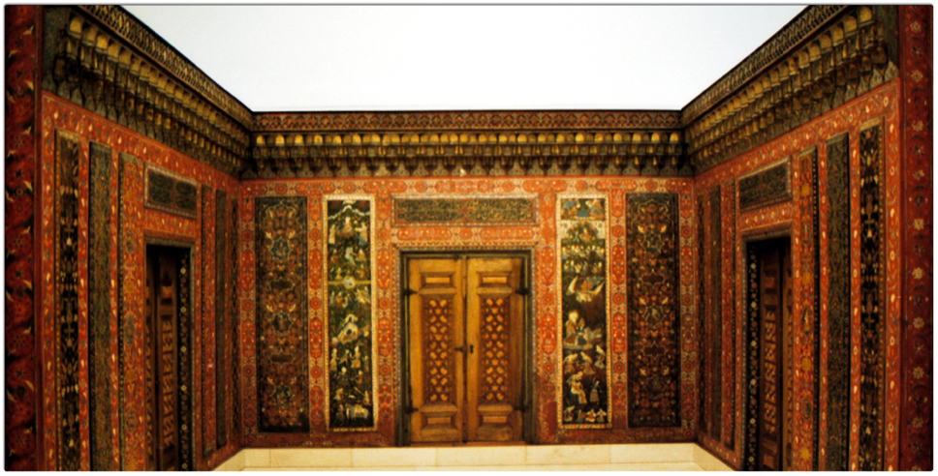
Baghdad became a hub of learning and commerce.
Scholars visited its great library, The House of Wisdom, from all over the world.

Slide 11
