Slide 1
Year 6 - Spring - Block 4
Converting Units

Slide 2
Teddy thinks his chew bar is 13.2 cm long.
Do you agree? Explain why.

Slide 3
Ron’s dog is about $\frac{1}{4}$ of the height of the door.
Ron is three times the height of his dog.
Estimate the height of Ron and his dog.

Slide 4
Here is a train timetable showing the times of trains travelling from Halifax to Leeds.
An announcement states all trains will arrive $\frac{3}{4}$ of an hour late.
Which train will arrive in Leeds closest to 09:07?
Halifax | Leeds
07:33 | 08:09
07:49 | 08:37
07:52 | 08:51

Slide 5
Mo thinks that 12,000 g is greater than 20 kg because 12,000 $>$ 20
Explain why Mo is wrong.

Slide 6
Put these capacities in order, starting with the smallest.
3 litres
3,500 ml
0.4 litres
0.035 litres
450 ml
330 ml

Slide 7
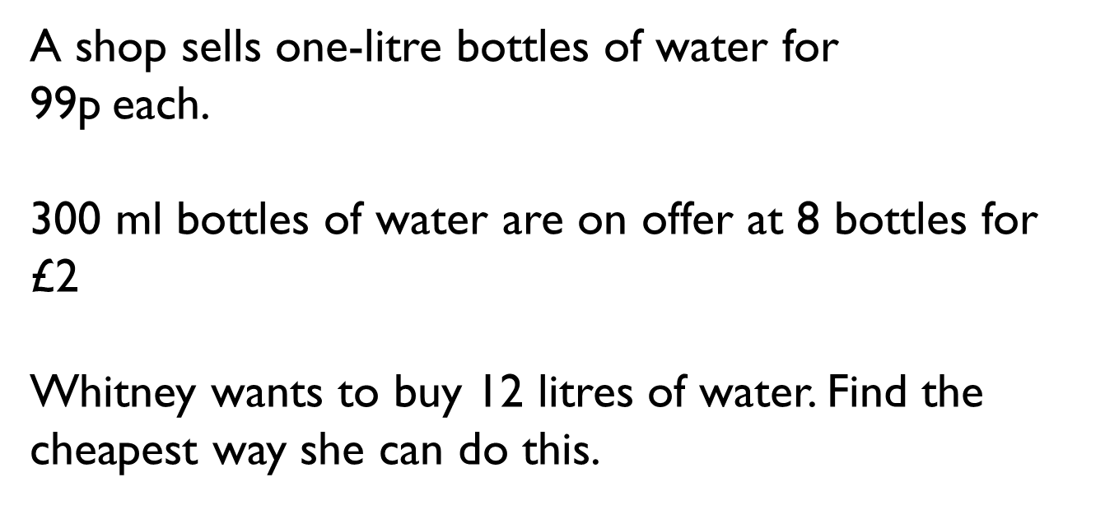
A shop sells one-litre bottles of water for
99p each.
300 ml bottles of water are on offer at 8 bottles for £2
Whitney wants to buy 12 litres of water. Find the cheapest way she can do this.

Slide 8
Jack, Alex and Amir jumped a total of 12.69 m in a long jump competition.
Alex jumped exactly 200 cm further than Jack.
Amir jumped exactly 2,000 mm further than Alex.
What distance did they all jump?
Give your answers in metres.

Slide 9
Dora made a stack of her magazines.
Each magazine on the pile is 2.5 mm thick.
The total height of the stack is 11.5 cm high.
How many magazines does she have in her pile?

Slide 10
Each nail weighs 3.85 grams.
There are 24 nails in a packet.
What would be the total mass of 60 packets of nails? Give your answer in kilograms.
How many packets would you need if you wanted $\frac{1}{2}$ kg of nails?
How many grams of nails would be left over?

Slide 11
Ron and Annie are running a 5 mile race.
Who has the furthest left to run?
I have run 6.4 km so far
I have run 3.8 miles so far

Slide 12
The distance between Cardiff and London is 240 km.
A car is travelling at 60 mph.
How long will it take them to get to London from Cardiff?

Slide 13
Mo cycles 45 miles over the course of 3 days.
On day 1, he cycles 16 km.
On day 2, he cycles 10 miles further than he did on day 1
How far does he cycle on day 3?
Give your answer in miles and in kilometres.

Slide 14
Jack is 6 foot 2 inches tall.
Rosie is 162 cm tall.
Who is taller and by how much?

Slide 15
60 gallons of water are drunk at a sports day.
Each child drank 3 pints.
How many children were at the sports day?

Slide 16
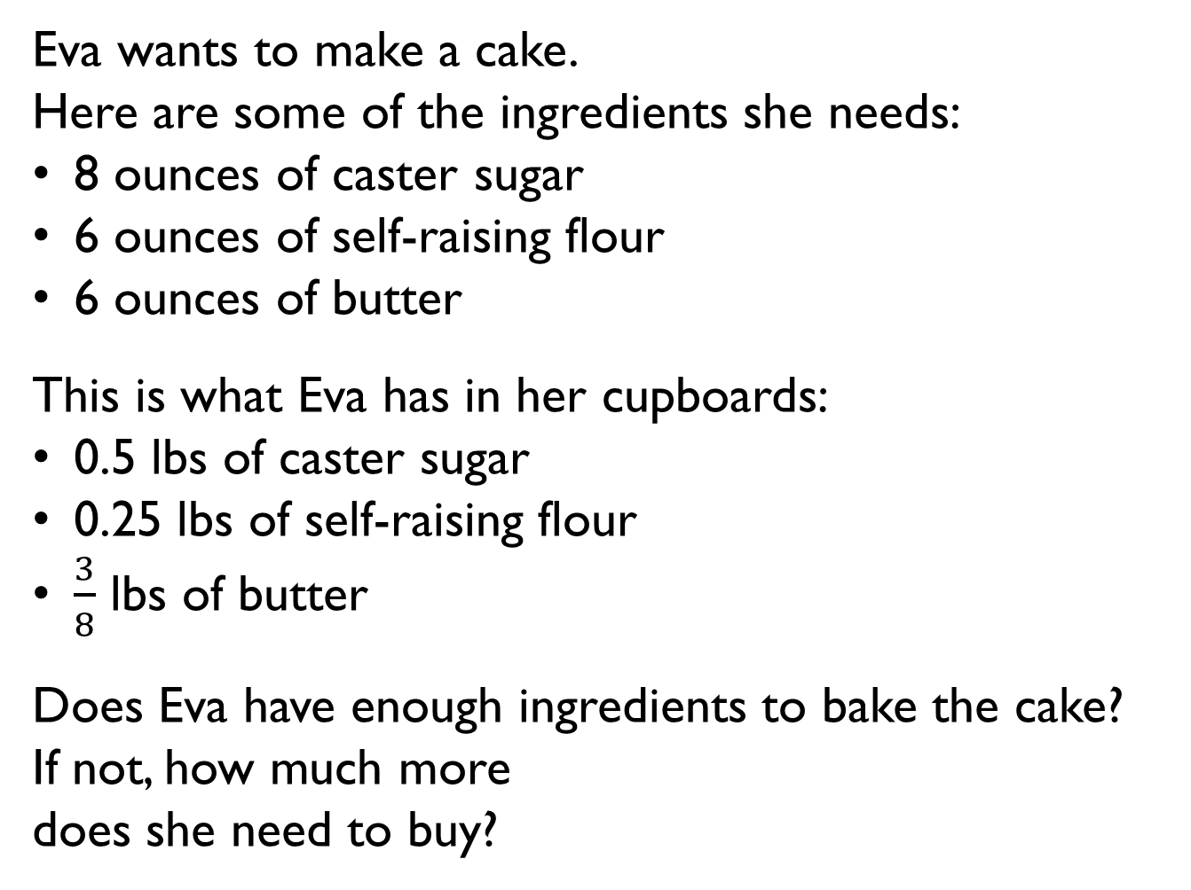
Eva wants to make a cake.
Here are some of the ingredients she needs:
8 ounces of caster sugar
6 ounces of self-raising flour
6 ounces of butter
This is what Eva has in her cupboards:
0.5 lbs of caster sugar
0.25 lbs of self-raising flour
$\frac{3}{8}$ lbs of butter
Does Eva have enough ingredients to bake the cake?
If not, how much more
does she need to buy?

