Slide 1
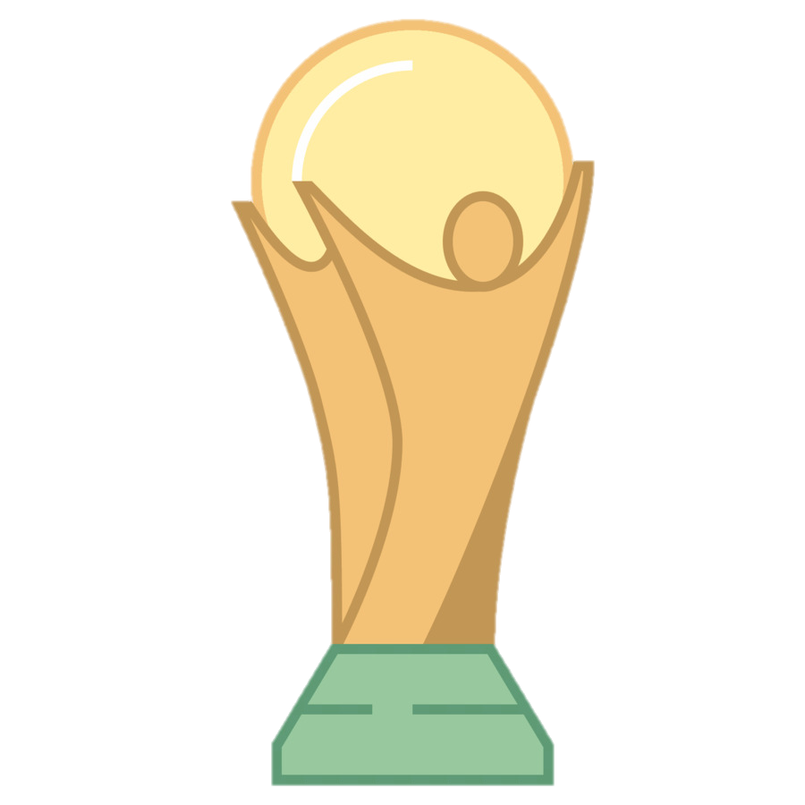
World Cup Champions

Slide 2
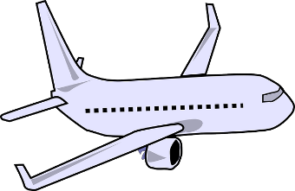
World Cup Champions
Fly around the world and learn about different countries and their cultures, completing a number of challenges along the way to earn points, can you become a World Cup Champion?
Each group contains six countries with a challenge to complete in each along with information about that country
Complete the challenge in each country and complete the group quiz at the end to earn points
Take pictures/videos completing the challenges and send to jack.mountain@pne.com to be entered into the prize draw

Slide 3
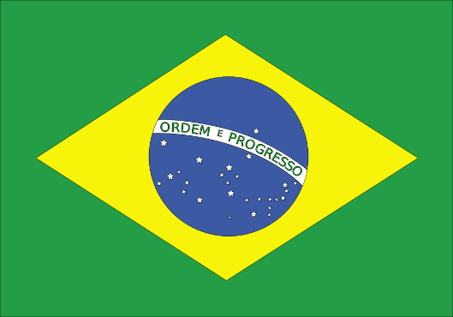
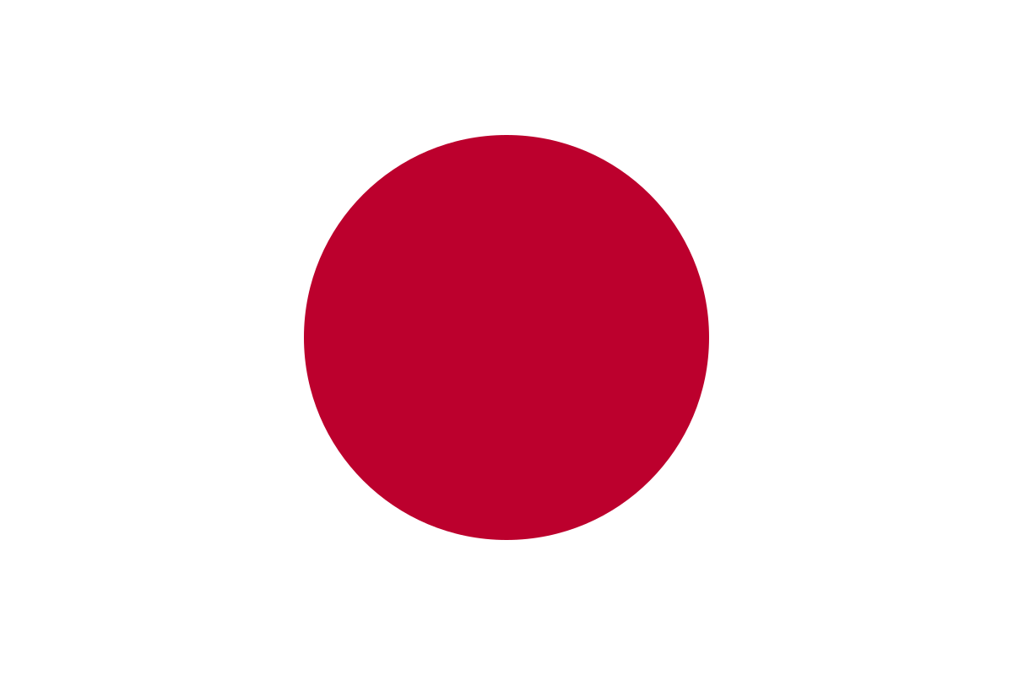
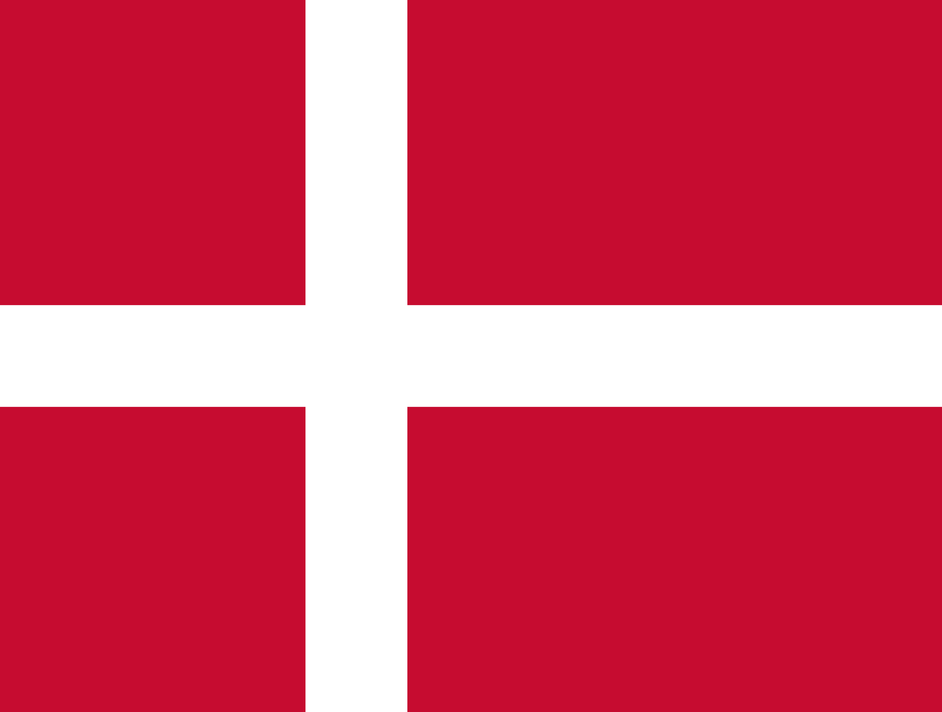
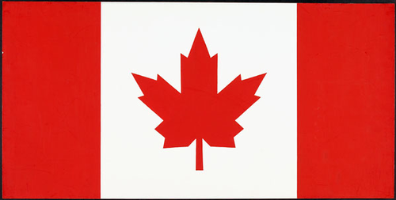
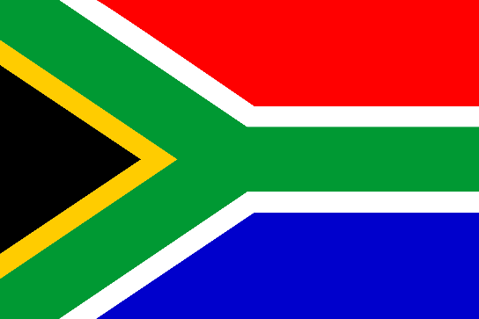
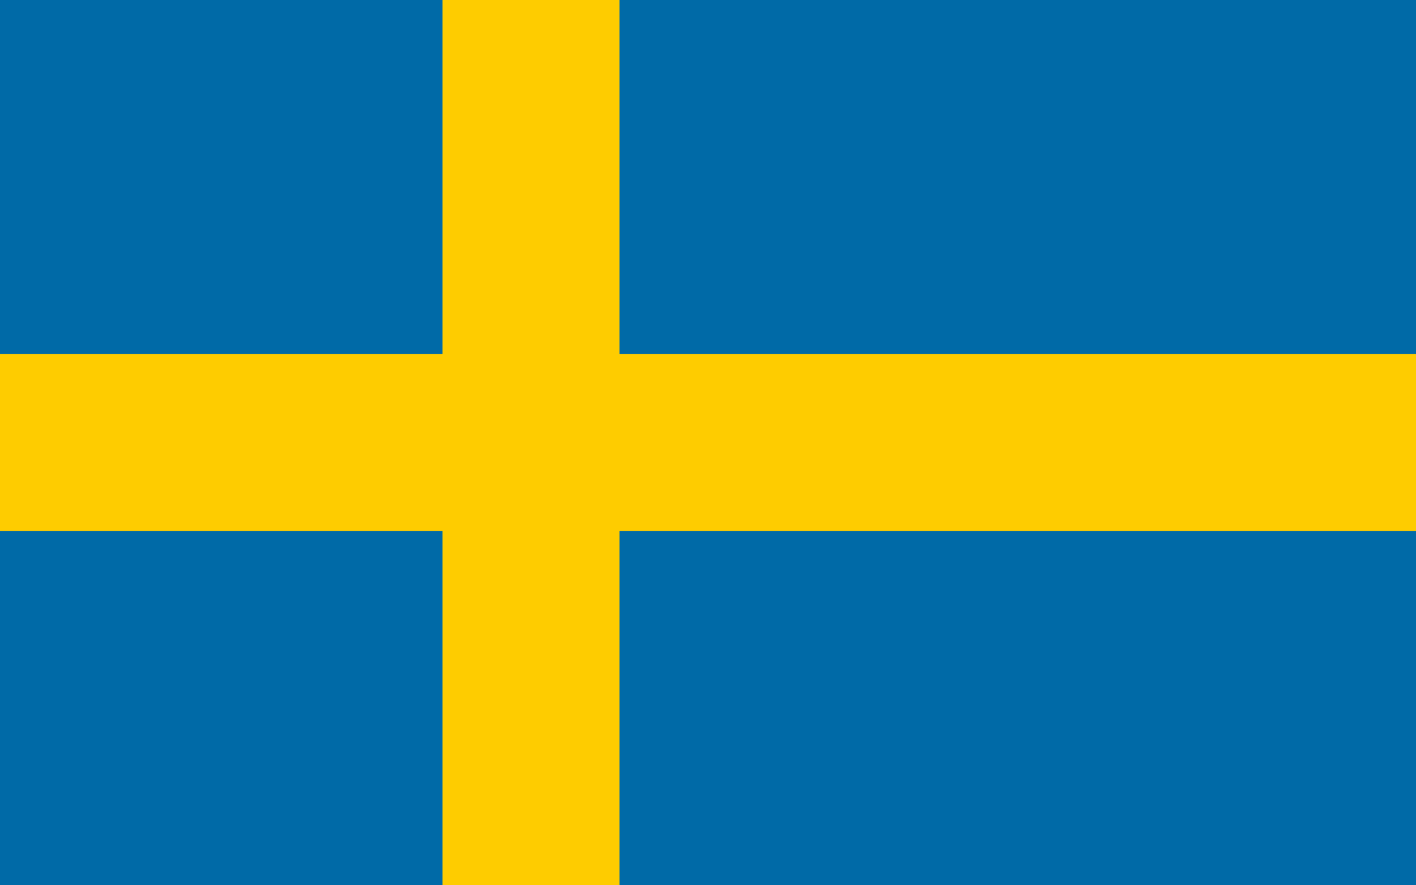
Group 1

Slide 4
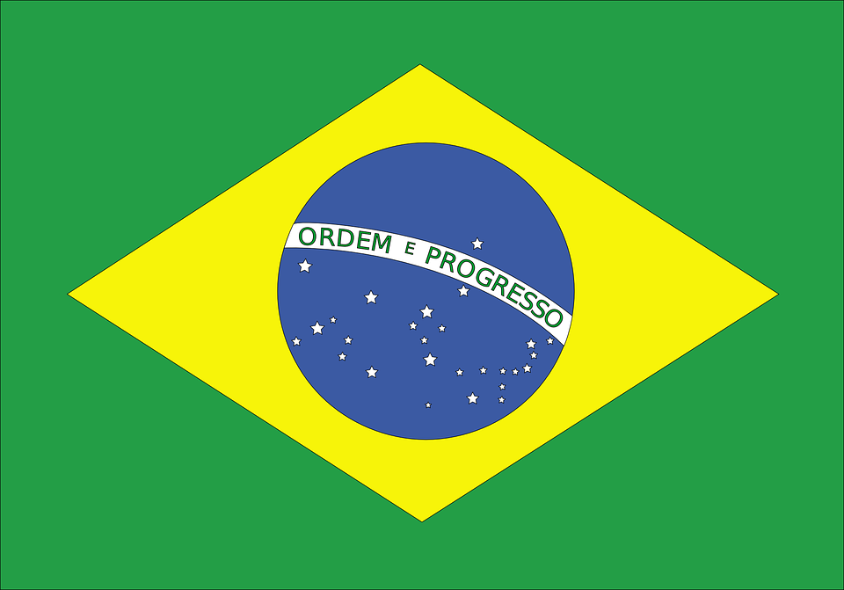
Brazil
Brazil is the largest country in South America
Brazil is the only country in South America that speaks Portuguese
Brazil is the 5th largest country in the world by both land area and population
The population in 2012 was around 194 million people
The capital city is Brasilia
Brazil covers 3 time zones
The Amazon River flows through Brazil, it is the 2nd longest river in the world (after the Nile)
Around 60% of the Amazon Rainforest is located in Brazil
Football is the most popular sport in Brazil with the national team consistently among the best in the world, winning the World Cup a record 5 times
Challenge
Brazil have won the Football World Cup a record 5 times, they are well known for their skills
Complete 5 kick ups with a football (1 point for each kick up)

Slide 5
Japan
Japan belongs to the continent of Asia
Japan is made up of 6,852 islands
The highest point in Japan in Mount Fuji, which stands at 3,776m (12,388ft)
Tokyo is the capital city of Japan
Japan sits along the “Pacific Ring of Fire”, so has many volcanoes and experiences many earthquakes
Ancient warriors of Japan were known as Samurai. They were very skilled fighters and swordsmen
Japan is an industrialized nation, producing some of the most technologically advanced motor vehicles, electronics, and machine tools
Japan is home to many different forms of martial arts. Karate, Judo, Sumo, Ninjutsu, Kendo, Jujutsu, and Aikido to name a few
Challenge
Follow the link https://www.qsl.net/7/7n2uto/japanese/ and find out how to write your name in Japanese and write it 5 times (1 point)

Slide 6
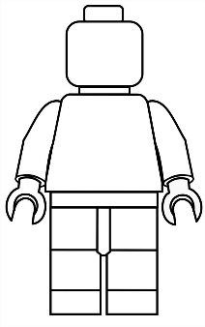
Denmark
Denmark shares a land border with Germany and is connected to Sweden by a bridge
Denmark has a population of just over 5.5 million people
The capital city of Denmark is Copenhagen, located on the island of Zealand
LEGO was invented in Denmark
Denmark is a relatively flat country with the highest natural point, Møllehøj, rising to just 170.86 m
International surveys and studies often rank Denmark as the happiest place in the world based on standards of health, welfare, and education.
Danish author and poet Hans Christian Andersen wrote notable fairy tales such as "The Emperor's New Clothes", "The Little Mermaid" and "The Ugly Duckling".
First acknowledged in 1219, the Danish flag remains the oldest state flag in the world still in use by an independent nation.
Challenge
Draw a Lego person starting with the blank template below and colour in with the colours of the Denmark flag (1 point)

Slide 7
Canada
In 2012 the population of Canada was around 35 million
The capital city of Canada is Ottawa
The 2 main languages spoken in Canada are English and French
Canada is the second largest country in the world by total area
Canada features the longest coastline in the world, stretching 125570 miles
Canada has over 30000 lakes
Winters can be very cold in Canada with temperatures dropping below −40 °C in some parts of the country
The most popular sport in Canada is ice hockey
The maple leaf is a Canadian symbol and features prominently on the national flag
Challenge
Research and write down 5 animals that live in Canada’s freezing weather (5 points)

Slide 8
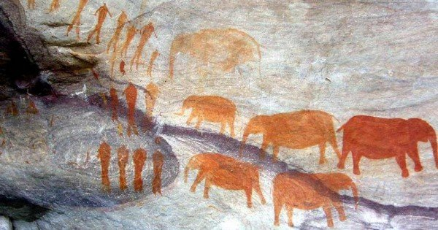
South Africa
South Africa is located at the southern end of Africa
The population of South Africa was around 52 million
South Africa has three capital cities, Cape Town, Bloemfontein and Pretoria
South Africa has 11 official languages, including Zulu, Afrikaans, Xhosa and English
South Africa's coastline stretches over 2500 kilometres (1553 miles) in length
South Africa is home to a wide variety of animals including giraffes, hippopotamus, leopards and lions
Cave paintings have been found in South Africa that date to around 75000 years ago
The most popular sports in South Africa are football, rugby and cricket
Challenge
Draw your own cave drawings on a piece of paper of the animals which can be found in South Africa (1 point)

Slide 9
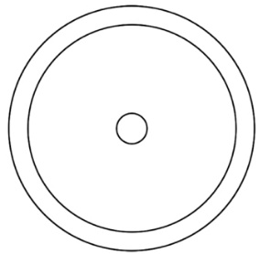
Sweden
The land area of Sweden is the 4th largest in Europe
The capital and largest city in Sweden is Stockholm
Sweden has a population of 9.5 million people
Low unemployment, a low birth rate, a highly developed welfare system and one of the world's longest life expectancies all contributes to modern Sweden having one of the highest standards of living in the world
Forests cover over 50% of Sweden, there are also around 100,000 lakes and over 24,000 islands throughout the country
The Swedish Vikings of the 8th-10th centuries were a fearsome group, highly skilled at warfare they invaded and settled throughout Northern and Eastern Europe
Ice hockey and football are Sweden's main sports, other popular sports include handball, golf, gymnastics, athletics and cross country skiing
Challenge
Large, round, wooden shields were used by Vikings to defend against attacks. Shields were 80-90cm across. Draw and design your own Viking shield (1 point)

Slide 10
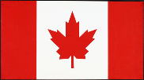
Group 1 Quiz
Q1: Name the flag
Answer all the questions about the countries you’ve learnt about without looking at the previous slides.
1 point for each question = 12 points
A B C
D E F
Q2: Which country sits along the “Pacific Ring of Fire”, so has many volcanoes and experiences many earthquakes?
Q3: The maple leaf is a symbol and features prominently on the which national flag?
Q4: Which country’s capital and largest city is Stockholm?
Q5: Which country is home to a wide variety of animals including giraffes, hippopotamus, leopards and lions?
Q6: Which country covers 3 time zones?
Q7: Which country remains the oldest state flag in the world still in use by an independent nation.

Slide 11
Group 1 Results
Challenge | Points | Total Points
Brazil | /5
Japan | /1
Denmark | /1
Canada | /5
South Africa | /1
Sweden | /1
End of group quiz | /12
Group 1 score = /26

