Slide 1
Easter – exploring the sadness and joy of Easter
Lesson 2

Slide 2
L.O To understand the events of Palm Sunday

Slide 3
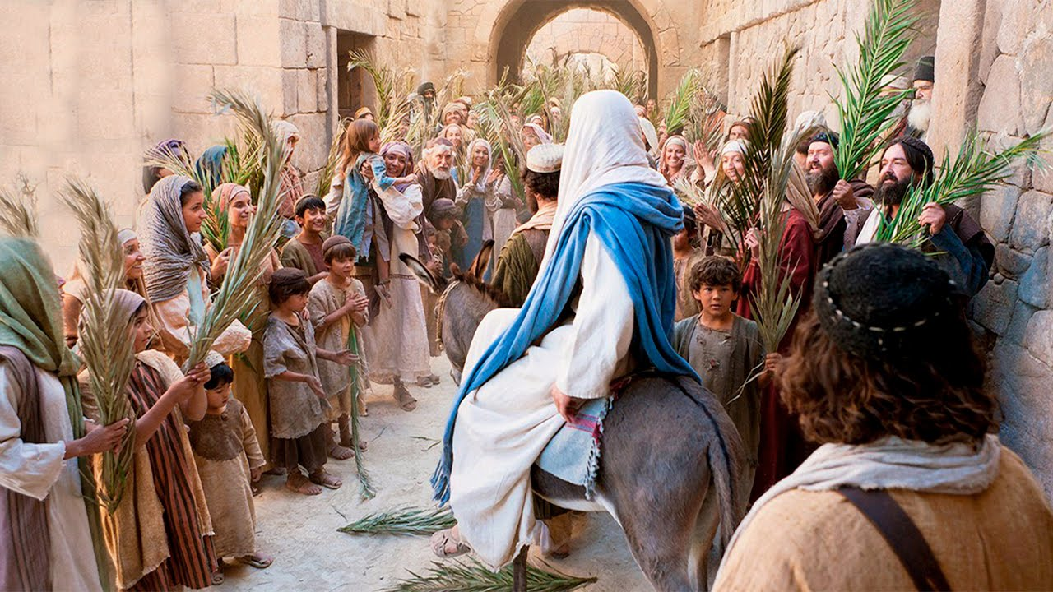
Listen to Mrs Slattery read about Palm Sunday from the Lion’s Storyteller Bible

Slide 4
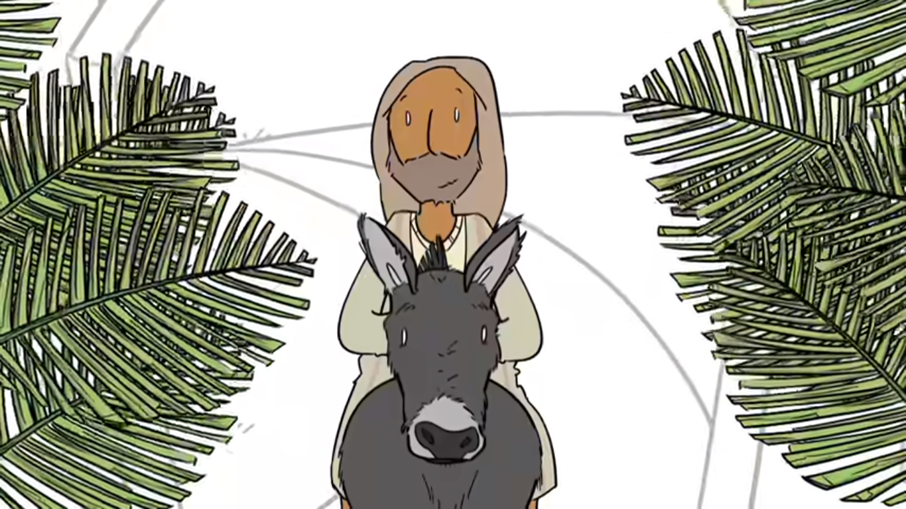
Now watch this video which tries to explain more about Palm Sunday
https://www.youtube.com/watch?v=lTmbTuutBgg

Slide 5
Also have a look at this short video https://www.bible.com/videos/25558-jesus-triumphal-entry-palm-sunday

Slide 6
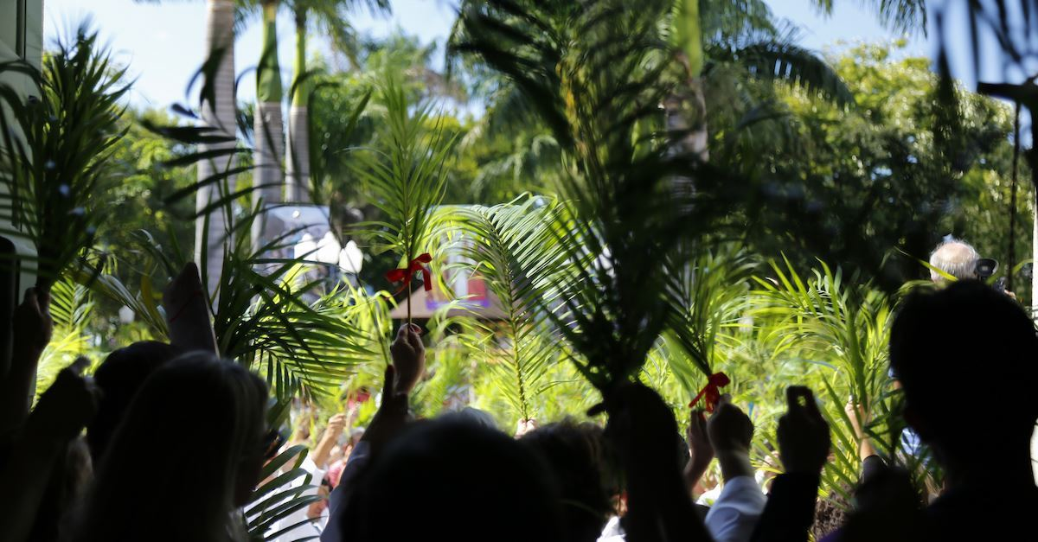
What are the main events of Palm Sunday?

Slide 7
What do you think the mood of the crowd was like? How were the people feeling? Think about the mood of the people waving the palm leaves The disciples The Pharisees (the religious leaders and people who didn’t believe Jesus was God’s son)

Slide 8
What do you think was Jesus’ mood like? How do you think was he feeling?

Slide 9
Complete the attached emoji grid for each of the people you have just thought about or copy it out onto your normal paper.

Slide 10
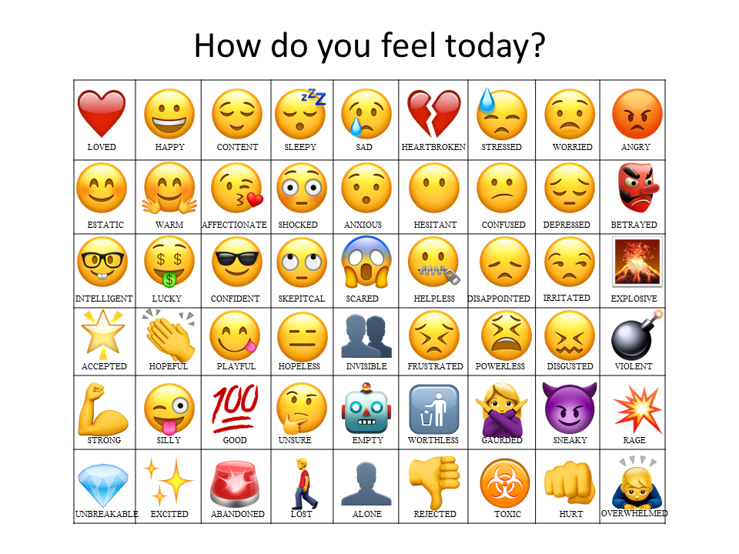
These are just a few you could choose from, there are lots of others online.

Slide 11
Remember to upload your work to seesaw

