Slide 1
Monday 8th February 2021
LO- To understand what Jesus taught us.

Slide 2
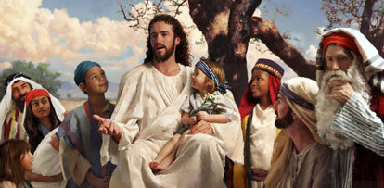
Starter
Think about what we have learned so far in R.E, IN REGARDS TO Jesus being a good teacher.

Slide 3
Main Activity
Imagine if we knew somebody who knew nothing about Jesus, heaven or Christianity. They have just read one of the parables we have been looking at in the previous sessions. On the next slide are the previous parables we have already looked at.
I want you to Explain how you would describe to this person about what you know about Jesus, heaven and Christianity.

Slide 4
Previous Parables
Here are the previous parables we have looked at this half term:
The good Samaritan- https://www.biblegateway.com/passage/?search=Luke%2010%3A25-37&version=NIV
The Sower- https://www.biblegateway.com/passage/?search=Matthew%2013&version=NIV
The Wise and foolish builders- https://www.biblegateway.com/passage/?search=Matthew%207%3A24-27&version=NIV
The lost sheep- https://www.biblegateway.com/passage/?search=Luke%2015&version=NIV

Slide 5
Dig Deeper
Thinking about the parables we have looked at previously. I want you to choose one of these that you feel has a strong message, one that feels very personal to you and explain why.
Explain what important message your chosen parable has given you.

