Slide 1
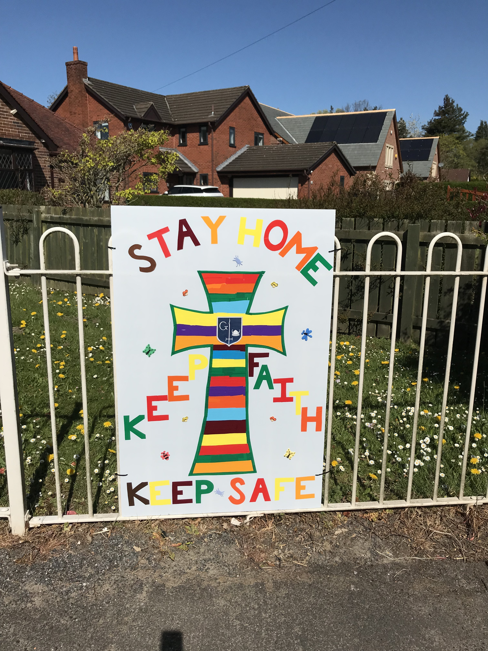
Hello Year 6
Our artwork this week will continue the theme of mindfulness.
We’ll be thinking about the people we can’t see or visit
because of the national lockdown.
You can choose to make the gift of a cross a heart or a rainbow
to send to someone in your family, a neighbour or someone in the
Parish who is alone at the moment.
On the school gate is a large sign of a cross, with the message:
STAY HOME
KEEP FAITH
KEEP SAFE
These words are important and can be included in your artwork.

Slide 2
These symbols all have a connection to Christianity and God.
You could send a heart to show your love for others and God’s love for us all.
You could send a cross to show your faith in God; that he will help us
in times of need.
You could send a rainbow to show your hope that things will be better – God sent
a rainbow after the great flood to remind us of the promise he made never to send a large flood again and to always have hope.

Slide 3
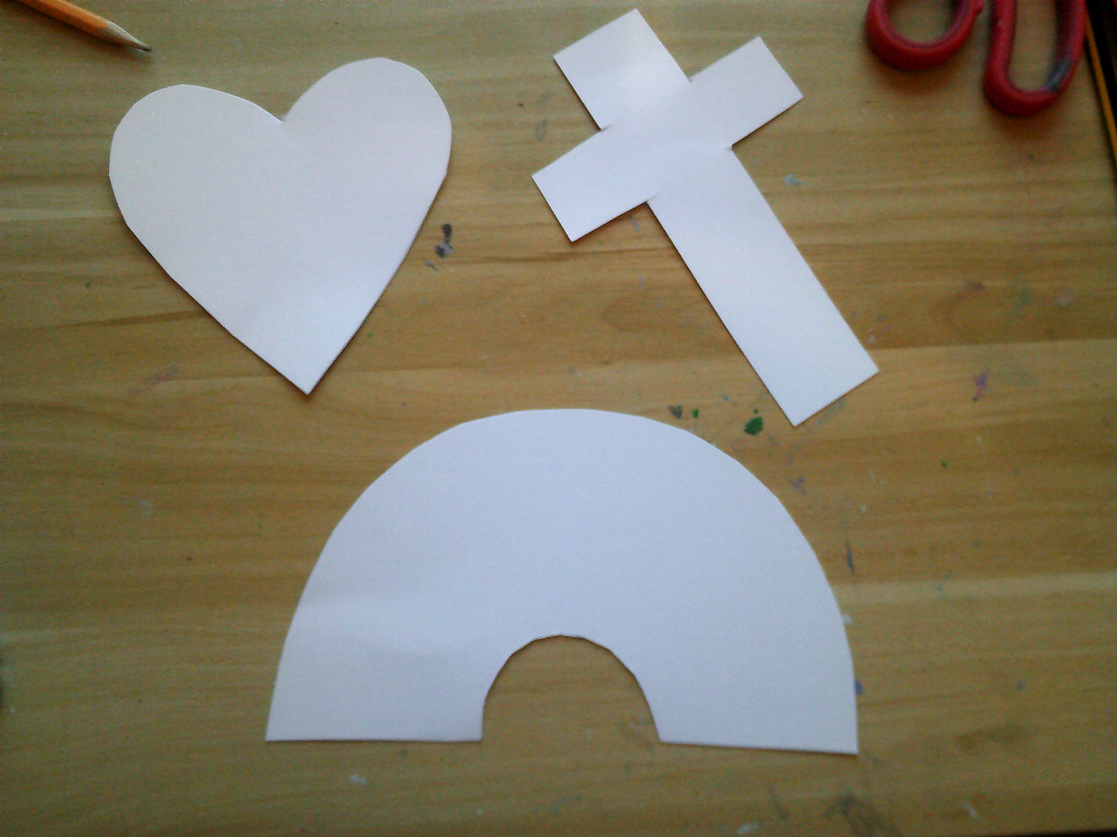
Look at the shape of the heart, cross and rainbow and choose your favourite.
Draw the shape on card and cut out. Not too large as it will be posted through a
letterbox!

Slide 4
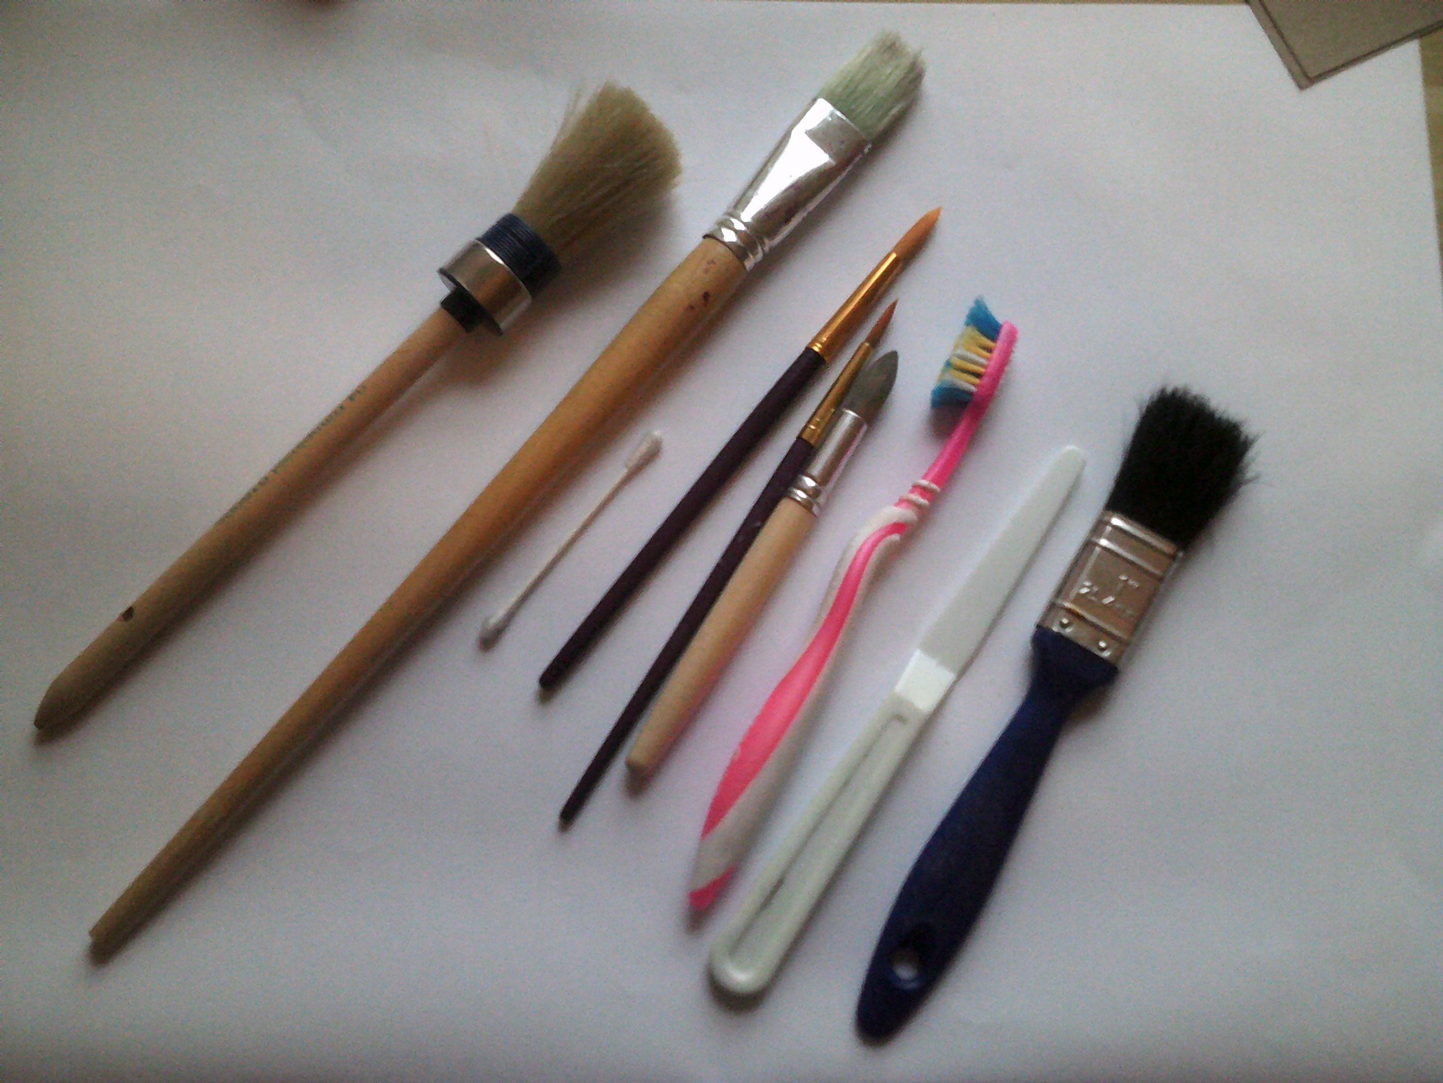
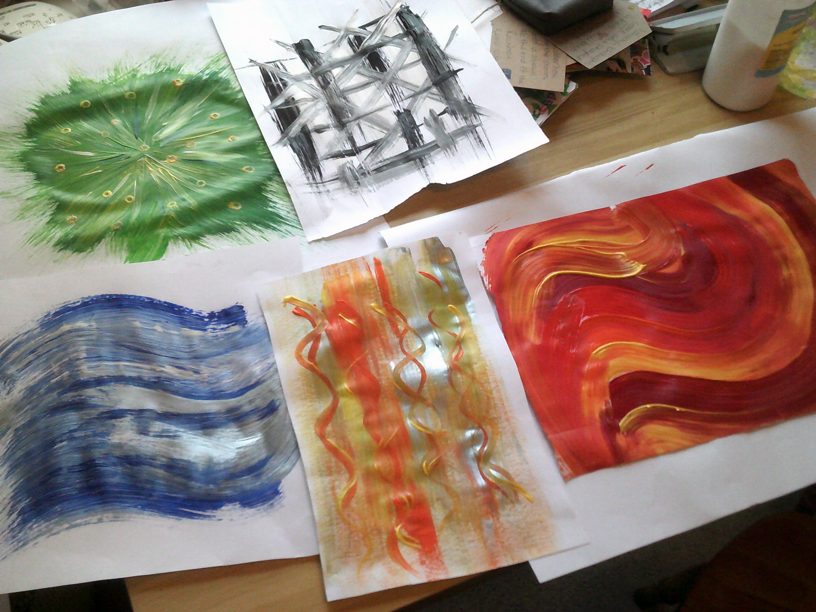
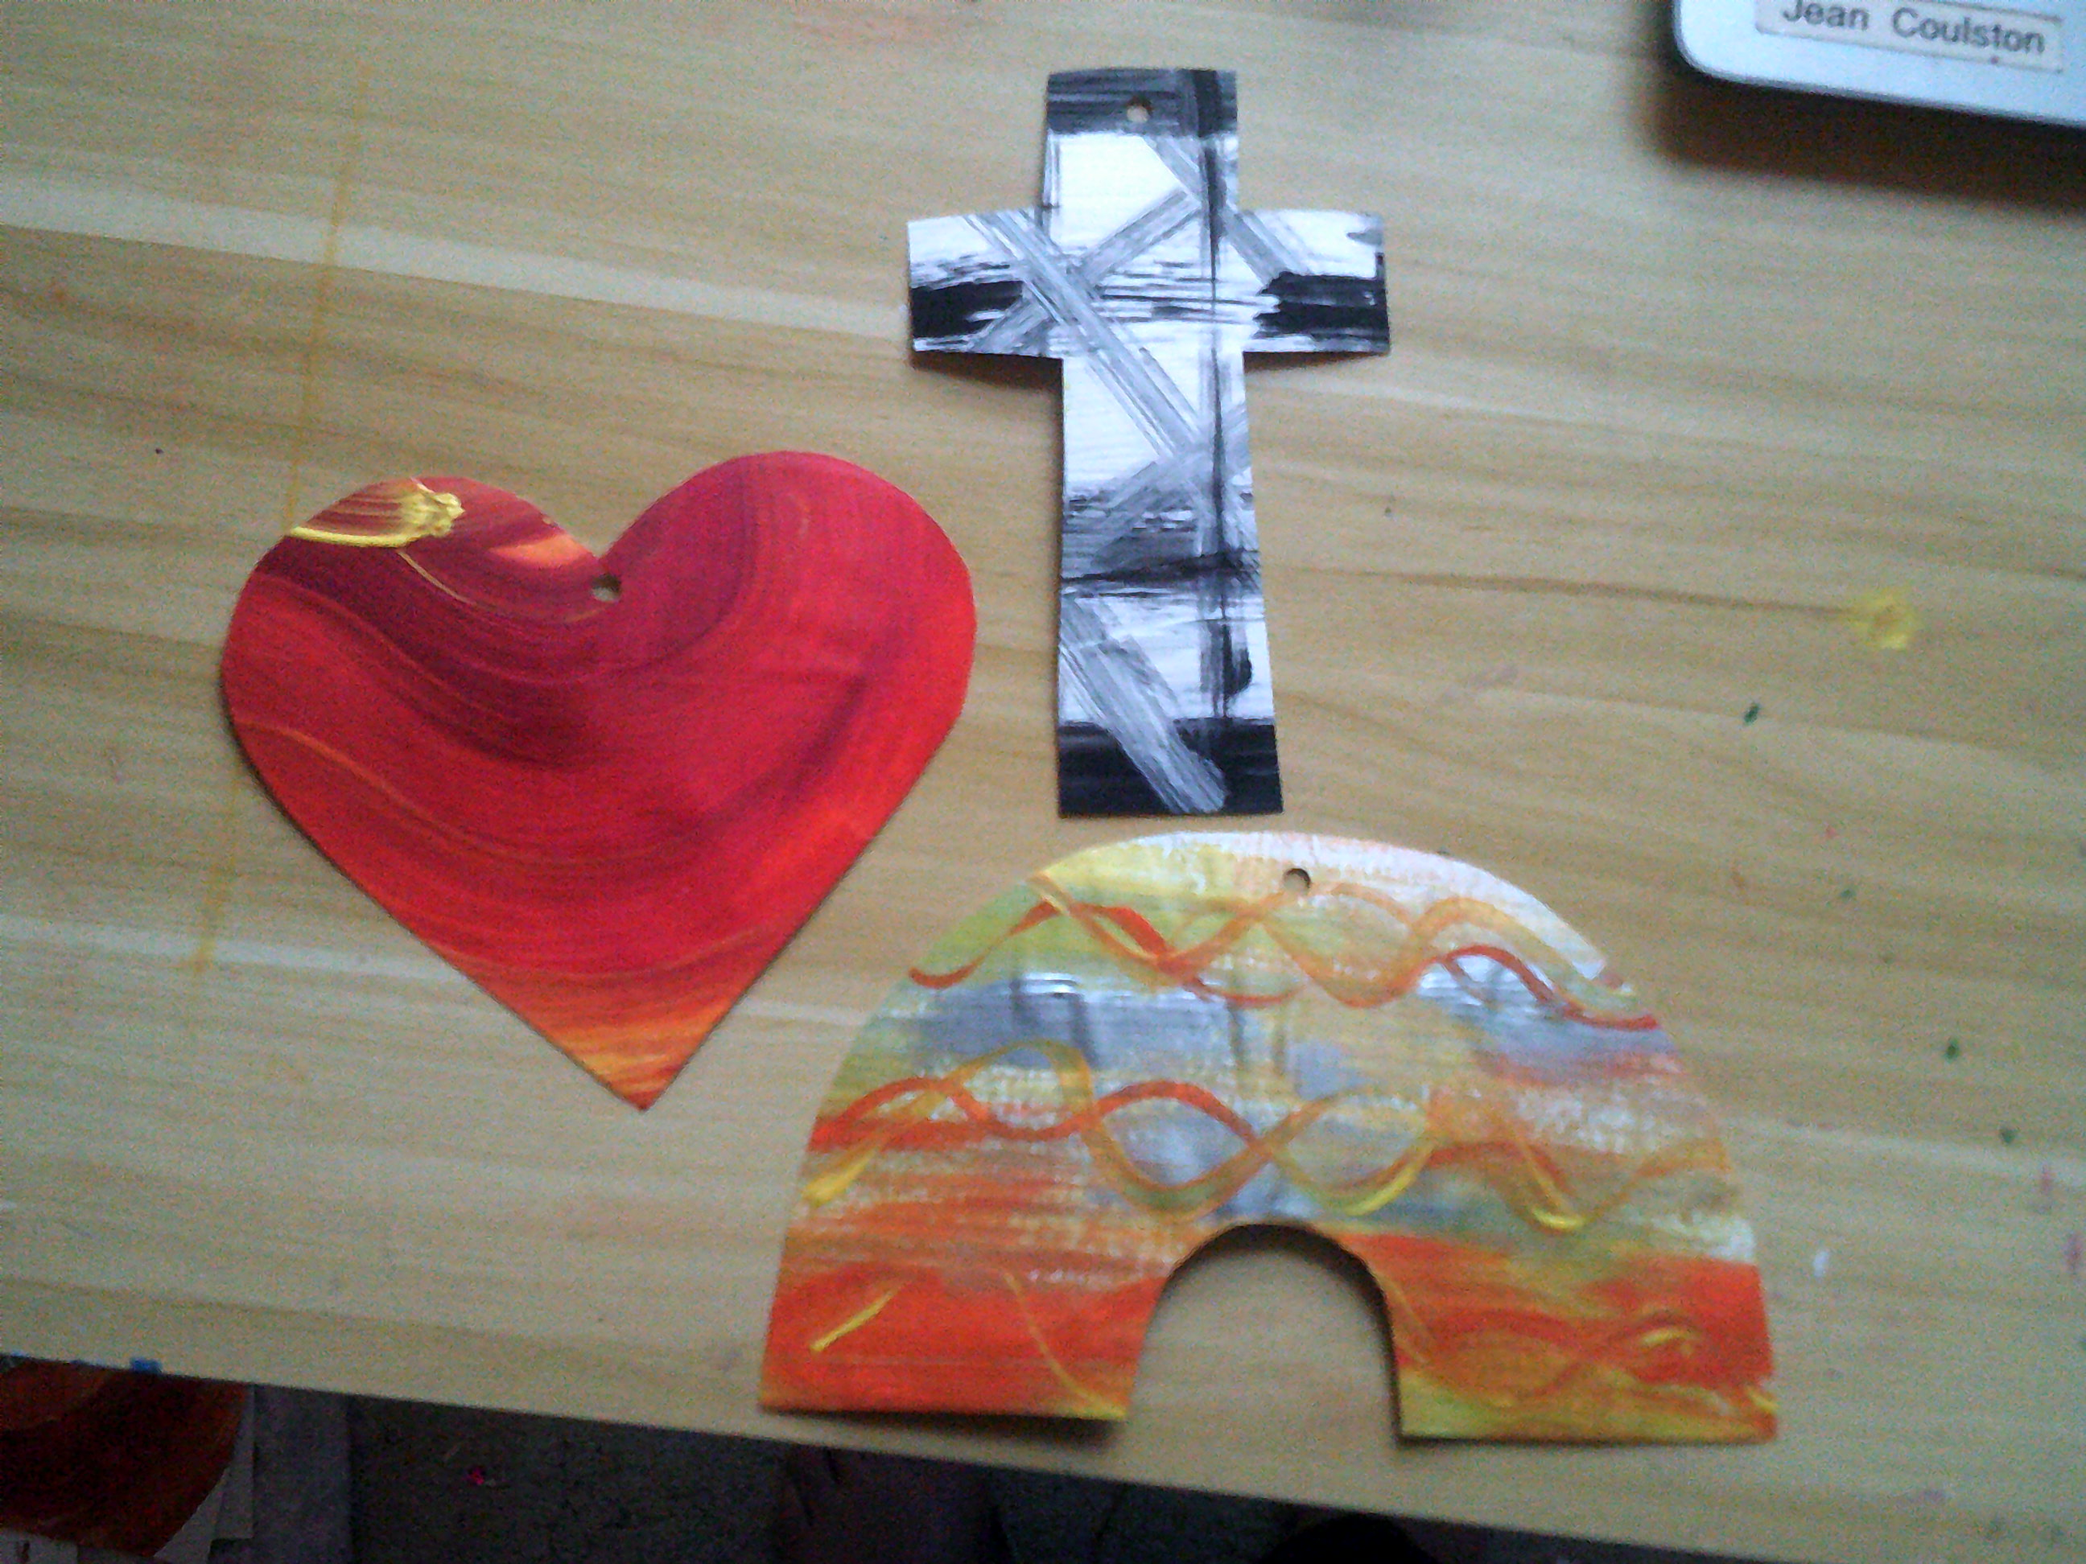
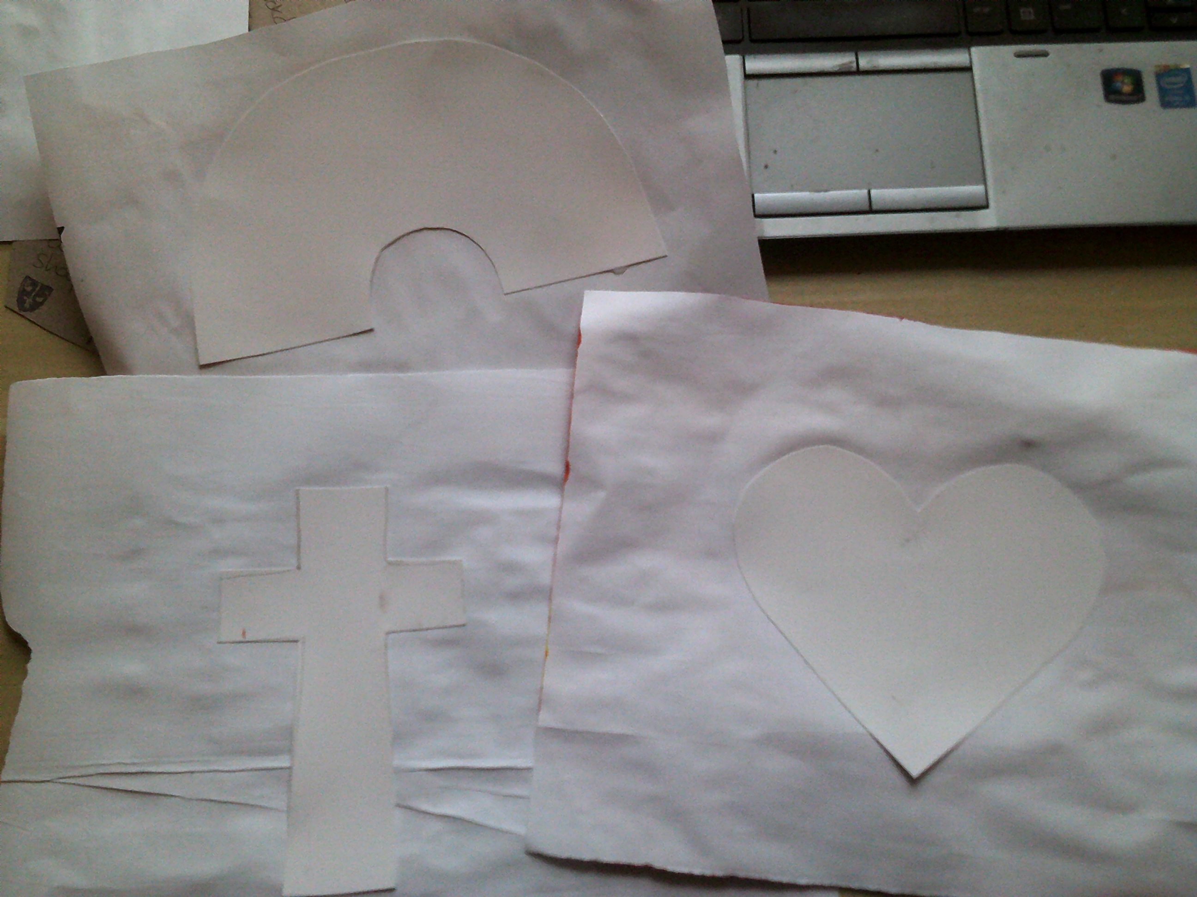
To decorate your symbol – create patterns by making marks with paint on paper. Use different brushes and tools, (or use any other media to create patterns and marks on paper).
Once the paint is dry choose your favourite part.
Glue the card symbol onto the back of your painting.
Cut around the shape neatly.

Slide 5
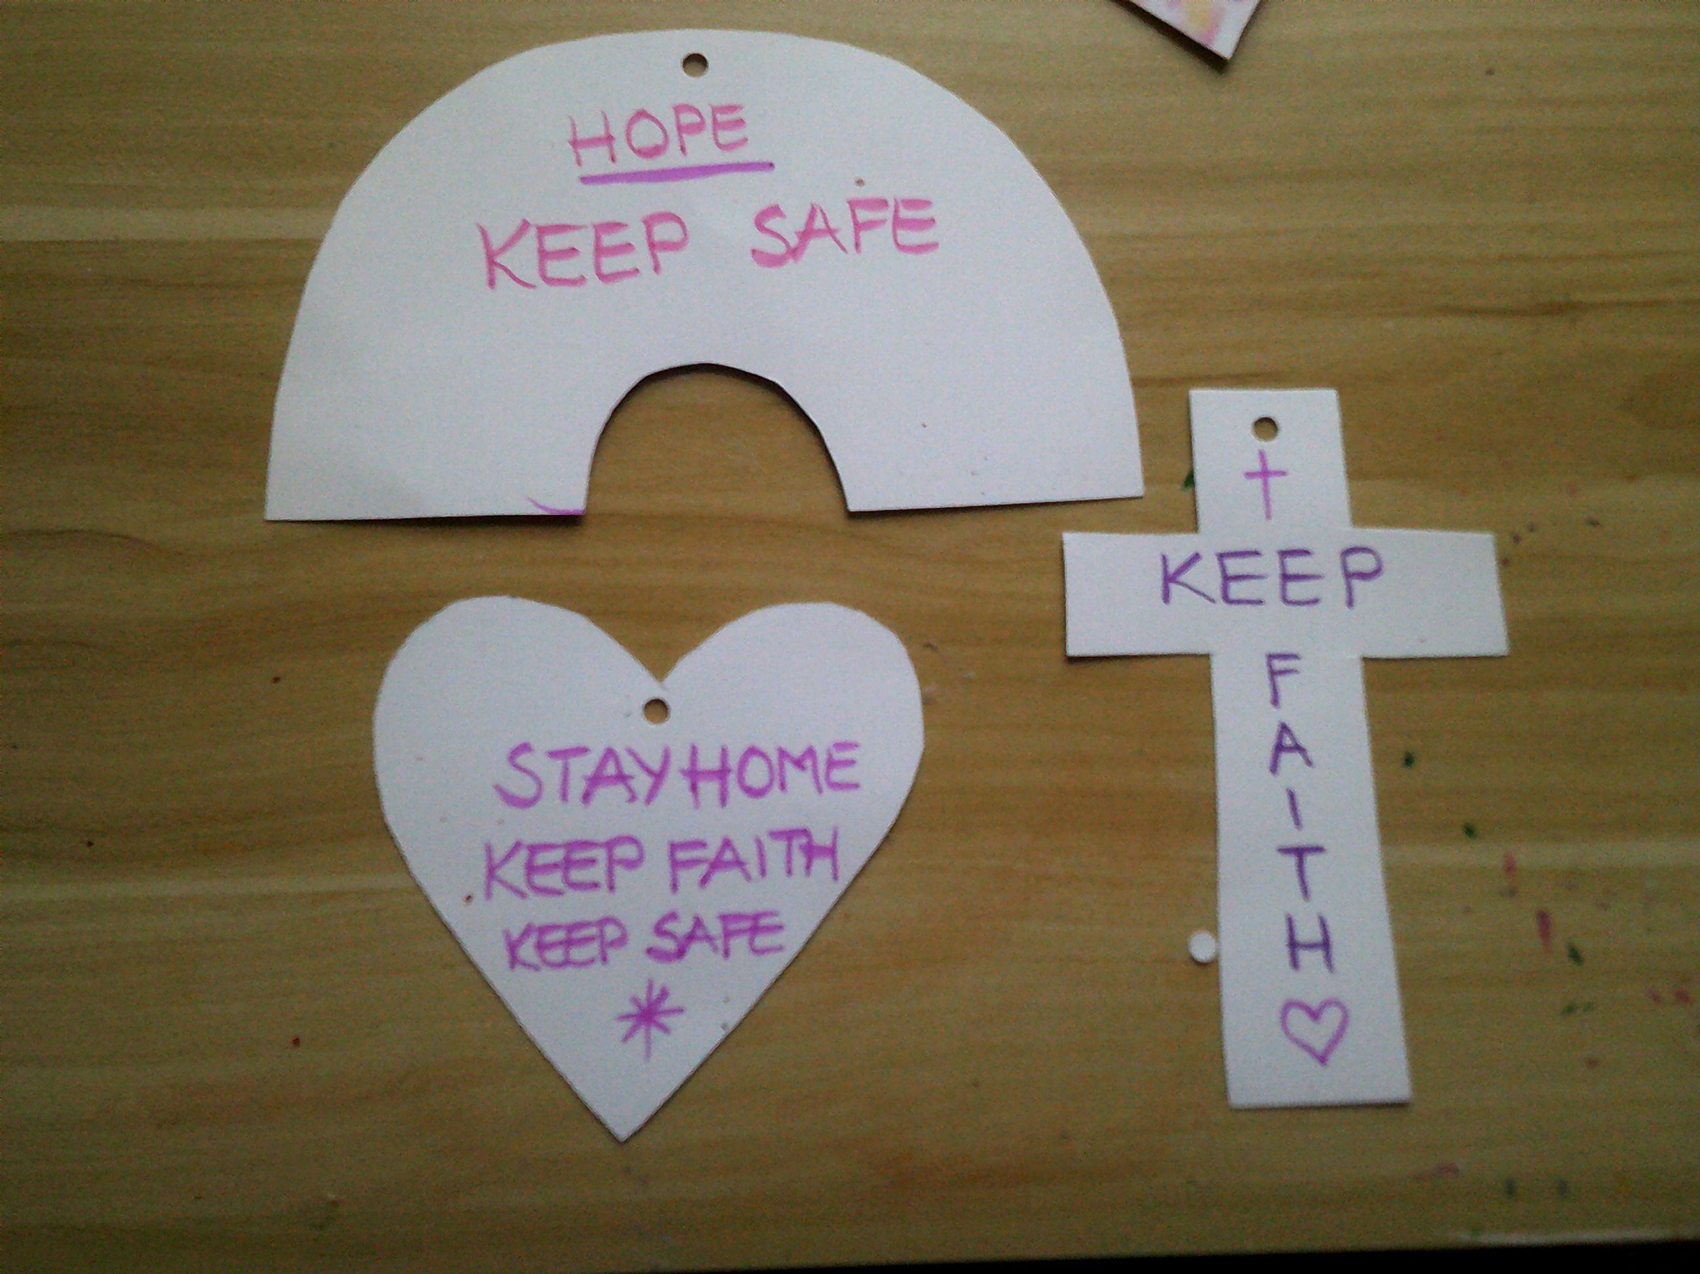
Once the glue is dry use a felt tip pen or pencil crayon to write on a message:
Keep Faith, Keep Safe, Stay Home.
Write one phrase, if they will not all fit!

Slide 6
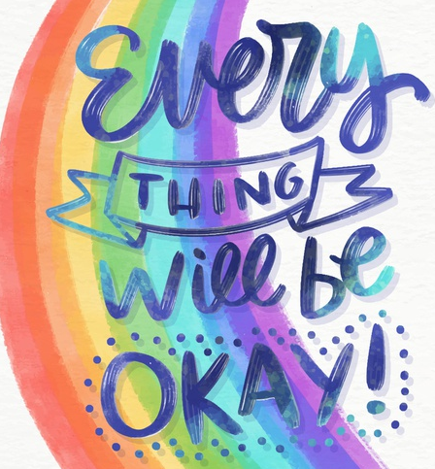
Now make a tag to add to your symbol.
On the tag write a longer message to say you are thinking about the person who will receive the ‘gift’ and that you hope they are happy and well.

Slide 7
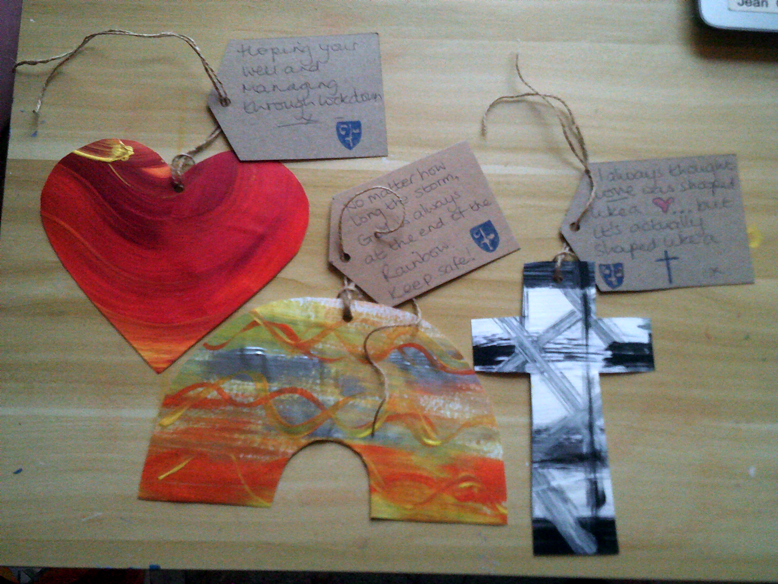
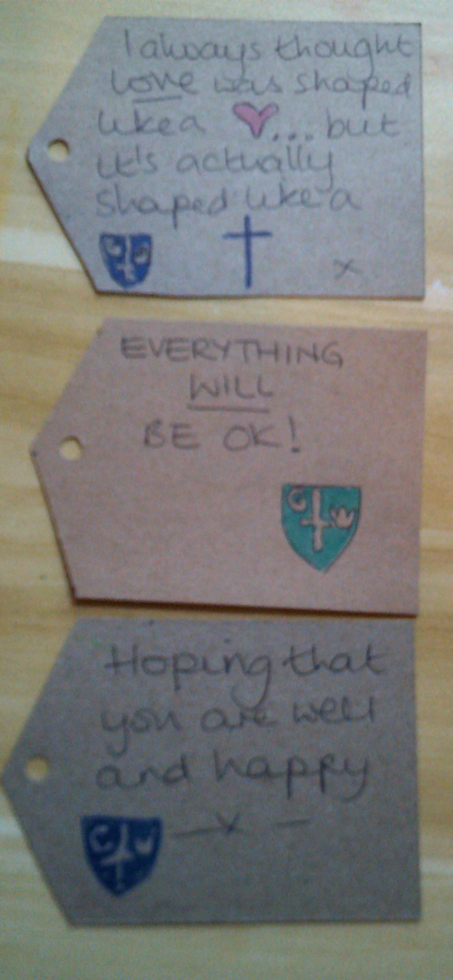
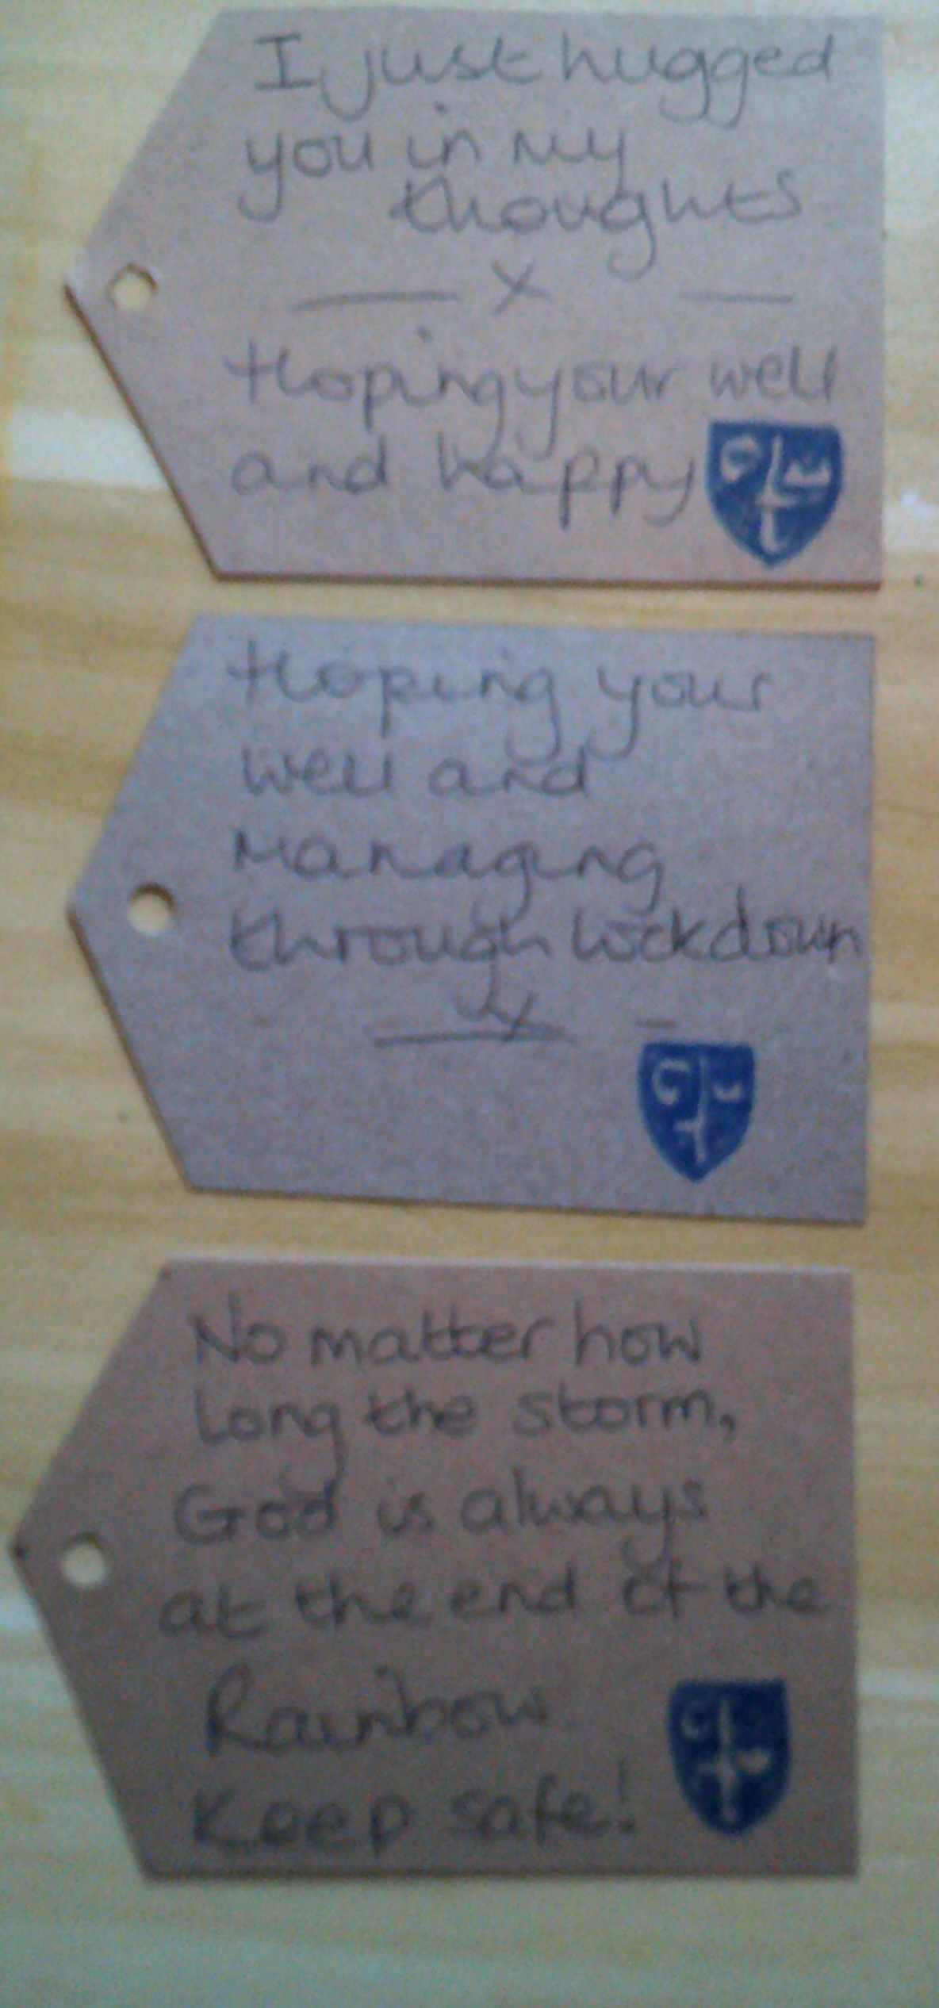
Please do not write your name but remember to draw our school badge on the label.
Finally send your gift to a family member you haven’t seen for a while, or somebody in your road who is alone, or could be worried and needs cheering up!
Before you send your gift, please send a photo to me via seesaw.
Thank you,
Mrs Coulston

