Slide 1
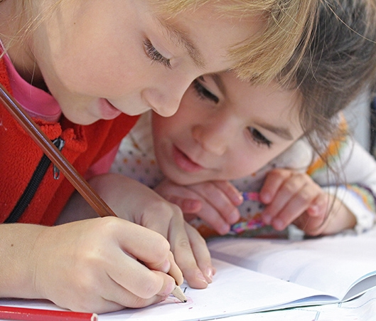
PSHE
Year
5
Mental health week

Slide 2
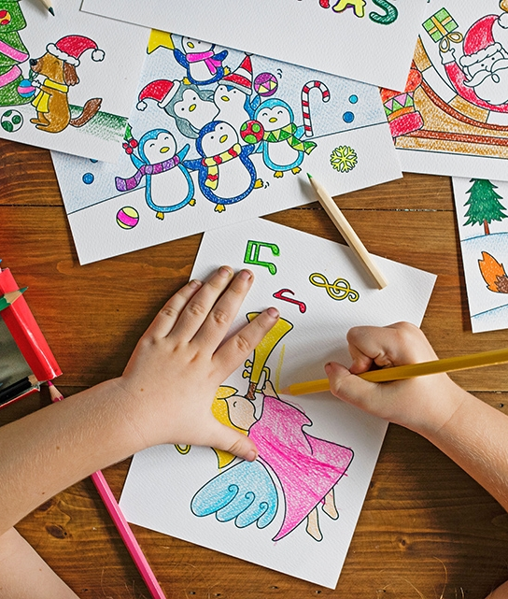
Mental health week
Thursday 4th February
This week, we will be spending 2 lessons thinking about the important of our mental health. During lockdown, our mental health has been affected massively.
Spending time to get creative and allowing us to have time to enjoy something we love doing is great to keep us mentally active.

Slide 3
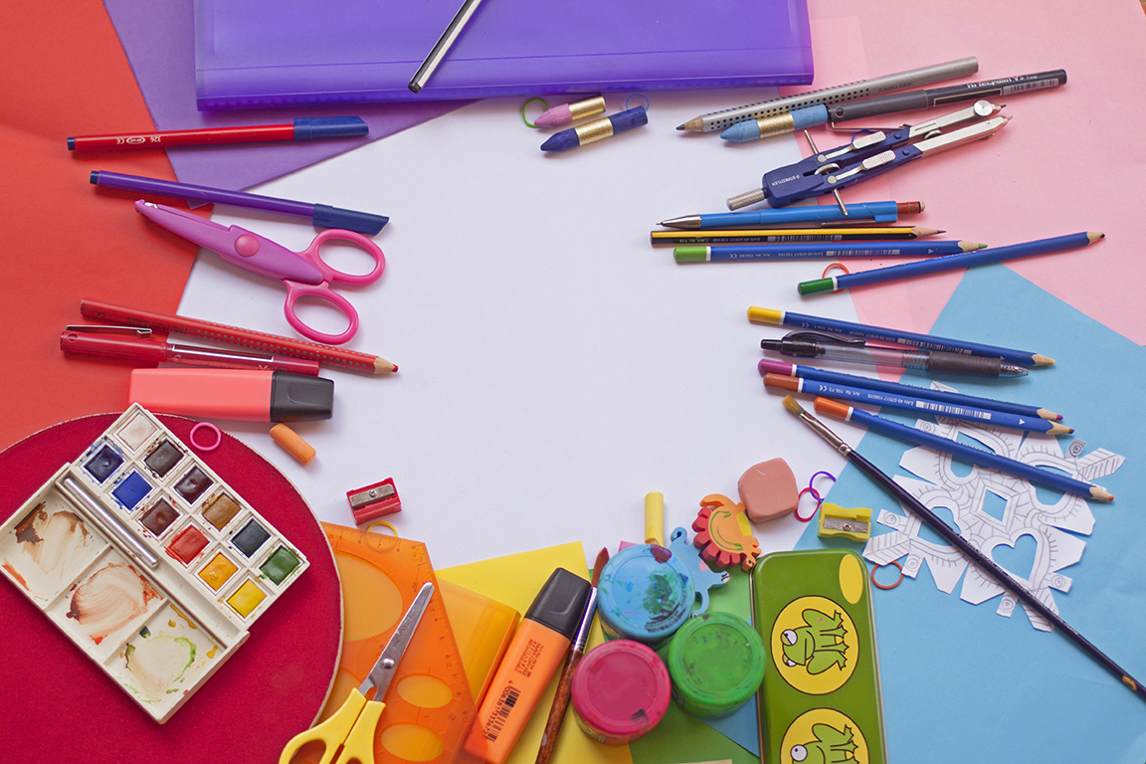
Activities
On the school website for this week’s home learning, I have attached a link to the school webpage that has a page for ‘Mental Health Week.’

Slide 4
Thursday activities
What is self- expression
This is about talking about yourself. This can be done not only through words, also through clothes, hairstyles. Also, through writing, drawing, creativity, music and dance.
Expressing yourself can allow to show your true self, talk about how you are feeling, share your thoughts and feelings.
Follow the link on our school webpage for more ideas about self-expression.

Slide 5
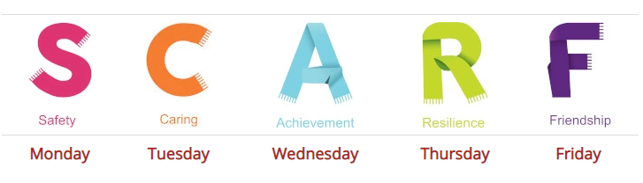
Creative time!
https://www.coramlifeeducation.org.uk/scarf-at-home-keeping-happy-and-healthy-during-lockdown-share-your-scarf-special
Click on the link and you will find an activity for Thursday
The letter today is ‘R’, which stands for ‘Resilience’
You will write around the letter all the different ways to be kind and caring.

Slide 6
Resilience
Resilience- The capability to recover quickly from difficulties; toughness.
In school, we face many difficulties throughout our learning and it is not always easy to recover quickly from them. For example, if we struggle with a piece of Maths work, we learn to understand that we are worthy and capable of overcoming challenges and we do not give up on trying our hardest.

Slide 7
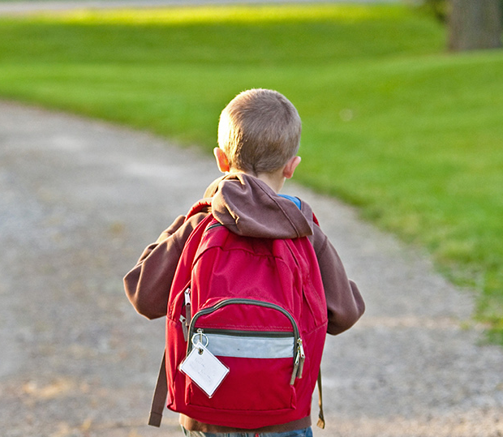
Have fun getting creative!
Make sure to send me photos on seesaw!

