Slide 1
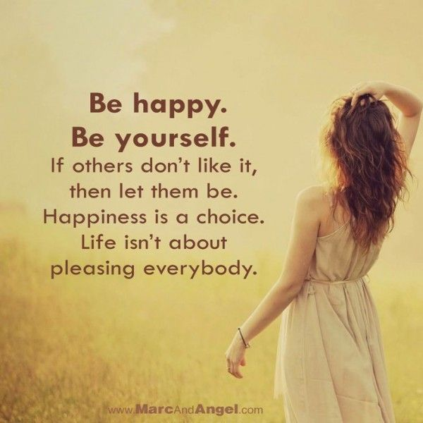
Children’s mental health week
Year 6 PSHE 5th February 2021
Question: What makes you happy? Make a list of as many things you can think of.

Slide 2
Where is your happy place?
https://www.youtube.com/watch?v=5dUhuK7TfUc
Your happy place is your favourite place
It is a place you feel safe
It makes you feel positive
When times are tough it is the place you think of in your head
When you feel sad it is the place that reminds you of happy times
If you are scared this place will help you feel safe
Where is this place for you?

Slide 3
Where are the teachers’ happy places?
Mrs Wilcock – Alderney (Corblet’s Bay) – on a balcony drinking tea
Mrs Coulston – Craft room at home
Mr Fletcher – on the football pitch
Miss Cross – by a river or the sea with my friends
Mr Booth – in a pool on holiday

Slide 4
ACTIVITY
At the moment, many of us cannot actually visit our happy place, or maybe not as much as we would like.
So we need to visualise and remember this place to help us get though tough times.
Activity
Because we cannot go to our happy place, we are going to draw and colour a picture of the place on plain paper.
Take a photo of your happy place drawing and upload it to Seesaw. Then write an explanation including where and why you have chosen this place (you can video record this if you like).
Then stick you happy place drawing up somewhere you can see it, like your bedroom, so whenever you are feeling sad, anxious or angry, you can see your happy place and it will help keep you positive!

