Slide 1
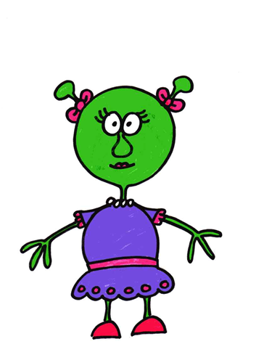
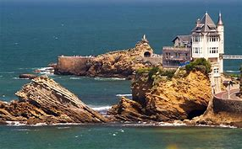
Bonjour!
The French adventures of “Bia Ritz”.
“Bia Ritz”
Biarritz

Slide 2
Inside a sports shop
Hey Folks,
Bia Ritz, the alien here.
Today I want to buy some new sports equipment.
Let’s go take a look.
I thought the shop was familiar.
Do you guys recognise it?

Slide 3
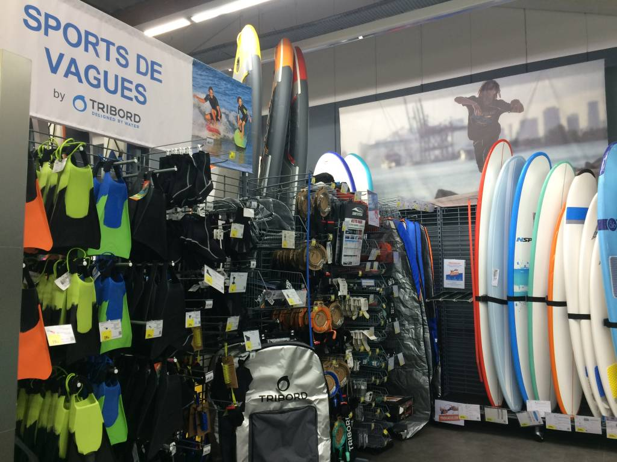
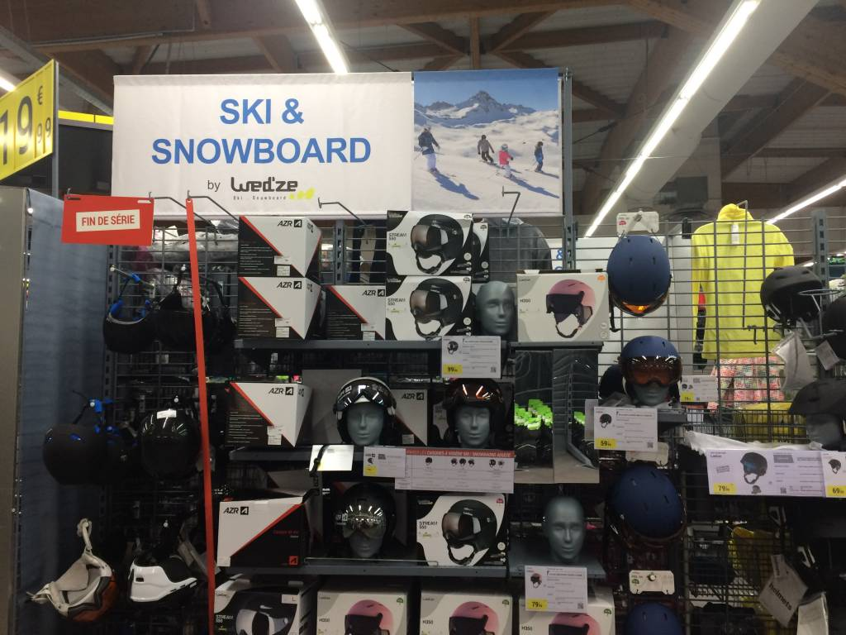
Where might you do these sports?

Slide 4
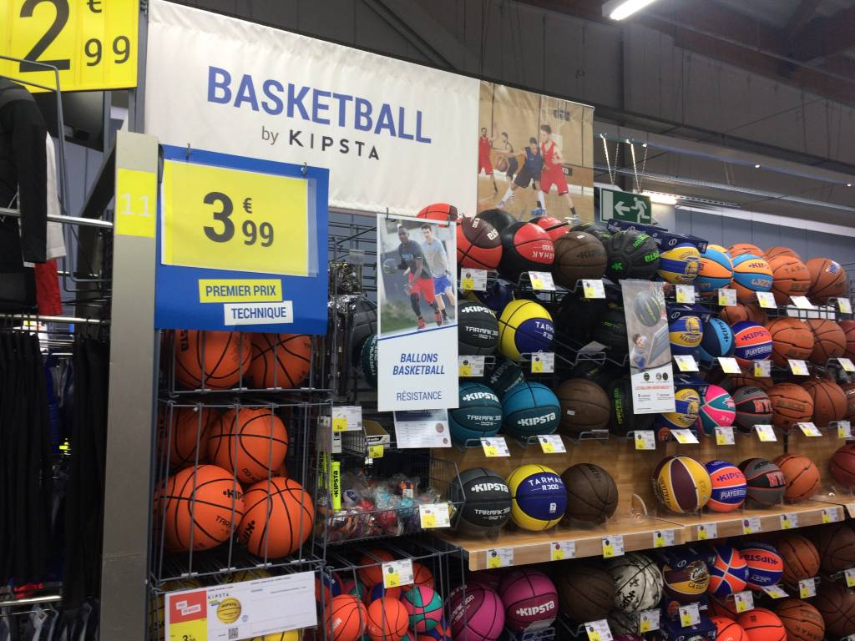
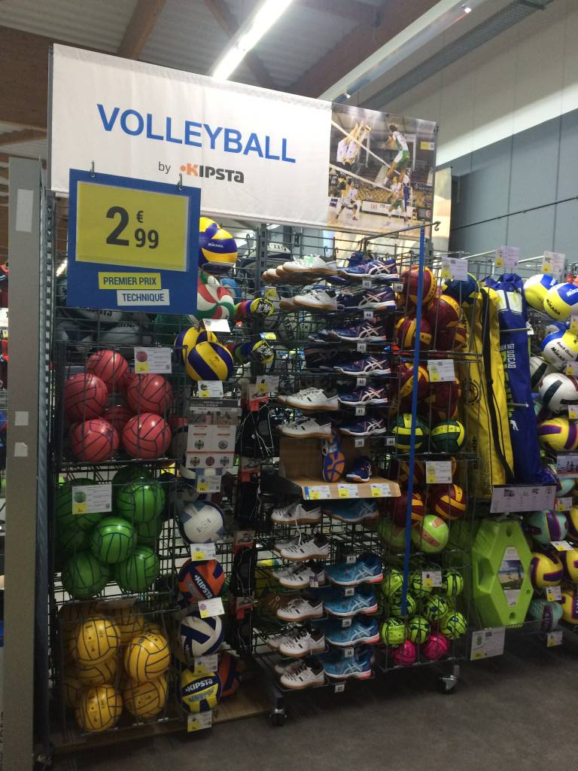
Can you identify these sports?

Slide 5
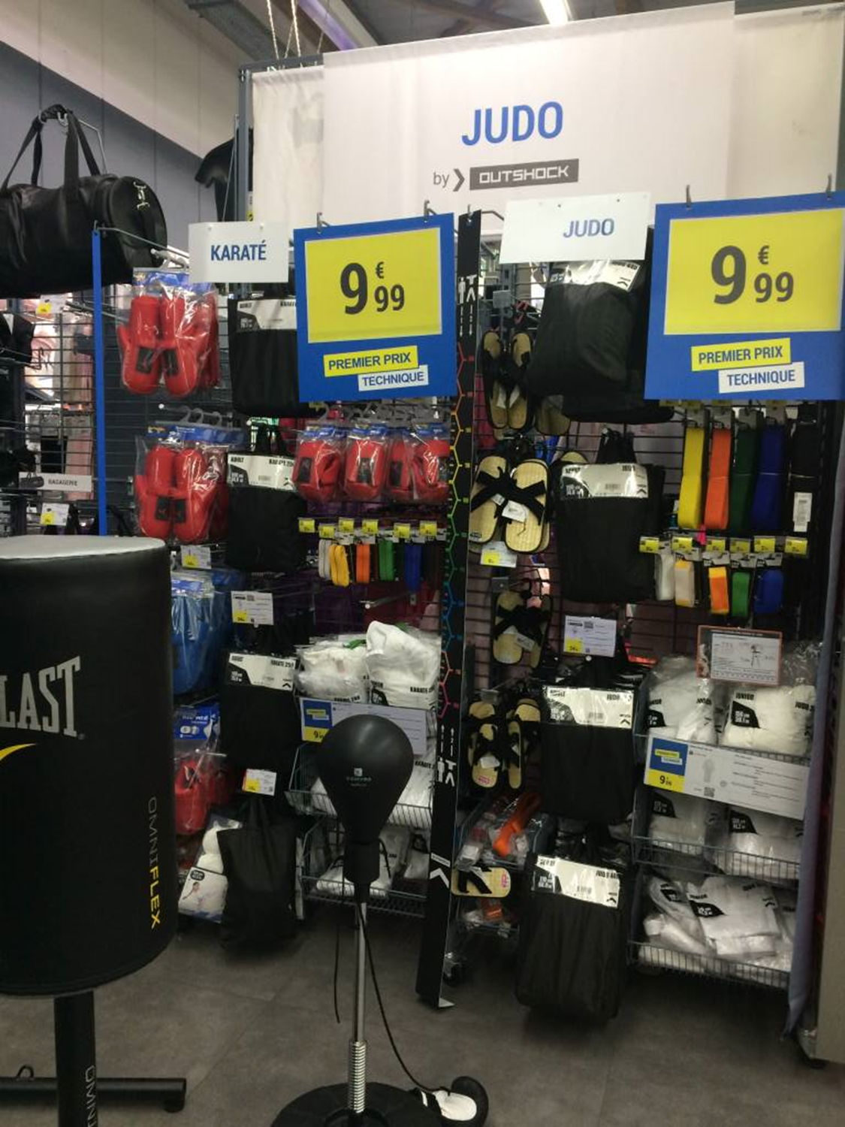
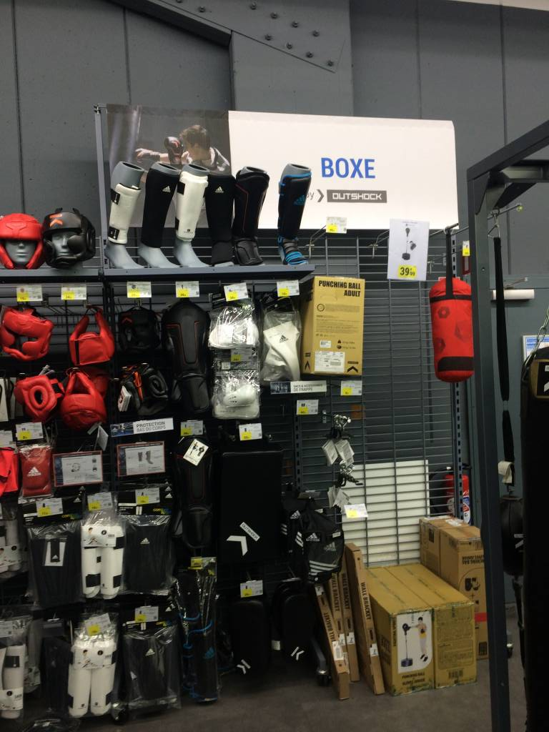
Do you know someone who would buy items for these sports? (They can be famous people.)

Slide 6
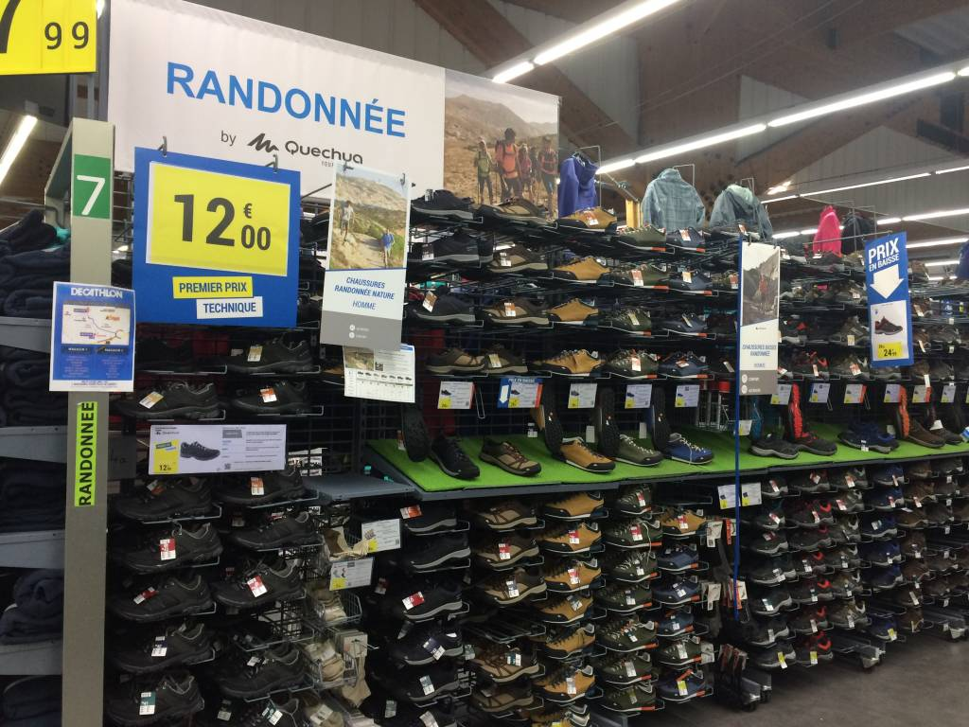
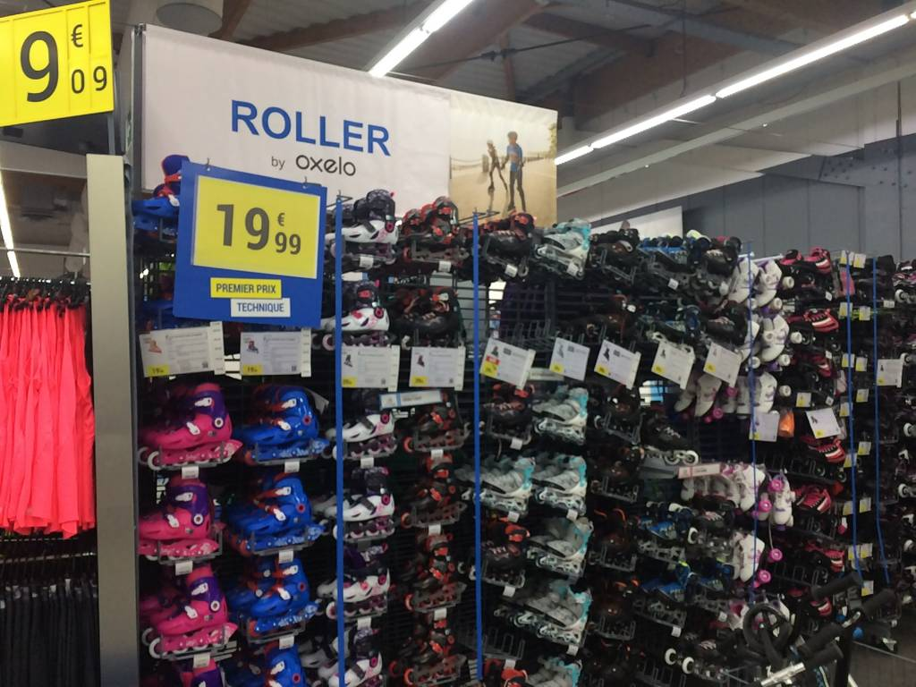
What is being sold here? Do you think you could read and say the nouns just like a French person?

Slide 7
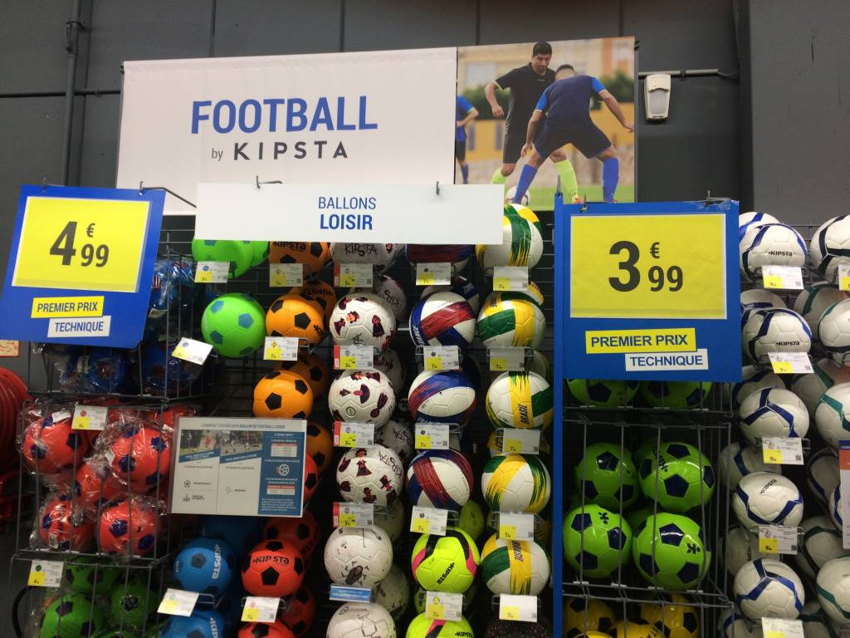
Which of these is your favourite sport?

Slide 8
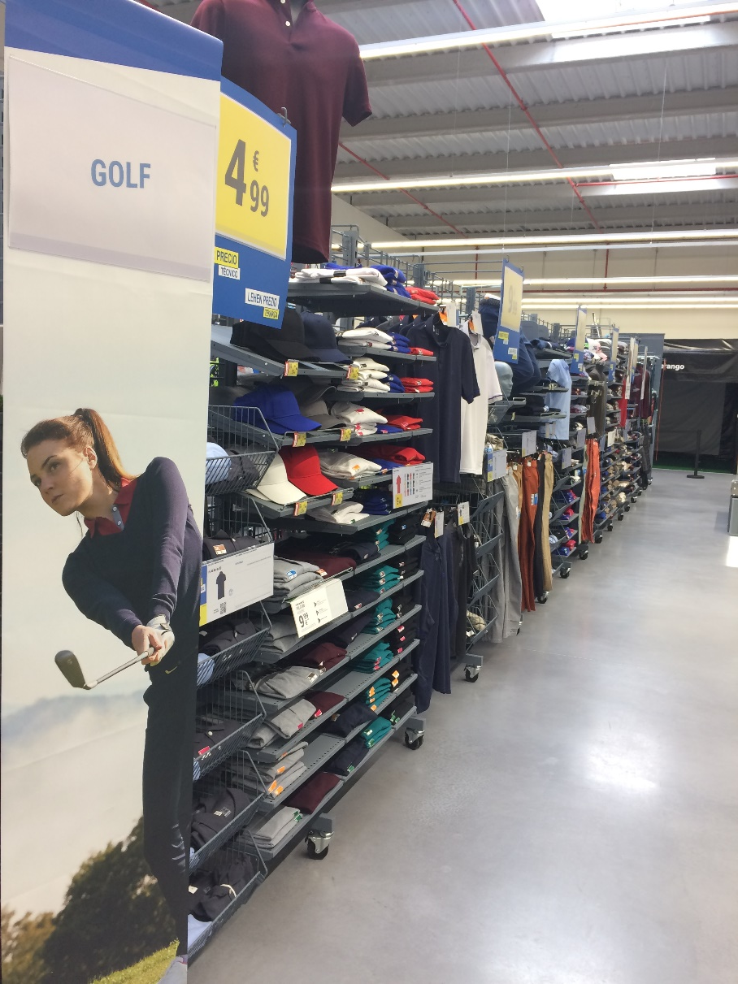
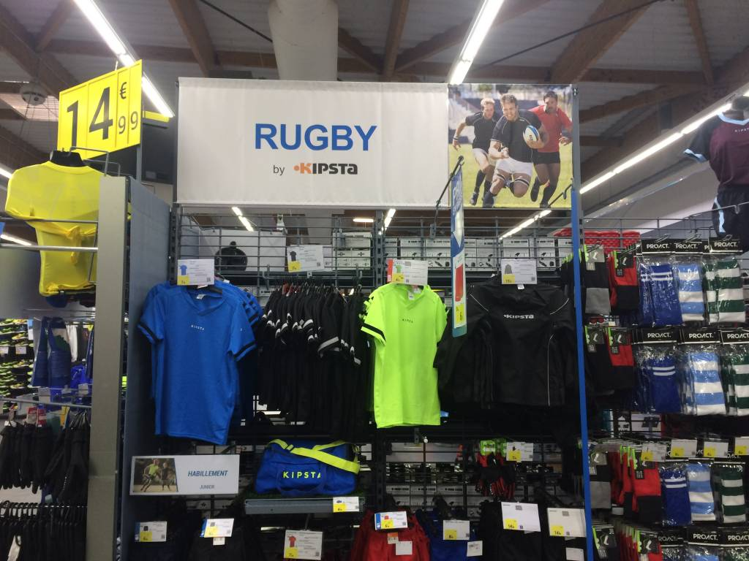
What is similar to English about how you say and write these sports in French?

Slide 9
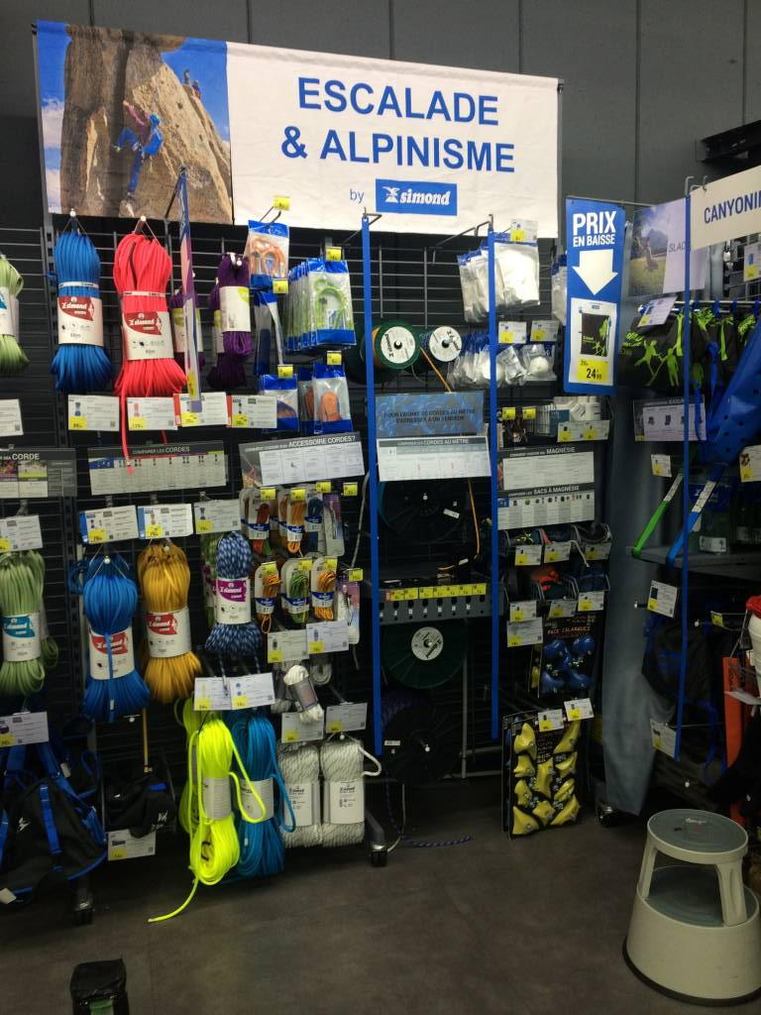
Can you describe in English what do you do in this sport?

Slide 10
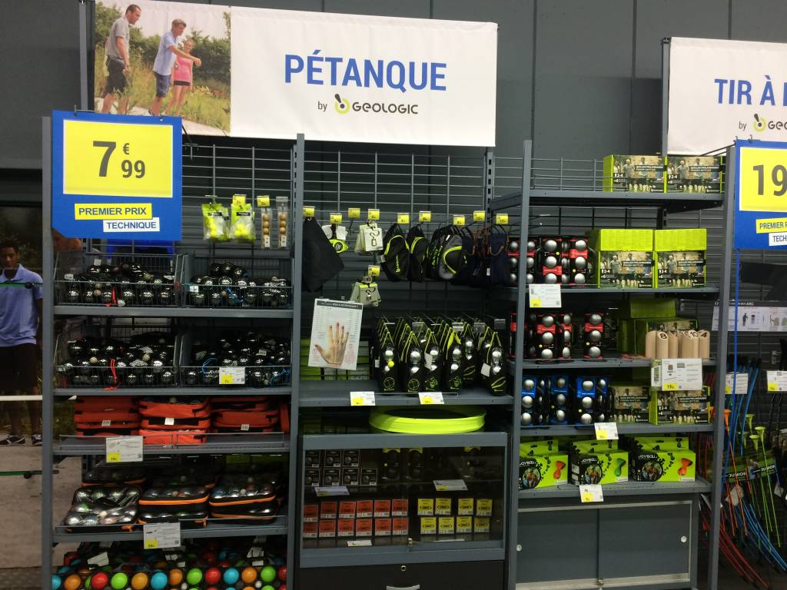
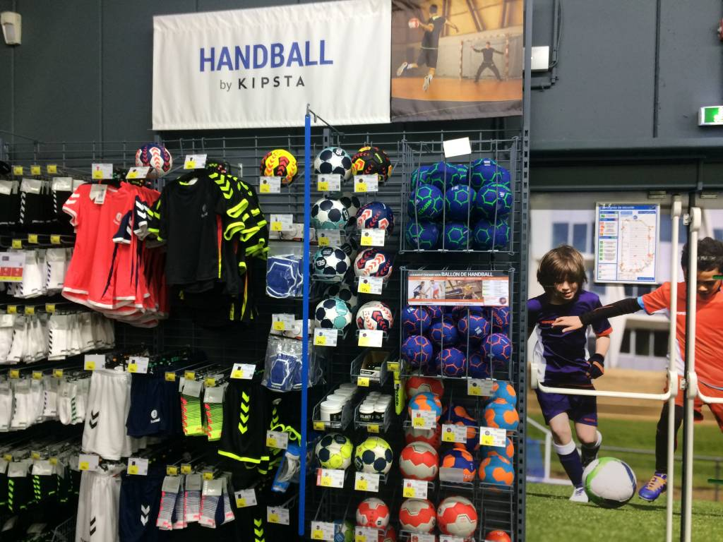
Which one of these would you like to play on a beach?
Why?

Slide 11
The sports shop have asked me to design a poster for them, I need to advertise all the sports equipment they have in the shop,
They need it to be colourful, carefully made and with French words so the customers can understand.
You must help me out and create it for me?

Slide 12
That’s all from me.
Au revoir.

