Slide 1
Jesus the man who changed lives
Lesson 3

Slide 2
Listen to the story of Zacchaeus from the Lions Story Teller Bible from the link on the website – hopefully this time it will work!

Slide 3
If you want to you can also watch this video again to hear a modern version of the story
https://www.youtube.com/watch?v=DdOSWhqQwhw

Slide 4
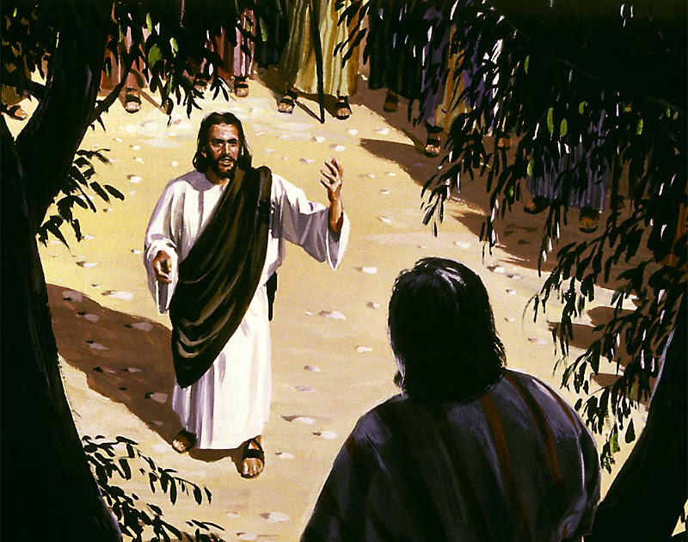
In your own words retell the story aloud to yourself or someone else.

Slide 5
What challenges do you think Zacchaeus would have faced following Jesus?

Slide 6
Let's pretend we are Zacchaeus. You are going to write a letter to a friend explaining what happened (using the story from the Bible) and how you, as Zacchaeus, have changed.

Slide 7
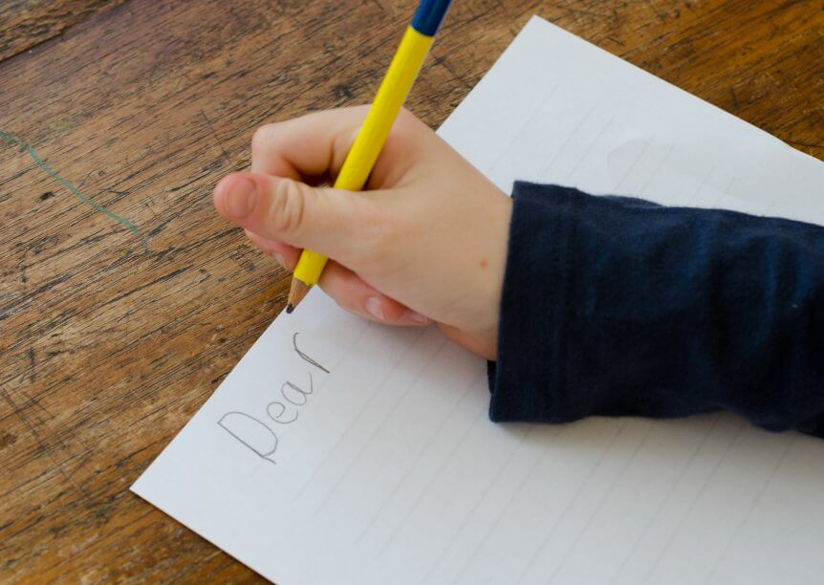
Have a look at a modelled piece of writing which I have started for you. You MUST NOT have this writing in front of you when you write your letter, it is to give you ideas only, not to be copied.

Slide 8
Dear Matthew, I am writing to apologise and return all the money I have stolen from you over the years. This might come as a shock to you, because I know that many people believe I am a mean, greedy tax collector. Amazingly, I have changed. A few days ago, Jesus came to my house for tea ( I was shocked that he picked my house).

Slide 9
Over tea we discussed my appalling behaviour to other people and how I had stolen money from everyone in the village. Jesus changed my life, he showed me how God loves and cares for me, he forgave me and allowed me to change my life. Jesus changed my life by showing me forgiveness and love, I am now a different character, I am warm hearted, generous and caring. To show that I have changed I…

Slide 10
Structure of your letter: Dear… (choose a friends’ name) Paragraph 1: Tell your friend why you are writing Paragraph 2: Explain how Jesus came to your house and you have changed. Paragraph 3: How will you show that you have changed? Sign your name

Slide 11
Success criteria – keep this in front of you as you write. 1. Use the structure I outlined on the previous slide. 2. Write neatly with a pencil (unless you have a pen licence) and join your writing. 3. Use capital letters, full stops and clear word spacing. 4. Think carefully about your word choice in each sentence before you write it down, try to wow us. 5. Read back and check your work for mistakes and correct any you find.

Slide 12
Put a photo of your work on seesaw so we can see your fantastic letters.

