Slide 2
Aim
To divide a 2 digit number by 1 digit

Slide 3
Divide 2 Digits by 1 Digit
Diving
Billy used base ten blocks to calculate 48 ÷ 2.
48 ÷ 2 = 24
Write and solve the calculation shown in this representation.
62 ÷ 2 = 31

Slide 4
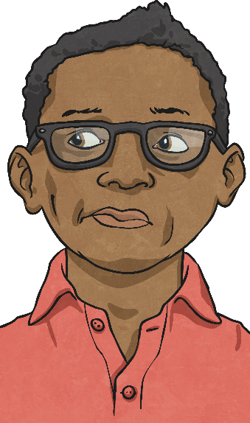
Divide 2 Digits by 1 Digit
Deeper
Roger has used a place value grid to represent a division calculation.
Do you agree? Explain your reasons.
Tens | Ones
10
10
1
1
1
My model shows 23 ÷ 3.
10
10
1
1
1
10
10
1
1
1
Roger is not correct. His model shows 69 ÷ 3 = 23.

Slide 5
Divide 2 Digits by 1 Digit
Deeper
Marisa says “The answer to 84 ÷ 4 is smaller than the answer to 84 ÷ 2 because the divisor is smaller.
Do you agree? Explain your reasons.
Tens | Ones
Tens | Ones
10
10
1
10
10
10
10
1
1
10
10
1
10
10
10
10
1
1
10
10
1
10
10
1
Marisa is not correct. Increasing the size of the divisor will decrease the size of the answer if the dividend remains the same.
The representations show 84 ÷ 4 = 21 and 84 ÷ 2 = 42. When the divisor is smaller, the answer is greater.

Slide 6
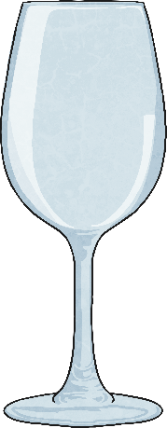
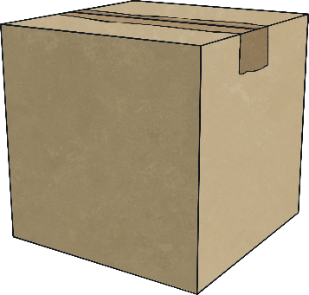
Divide 2 Digits by 1 Digit
Deepest
Lyra has some glasses to pack into boxes. She estimates there are between 80 and 90 glasses.
If she shares the glasses into four boxes, she has none left over.
How many glasses could she have?
Tens | Ones
Tens | Ones
Tens | Ones
10
10
10
10
1
10
10
1
1
10
10
10
10
1
10
10
1
1
10
10
10
10
1
10
10
1
1
10
10
10
10
1
10
10
1
1
There could be 80 glasses altogether.
There could be 84 glasses altogether.
There could be 88 glasses altogether.

Slide 7
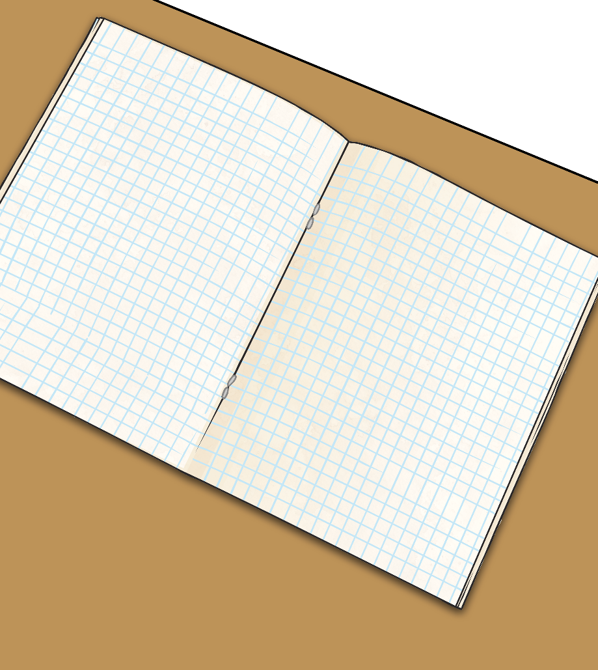
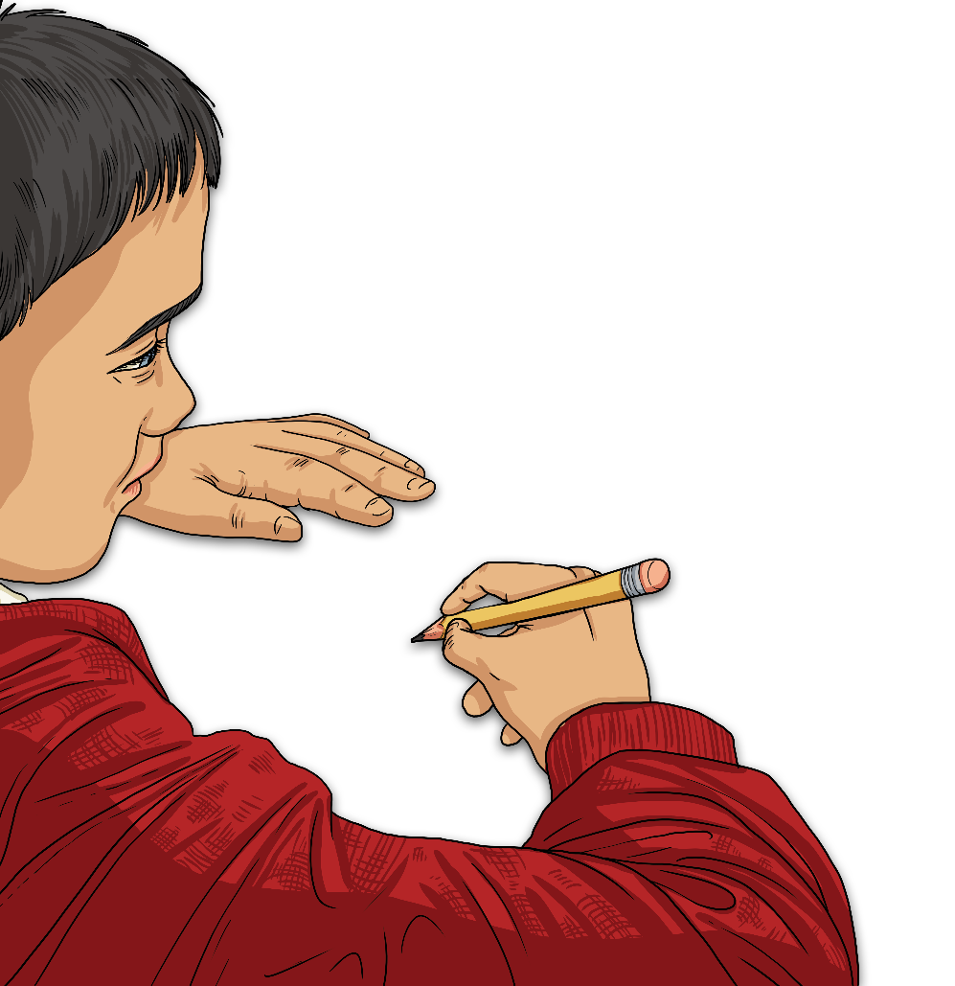
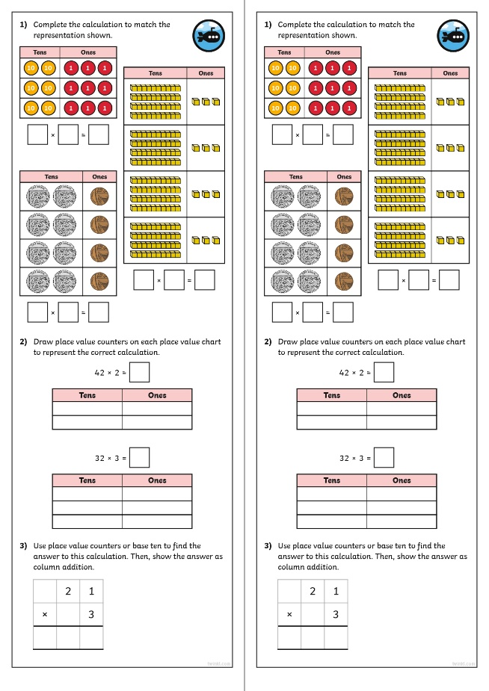
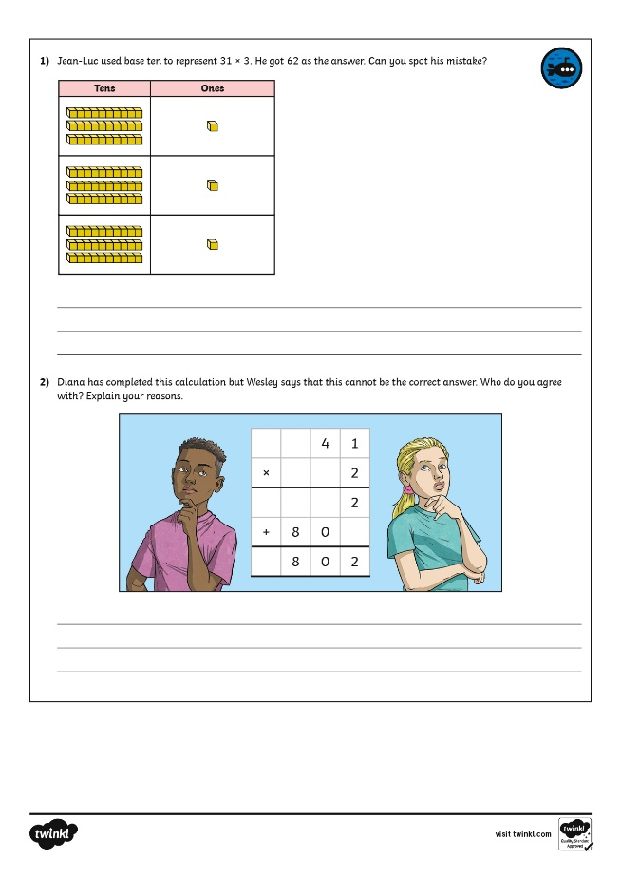
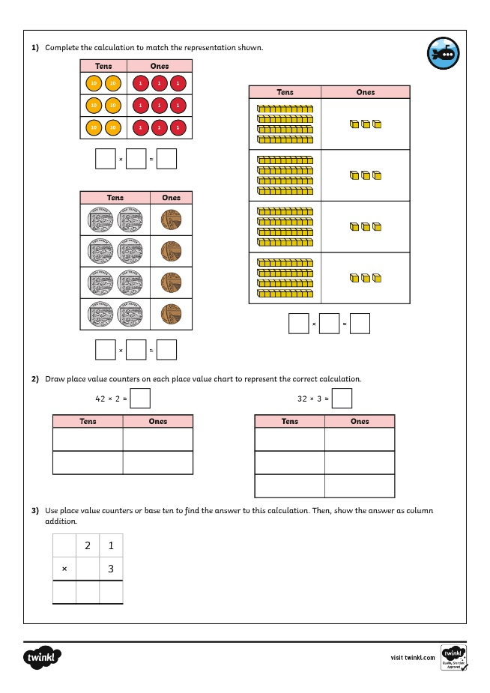
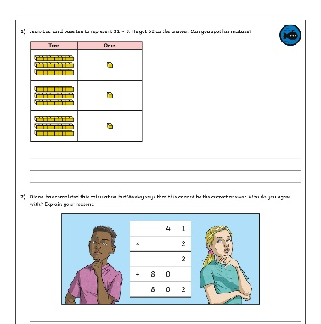
Divide 2 Digits by 1 Digit
Dive in by completing your own activity!

Slide 8
Which work should you do? Circles – separate work on the website. Squares, Hexagons and Pentagons, try to do sheet 1 and 2, but just do 30 – 40 minutes at the most then stop. Octagons – Try all of the sheets, so how far you can get in 30 – 40 minutes All groups – draw base ten or a place value grid to help you.

