Slide 1
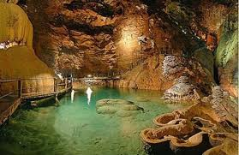
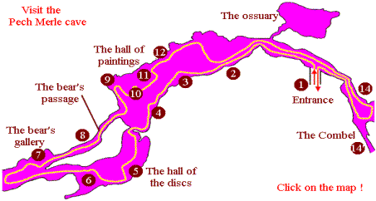
Hello Year 3
Our Artwork this week links to our topic about The Stone Age.
Last week you created fantastic drawings of fossils
using shading pencils, charcoal and chalk.
This week in school, we are using chalk pastels and charcoal,
but you can use any media you have at home – pencils, crayons, paint etc.
Pech Merle Cave Paintings
France (high hill)
Look at the following
images of cave paintings
found in underground
caves in France.
.

Slide 2
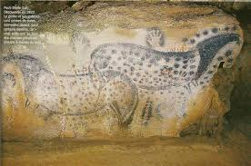
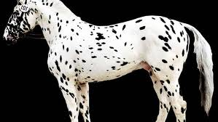
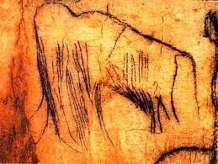
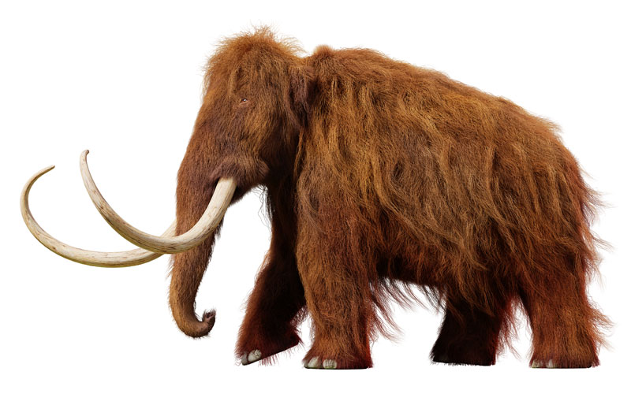
Can you identify these animals?

Slide 3
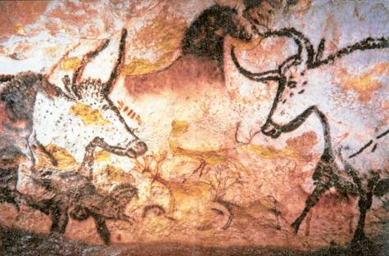
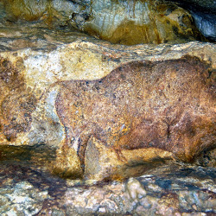
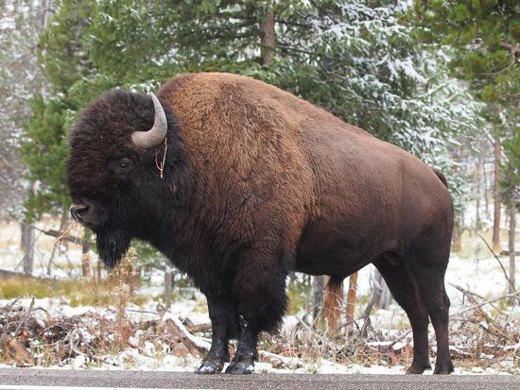
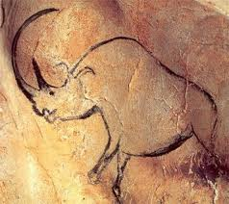
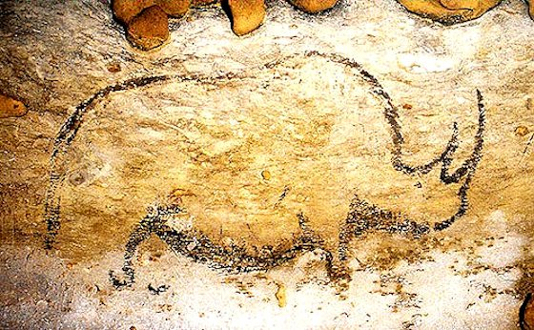
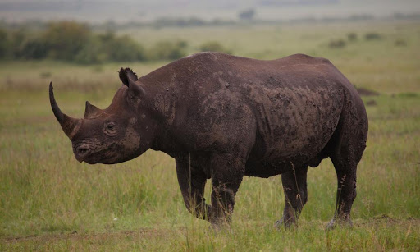

Slide 4
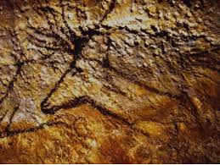
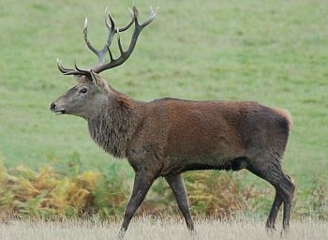
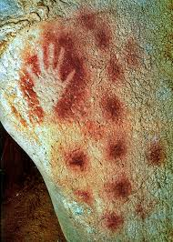
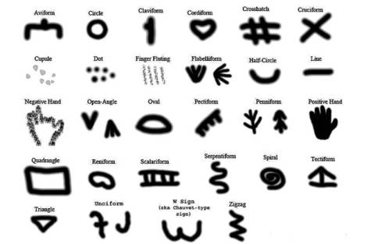
Besides drawing animals on the cave walls, Stone Age people also made hand prints and created symbols.

Slide 5
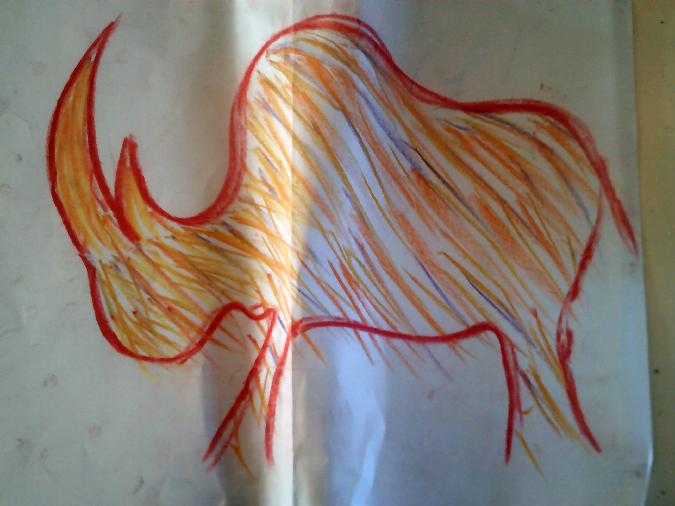
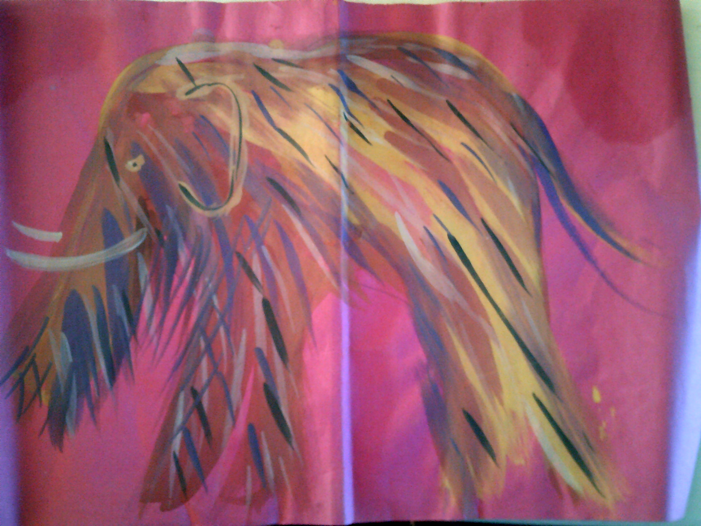
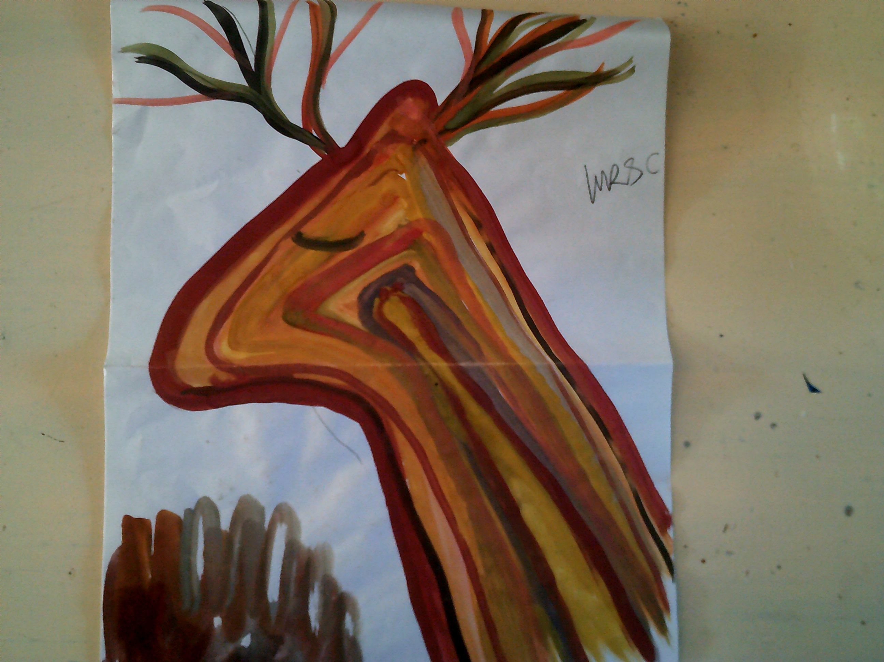
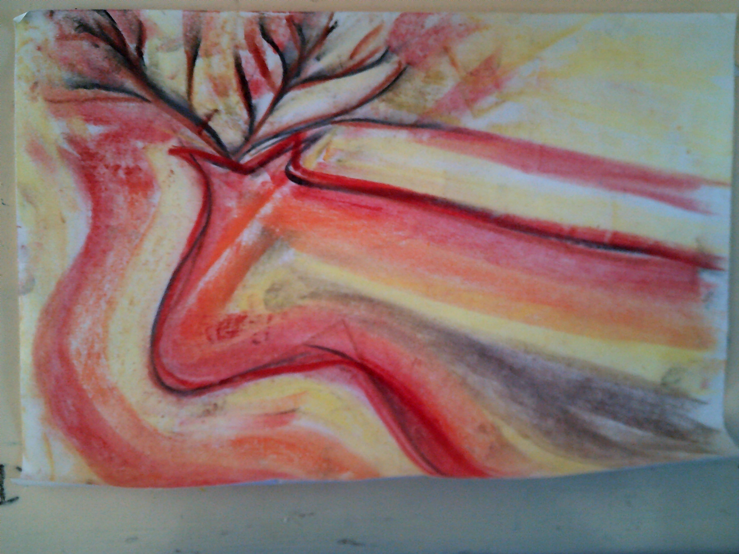
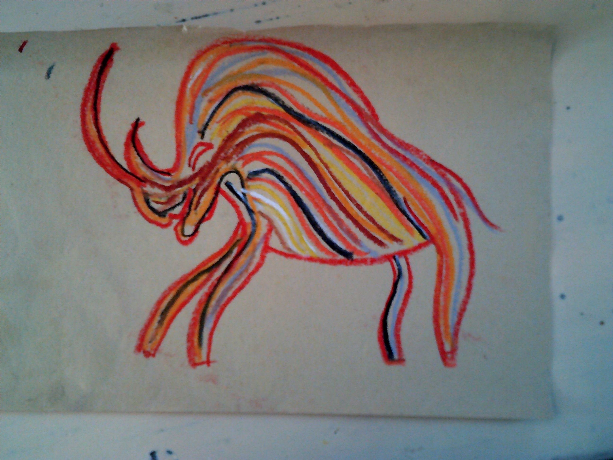
I can create images of cave paintings
Sketch the shape first, then use simple strokes to create texture and pattern.
Here are my examples – try for yourself.
I’m looking forward to seeing your artwork. Please send a photo to me via Mrs Patterson in the usual way.
Have fun creating your Stone Age images.
Thank you, Mrs Coulston

