Slide 1
January 2021
Hello Year 6.
Our art work this week will link to our RE topic –
Why do Christians Celebrate the Eucharist.
During the Holy Communion service the Vicar performs rituals
which link back to the Jewish festival of
Passover and the Last Supper Jesus ate with his disciples.
We will explore the artwork of artists
and then create our own piece depicting elements of
The Holy Communion

Slide 2
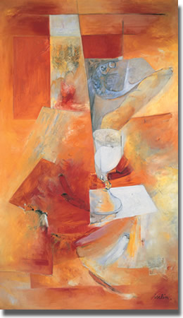
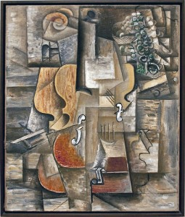
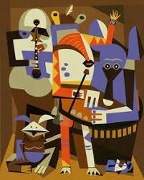
The Elements of the Holy Communion Jacques Iselin (1933- )
Oil 1963 Methodist Collection of Modern Christian Art, No.19
In class we will link this cubist image by Iselin to the work of Picasso – then create our own image and give it a cubist slant!
Cubism – Picasso
violin and grapes three musicians

Slide 3
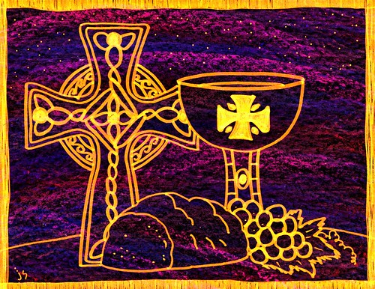
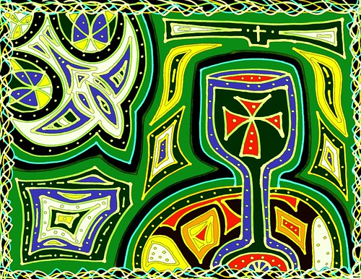
You can choose to follow the instructions to work in the style of Picasso or
look at the following pieces of artwork depicting the Holy Communion
Decide which is your favourite – or research/design your own, and create your image.

Slide 4
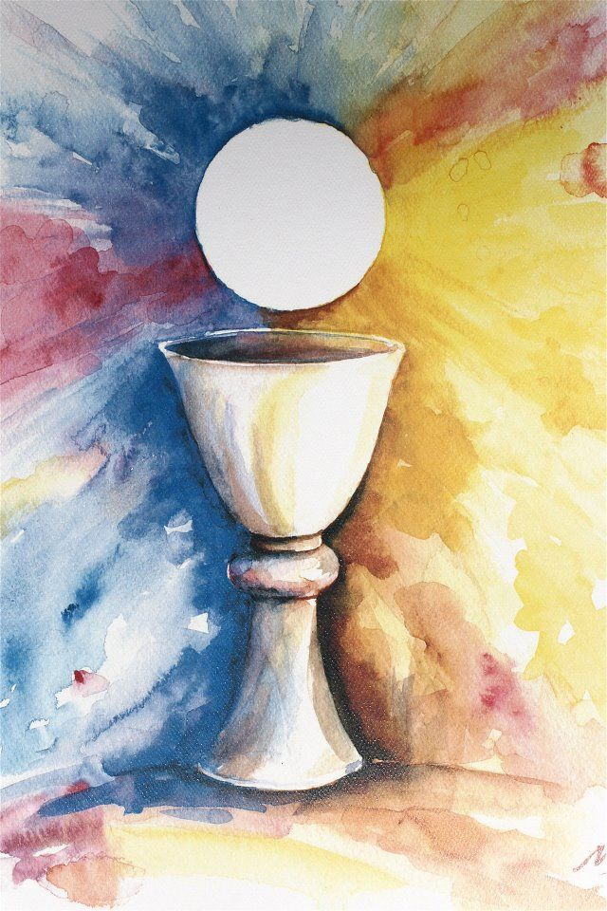
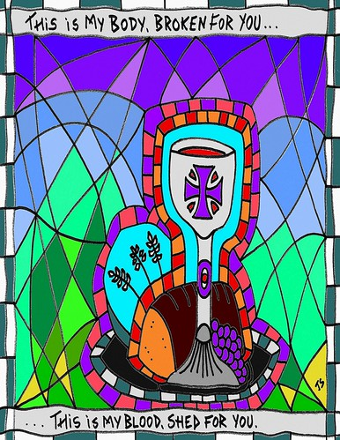

Slide 5
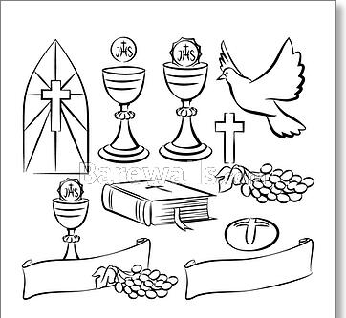
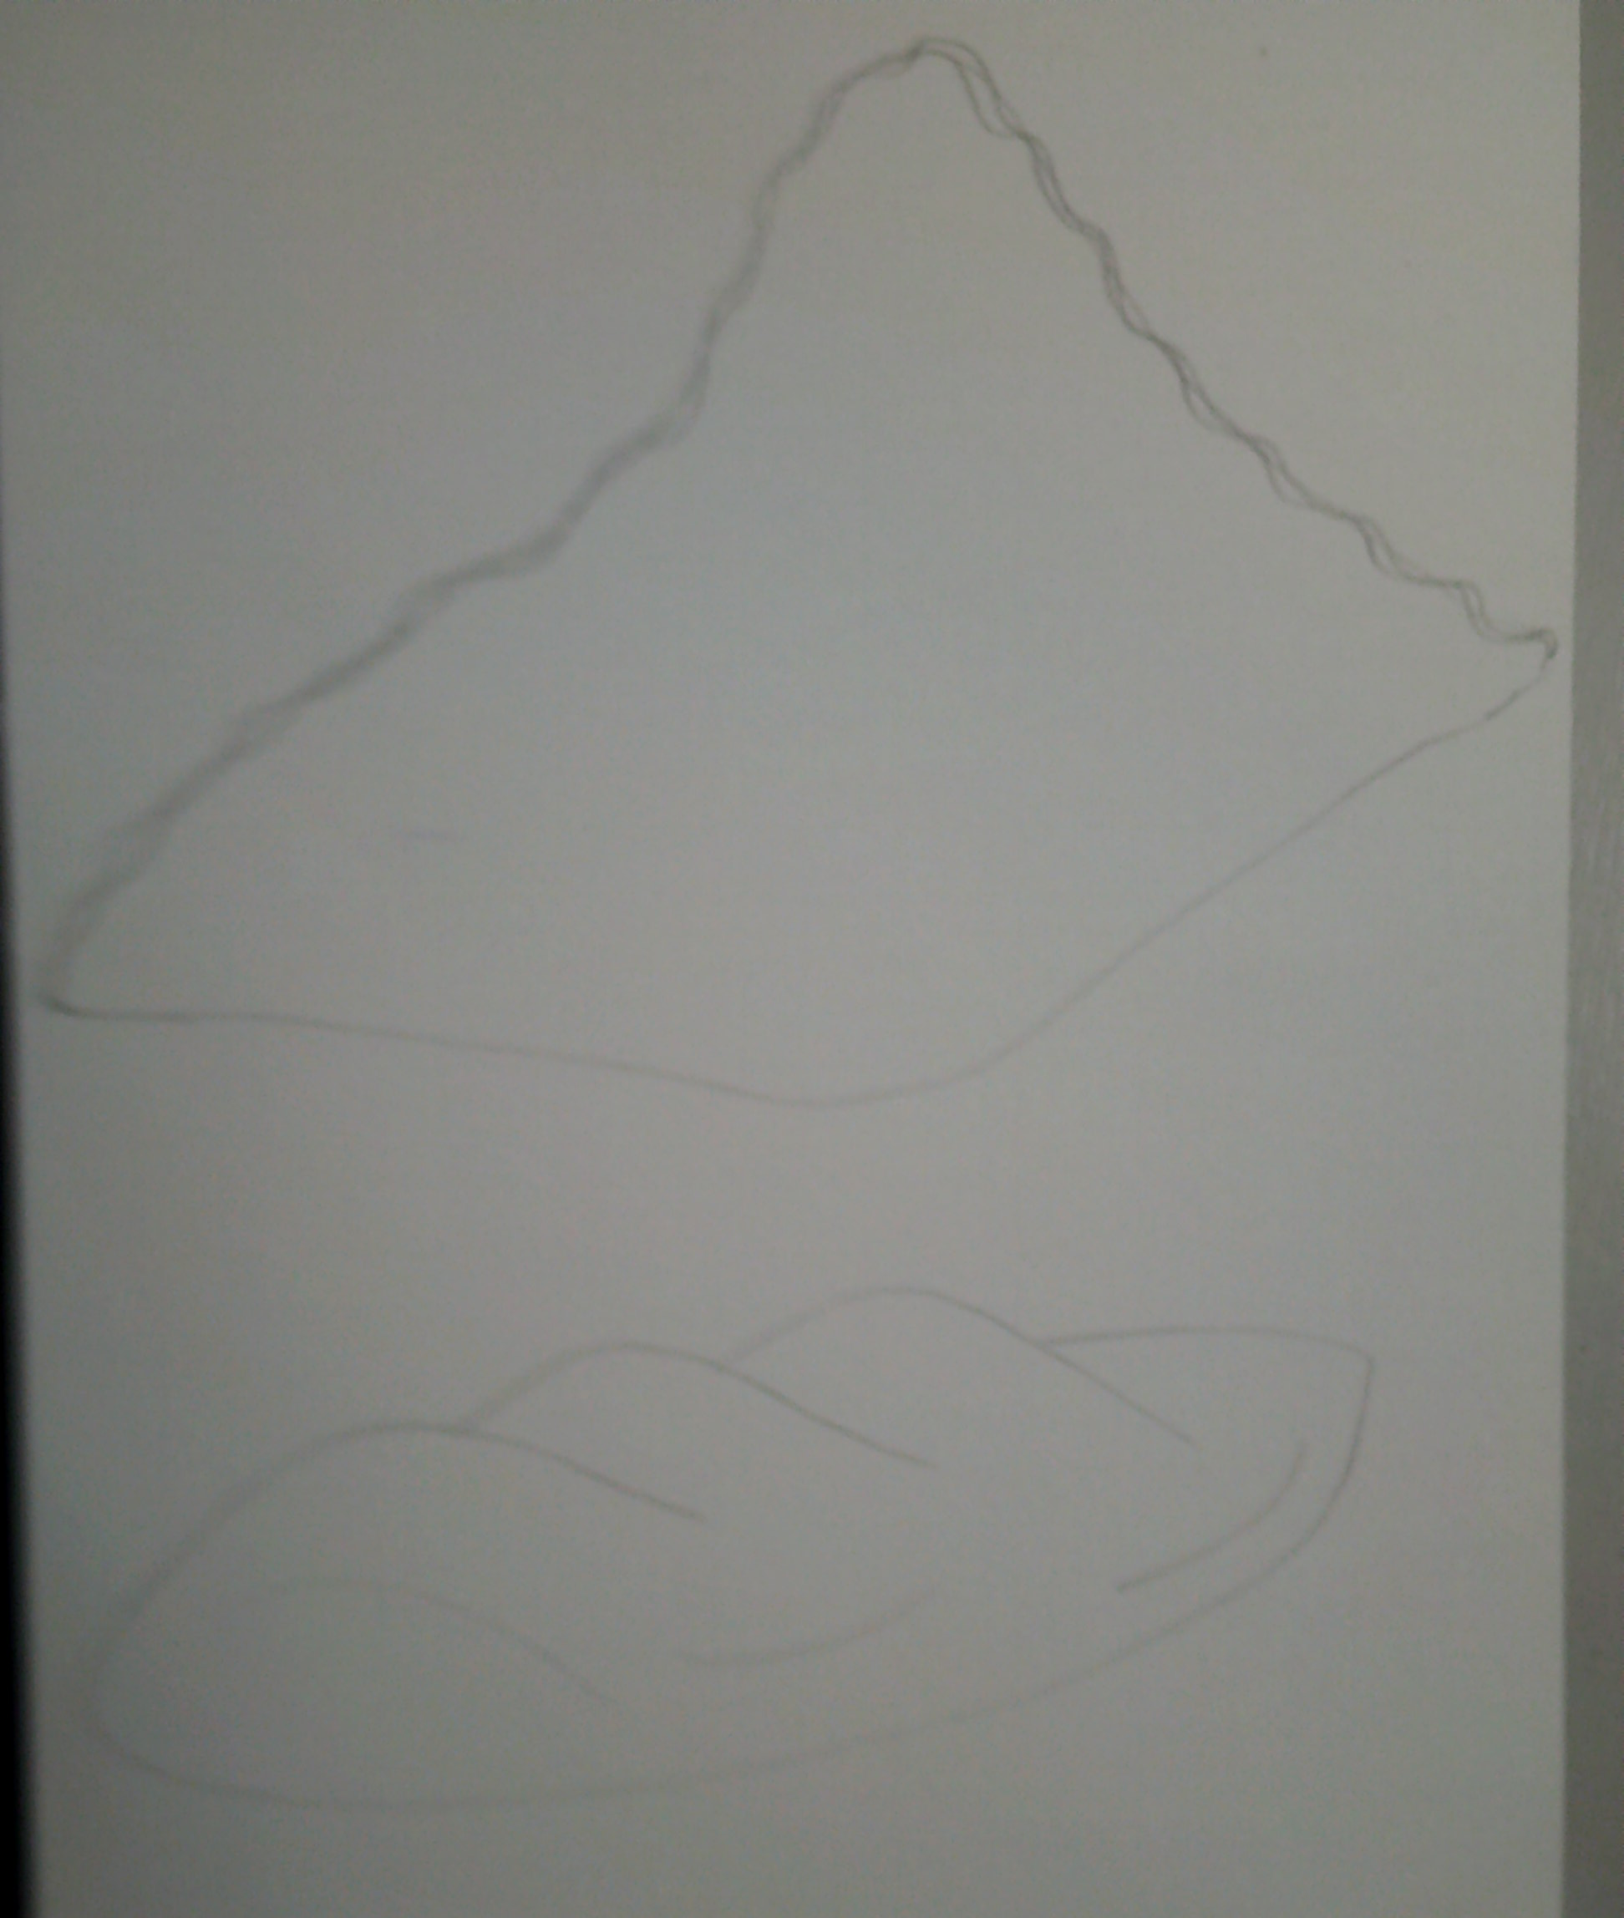
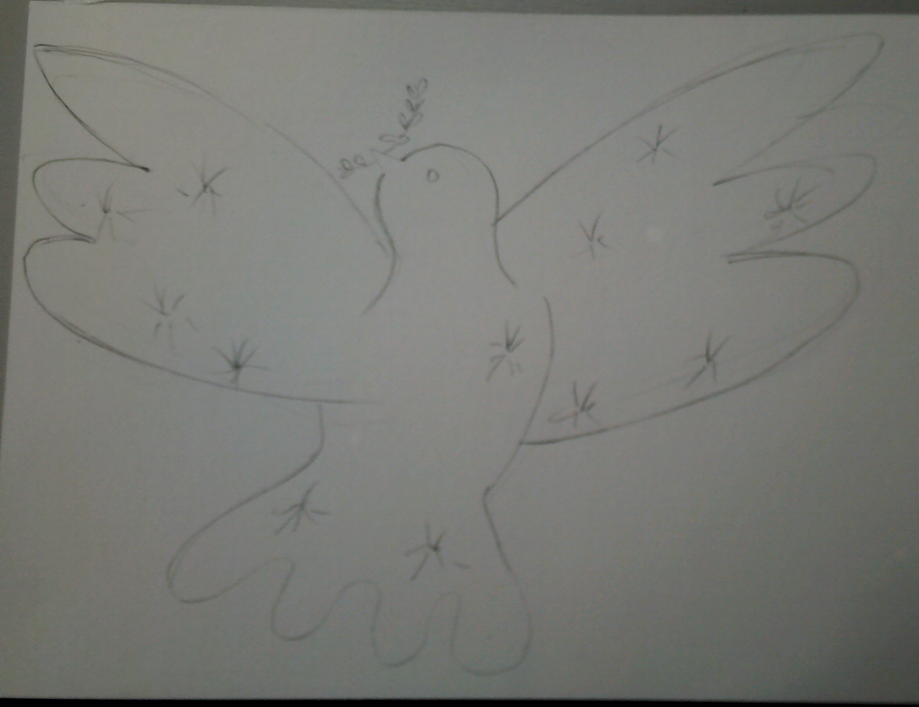
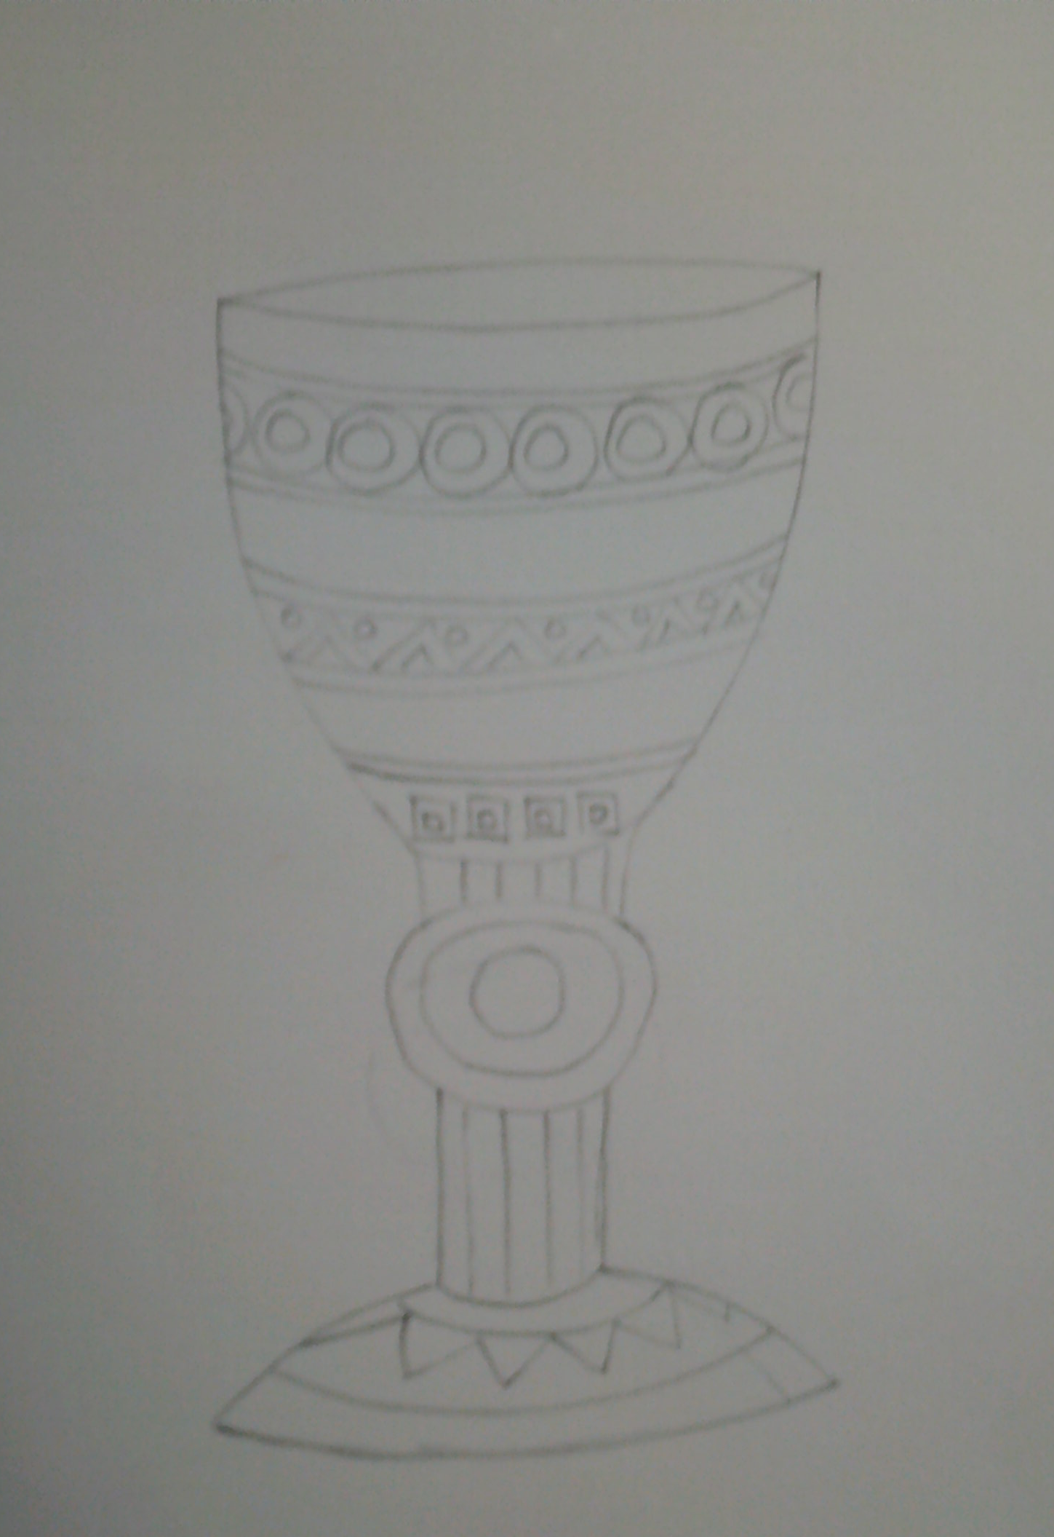
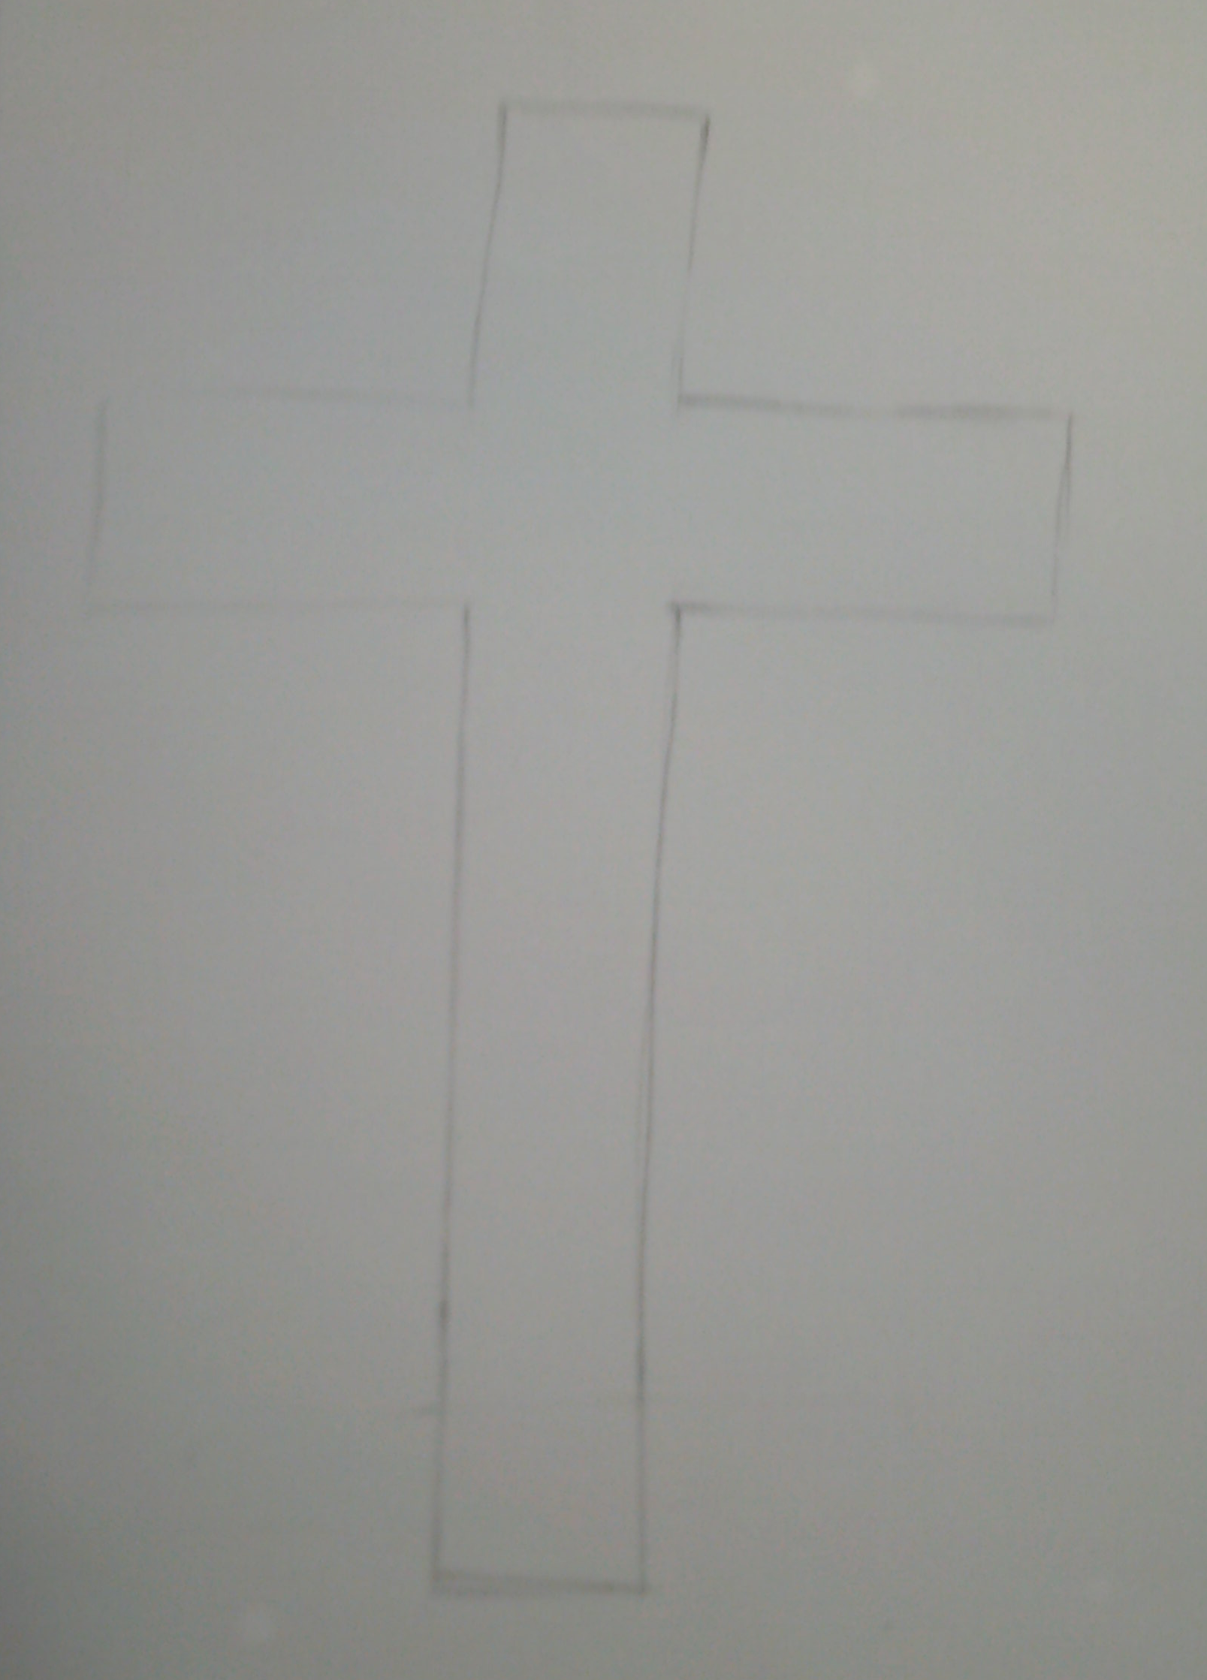
The elements of the Holy communion
To begin –
draw the elements of the
Holy Communion as separate pieces
Chalice
Bread
White Cloth
Cross
Dove

Slide 6
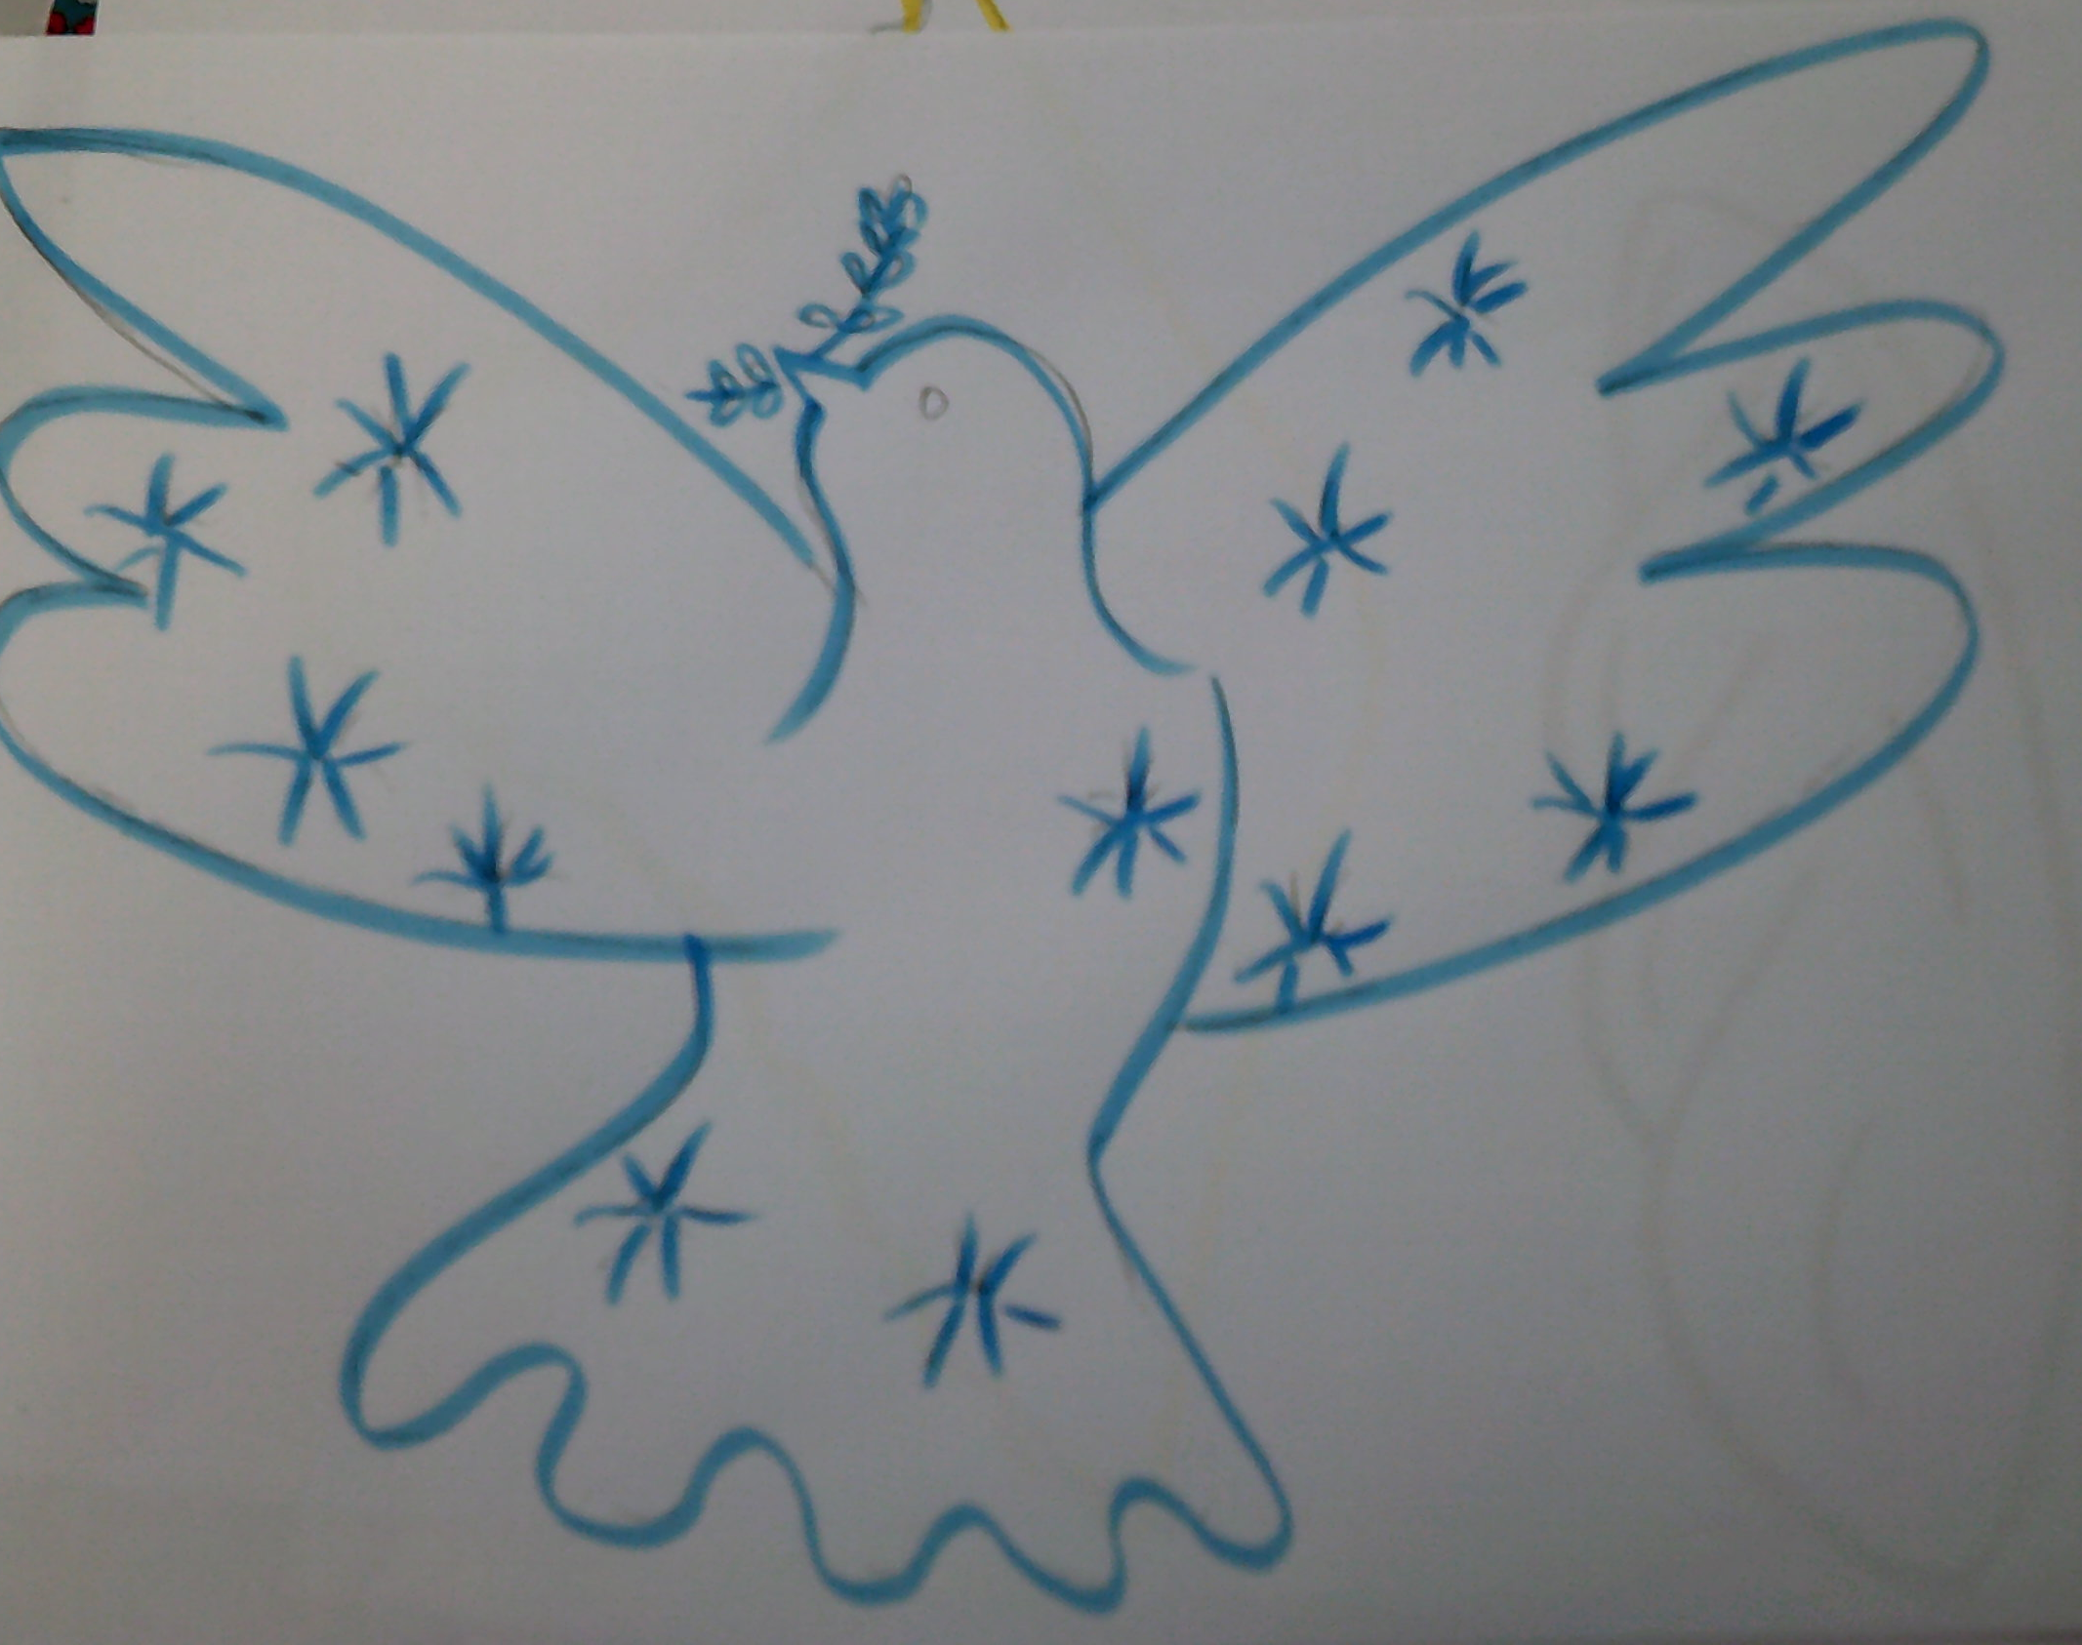
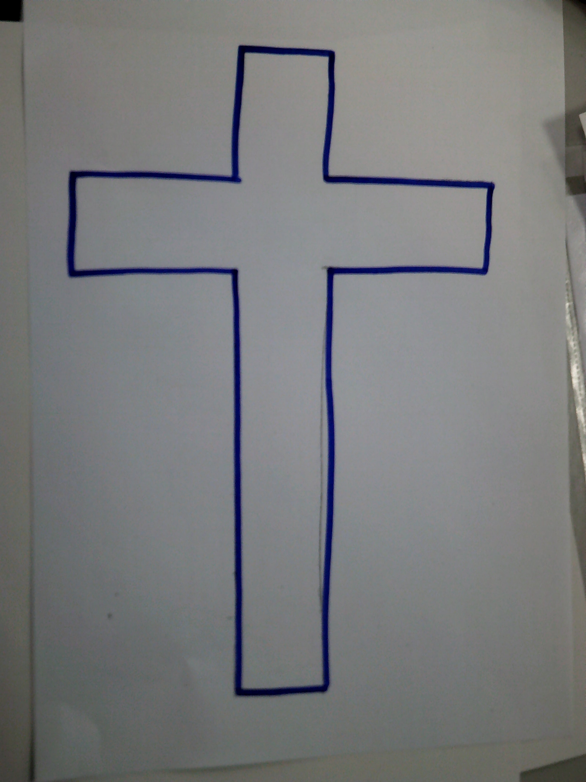
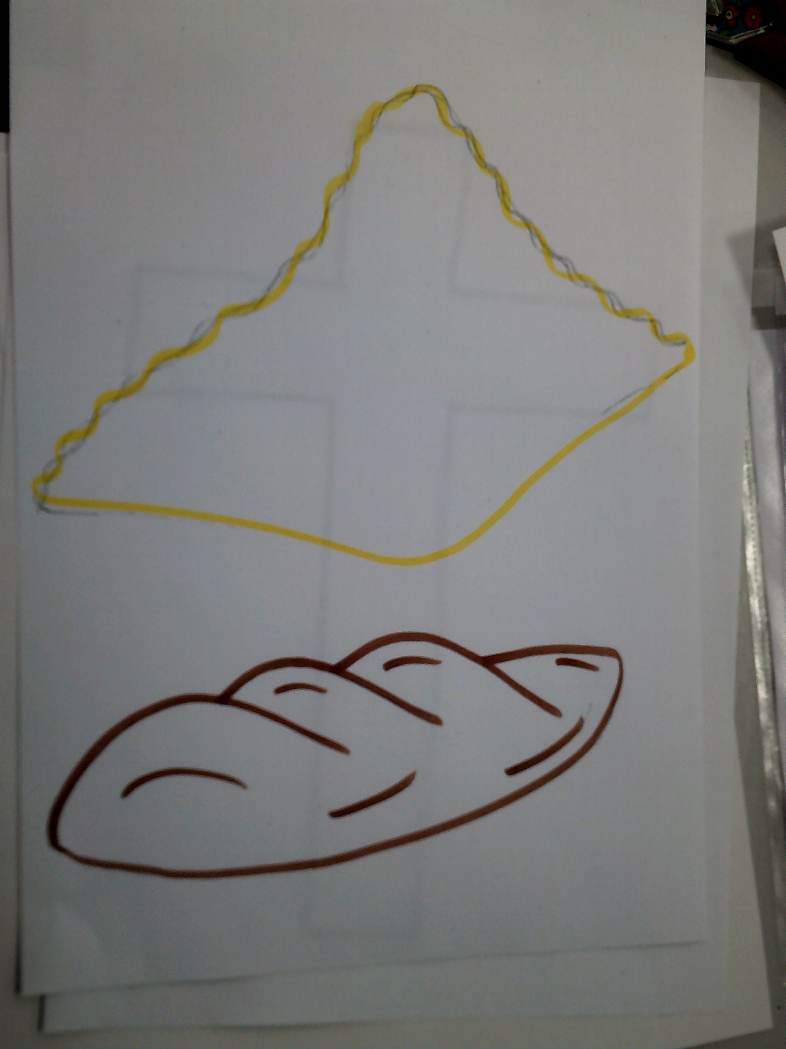
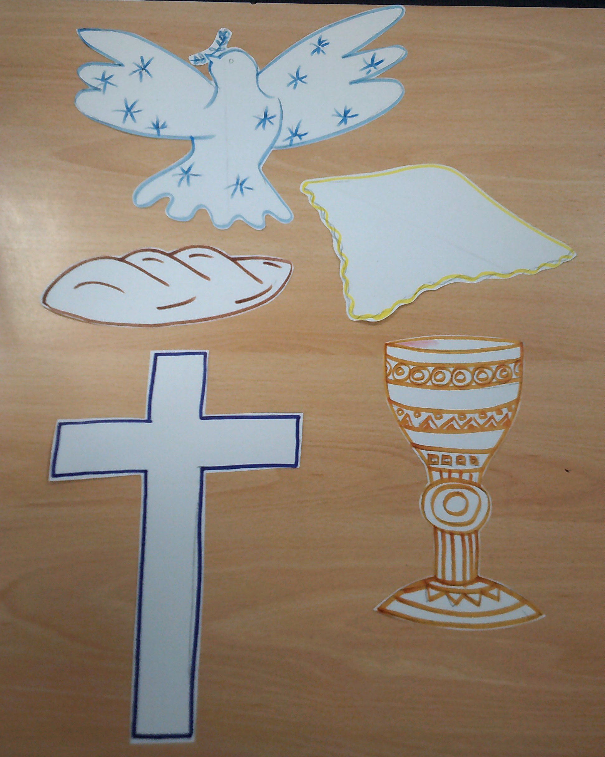
Now draw over your pencil with a felt-tip, a different colour for each object.
Next cut out each piece carefully

Slide 7
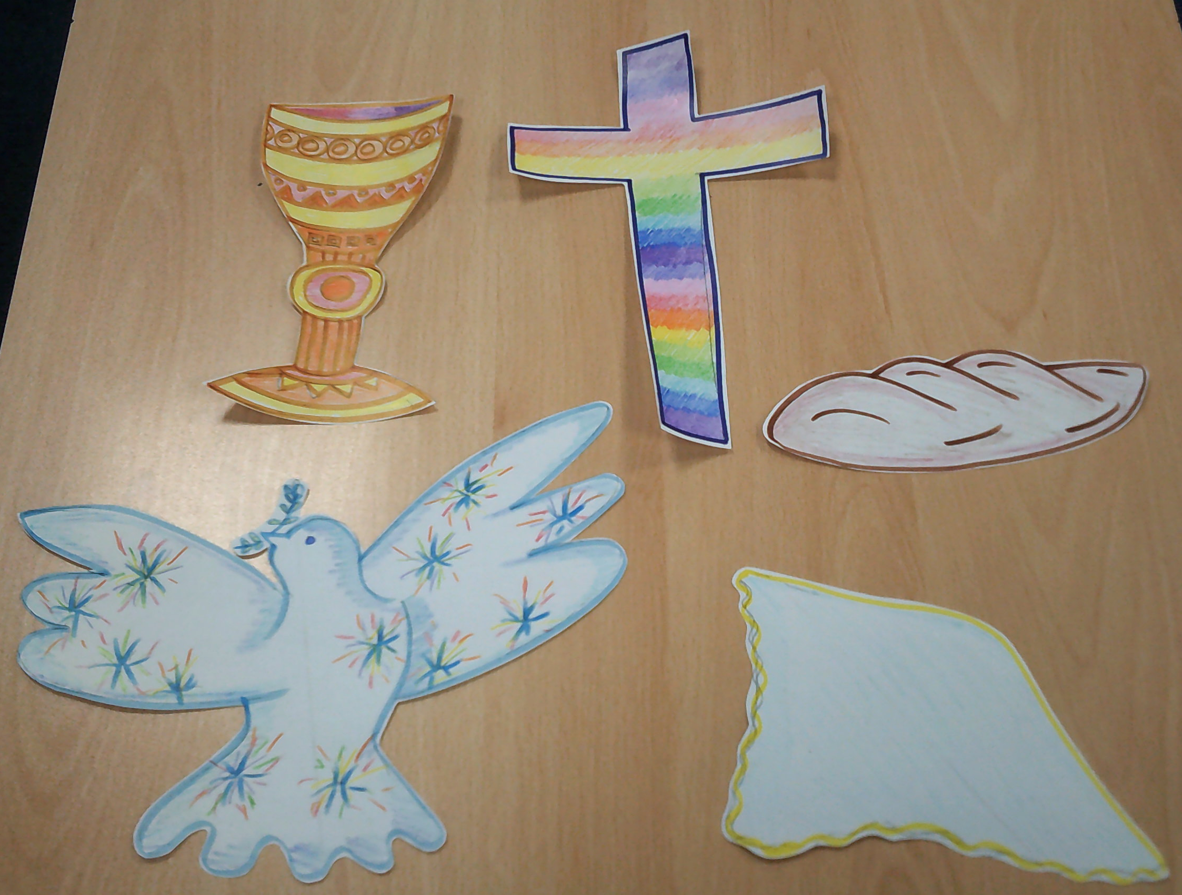
Colour with pencil crayon – or paint which ever you prefer.

Slide 8
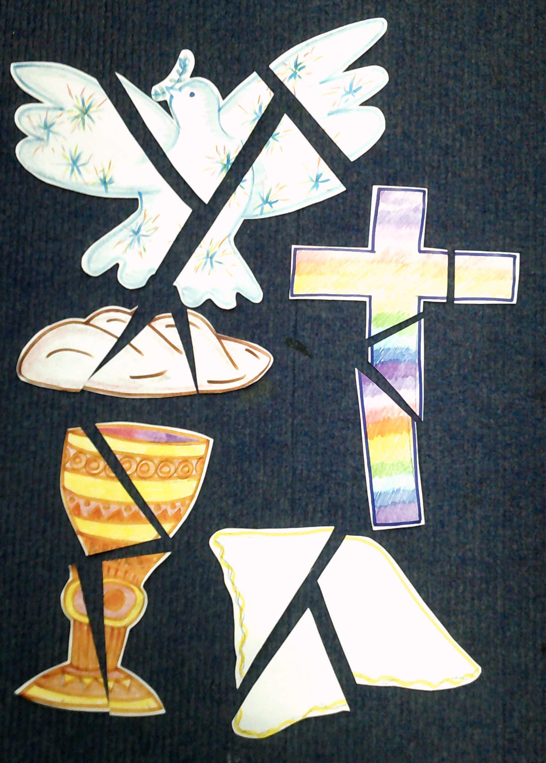
Crazy I know – next cut the images you have drawn at different angles.
(see example).
Make sure you don’t cut your pieces too small.

Slide 9
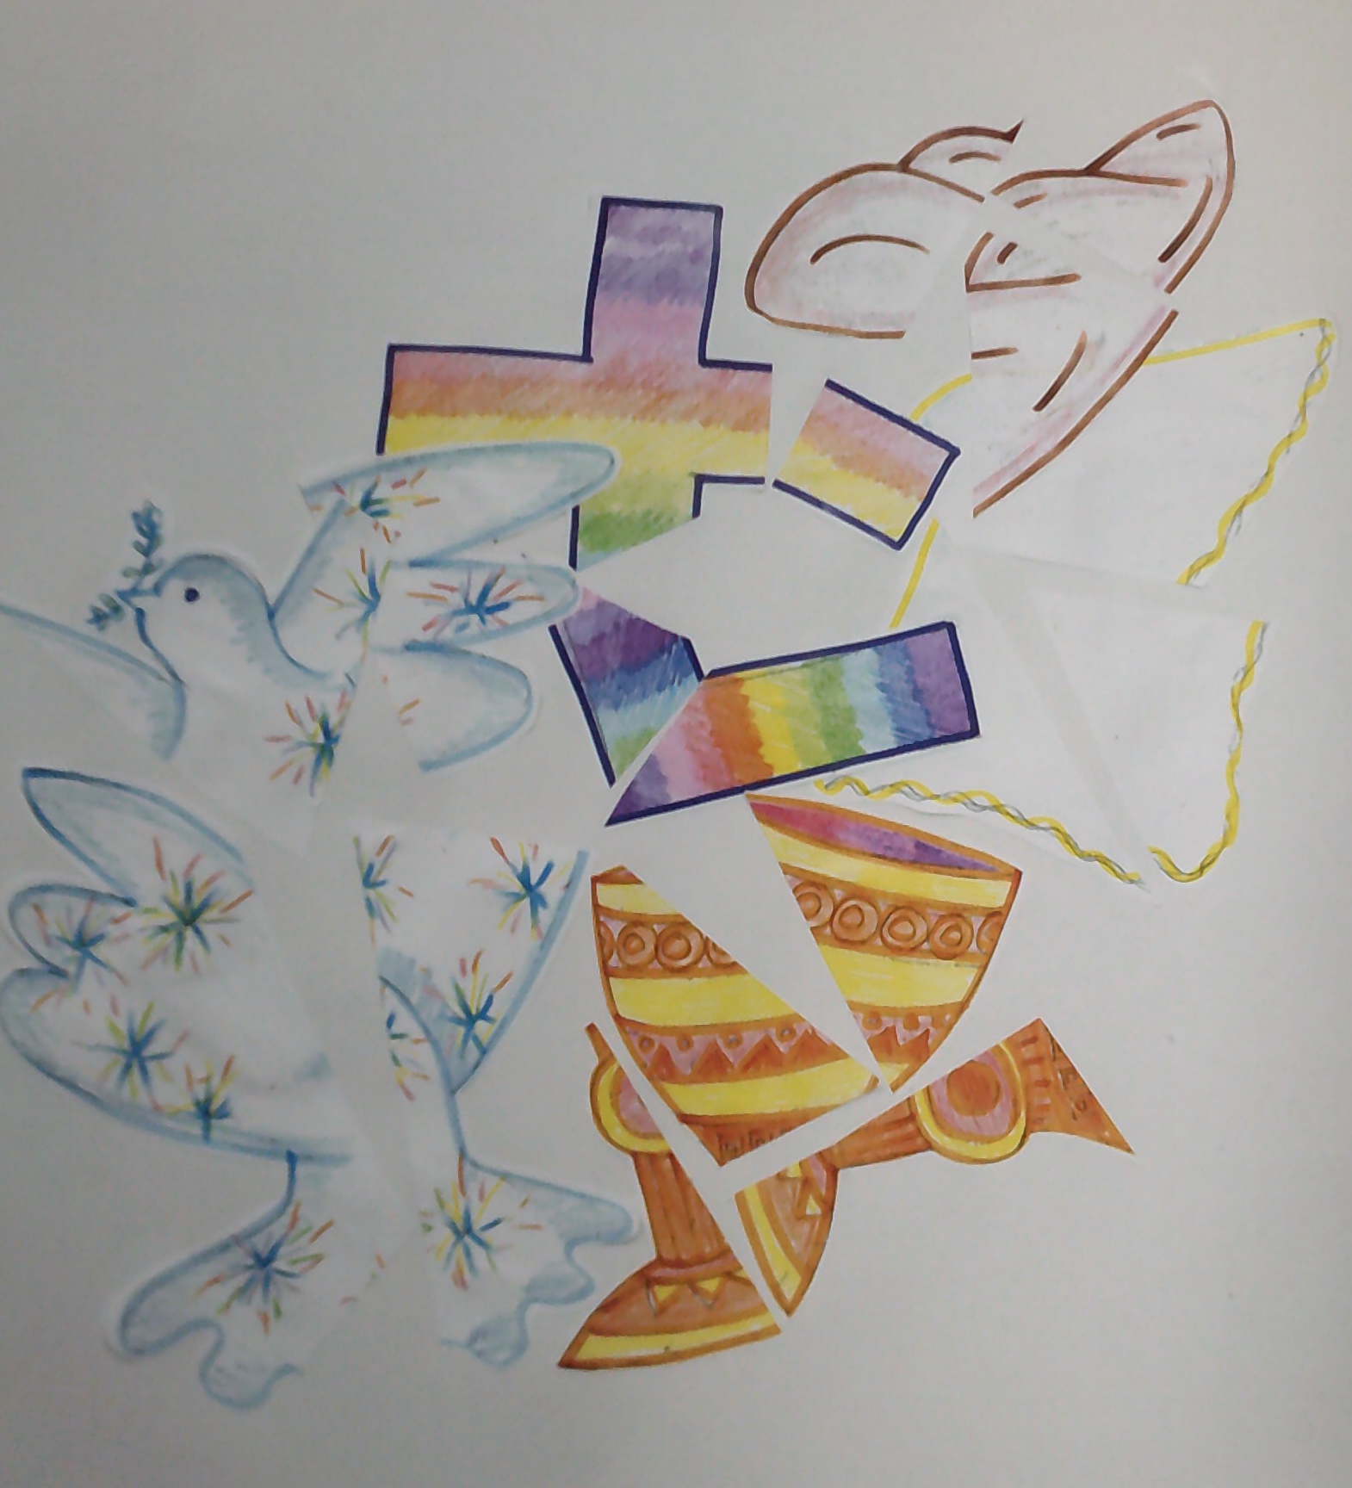
Arrange the pieces at angles onto another, much larger piece of paper.
Glue carefully in place – try to keep the glue off the new piece of paper. (Remember to use scrap paper for gluing).

Slide 10
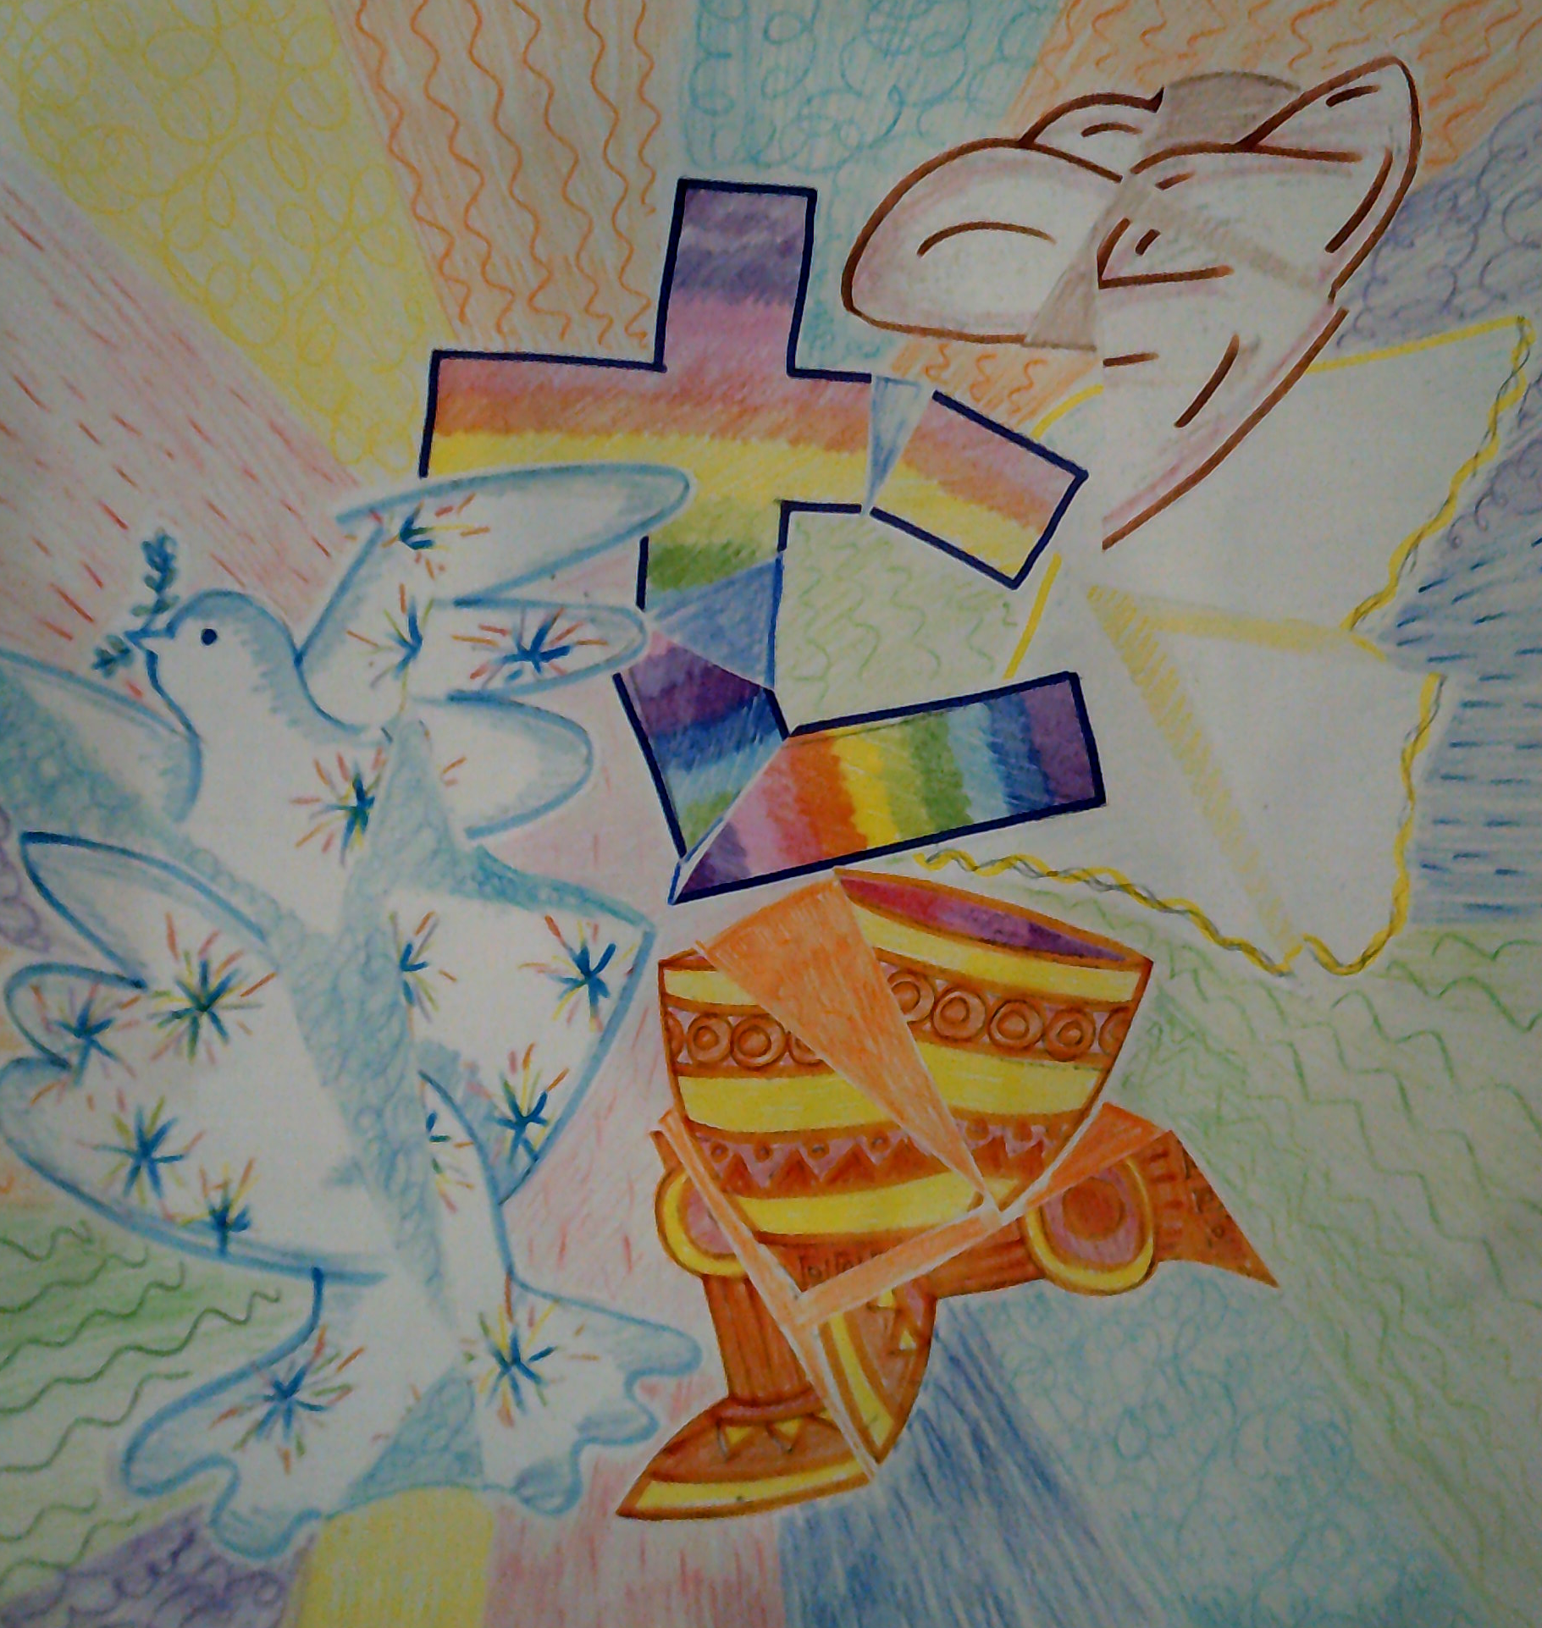
Next - colour in the gaps…
Choose a different colour for the spaces between the elements.
Add pattern to the colours to create texture.
Voila – you have created
a cubism image of
‘Elements of the Holy Communion’.
Please send a photo of your artwork to Miss Cross,
for me to see and print out.
Thank you, Mrs Coulston

