Slide 1
Tuesday 26th January 2021
LO- To continue planning our information booklet.

Slide 2
Starter
What facts did you learn in yesterdays lesson?
I learned that for thousands of years, astronomers have studied the movements of the planets across our solar system.
Astronomers are scientists who study the universe, its objects and how it works.

Slide 3
Main Activity
Our outcome for this week is:
Using our knowledge and understanding gained through learning opportunities in English to plan, write and make an information booklet about the solar system and/or space travel.

Slide 4
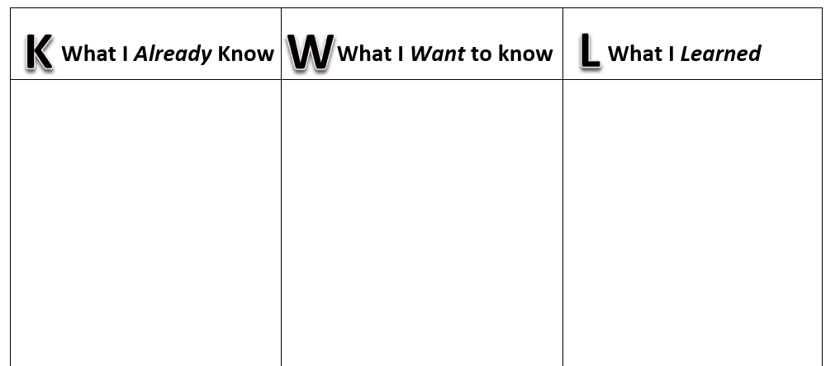
For this lesson, we will be using the KWL grid once more
I have provided one on the school website.
So, looking at what you have learned last week, through the different non-fiction texts, use the grid to fill in what you have found out (last week), discuss what you would like to find out in today’s and tomorrow’s lesson and then after today’s lesson, write down what you have found out through more reading.

Slide 5
Main activity
For today’s lesson you are going to choose a topic that you are going to discuss in your information booklet.
For my example, I am going to choose the Solar System.
Using the recommended website, I found an interesting piece of text, talking about our solar system.

Slide 6
Main activity
Recommend website- https://www.literacywagoll.com/non-fiction.html
Use this website to find different pieces of information texts, if possible, use texts relating to our topic (Science Fiction).

