Slide 1
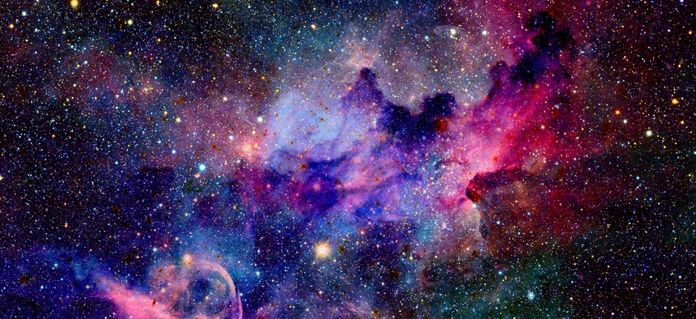
Earthlings
Hello again Year 5
I hope you managed to make the base of your sculpture and leave it to dry thoroughly.
This week we will decorate the planet, to create colour, texture
and ‘galactical presence’.

Slide 2
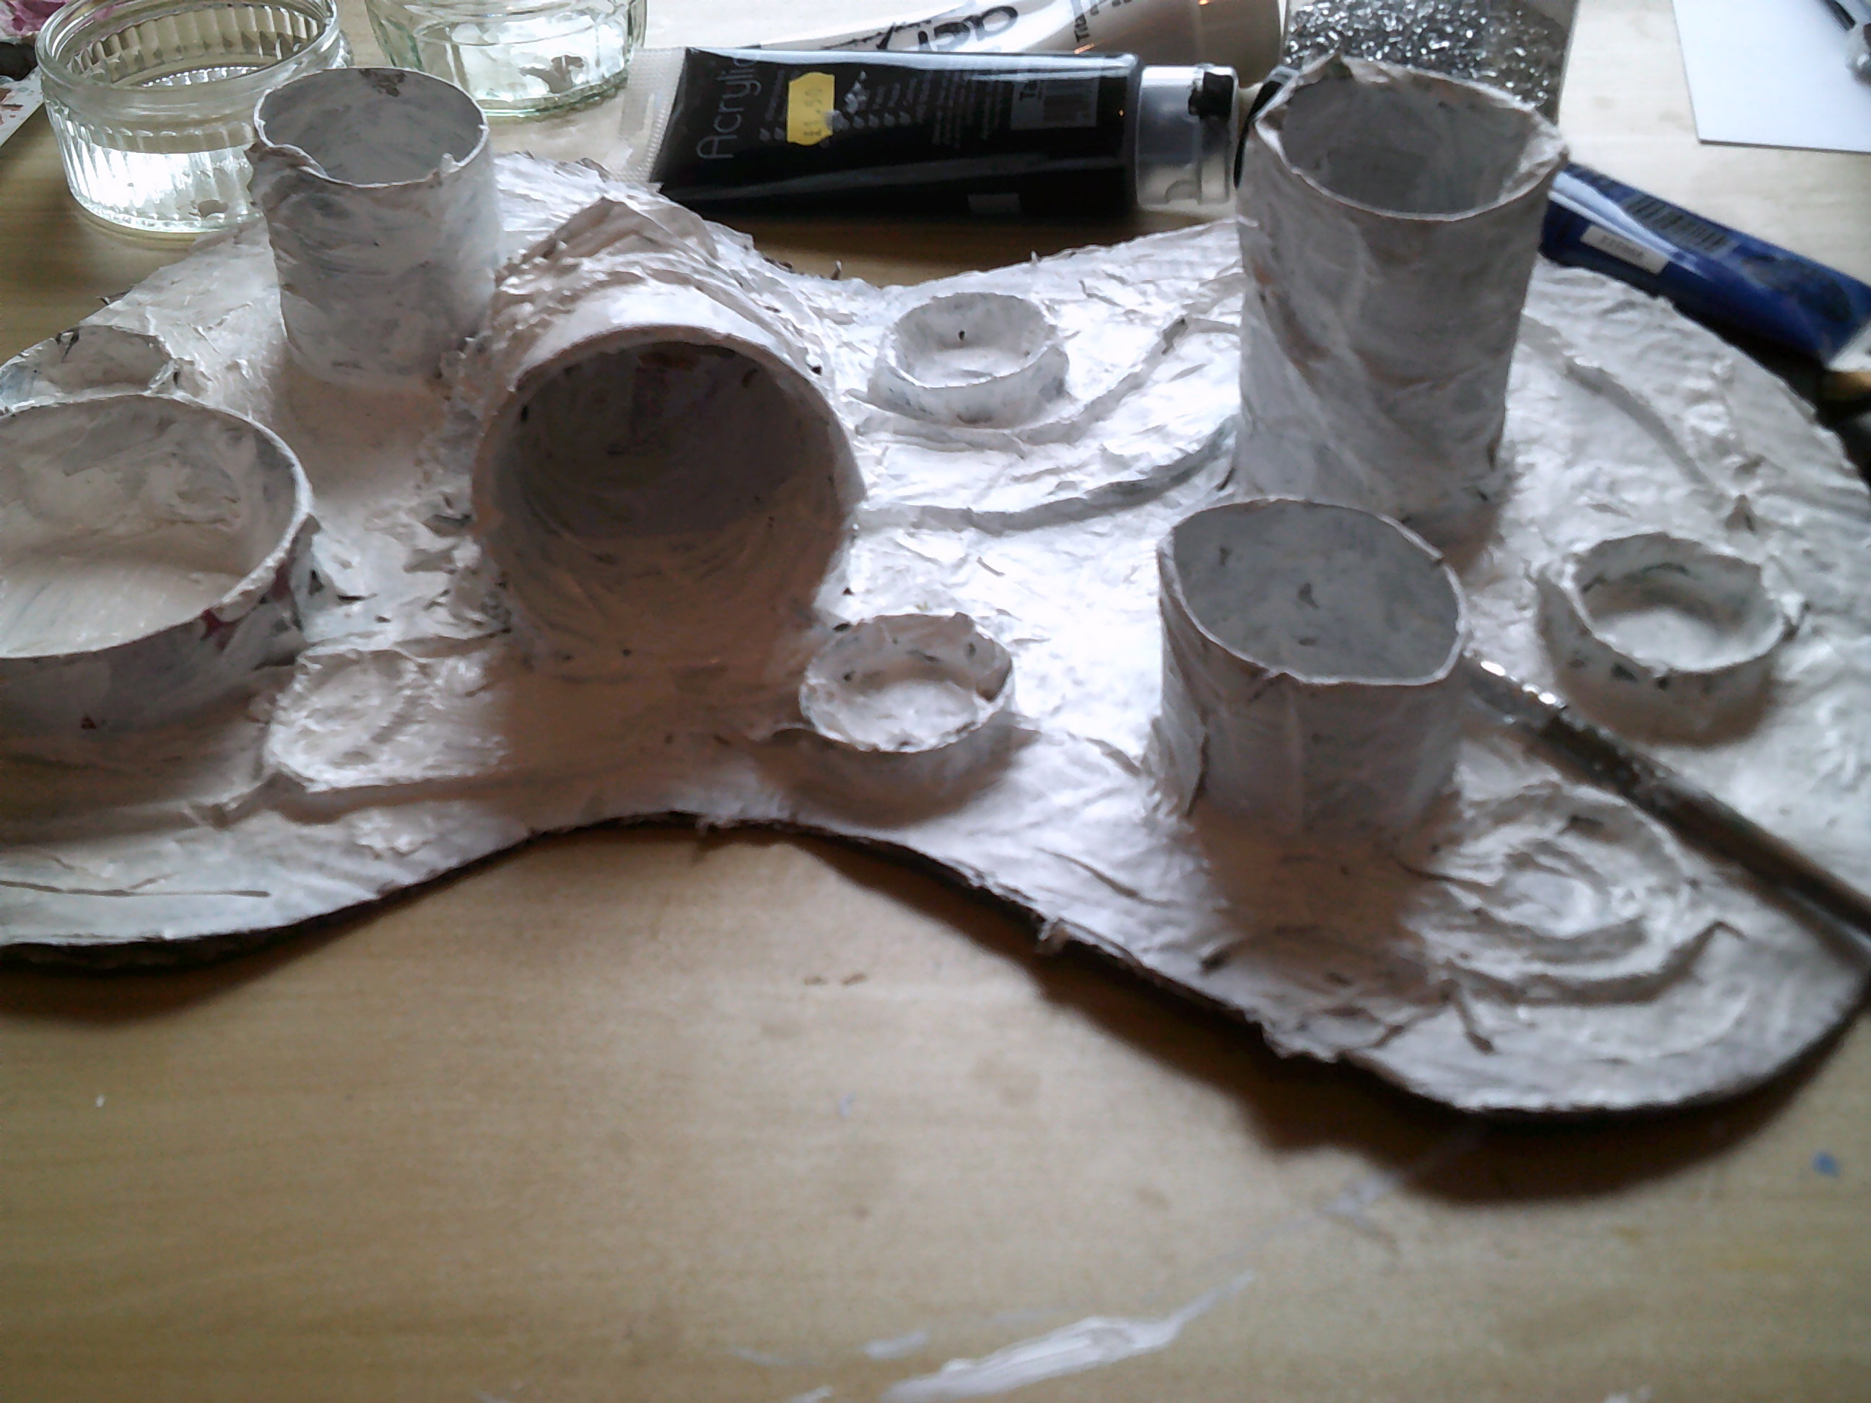
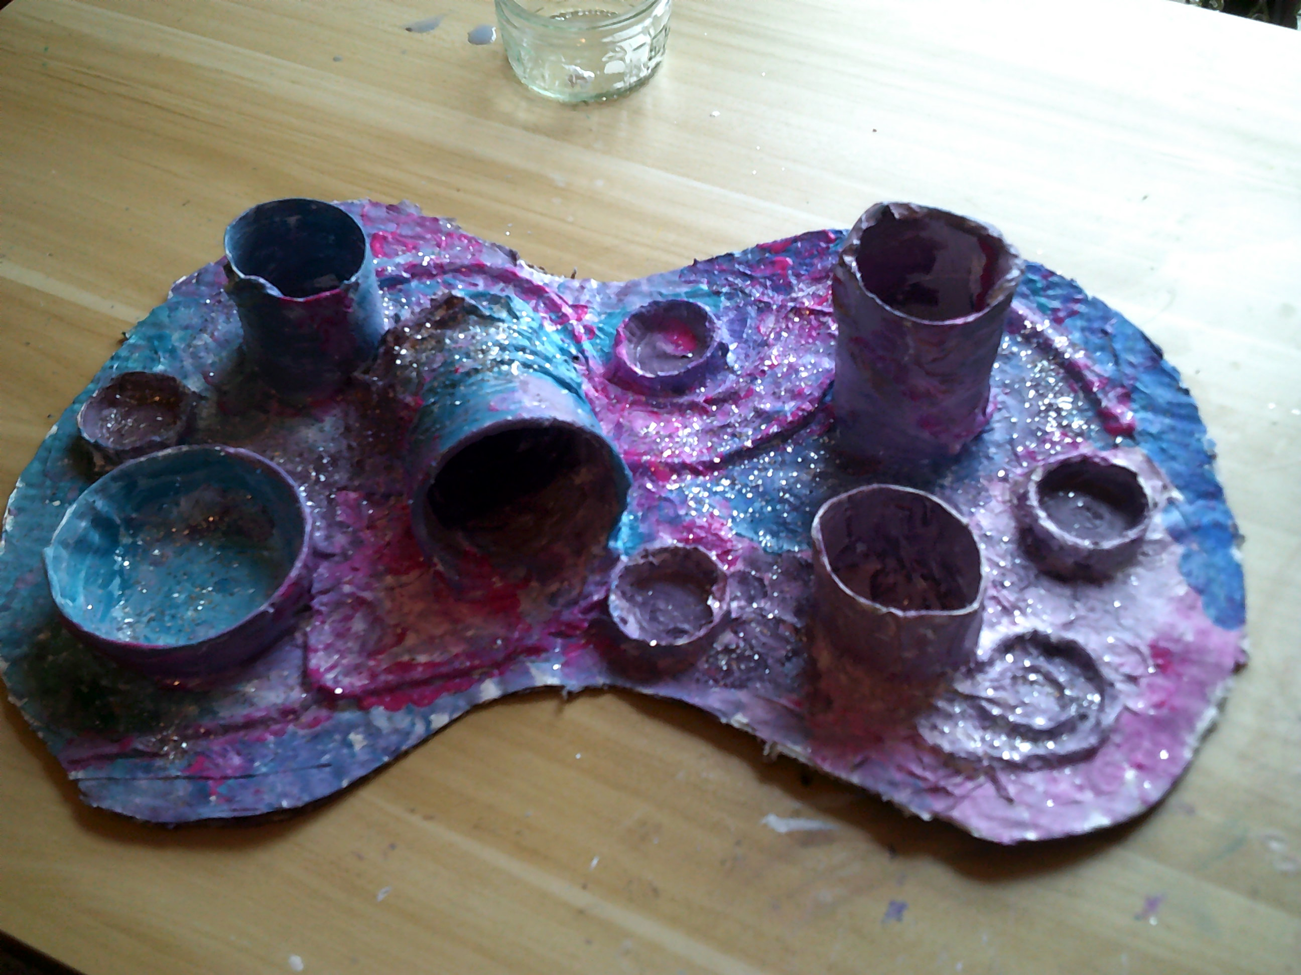
Paint your planet surface.
Choose your paint colours and begin to cover the surface of your planet.
I covered mine in white paint as a base for my colours
Be sure to paint more than one coat, as the newspaper text often shows through!
Paint abstractedly to create images with texture, form and colour.
Flick paint - gold and silver for precious rocks and minerals.
Sprinkle with glitter to make your planet surface sparkle.

Slide 3
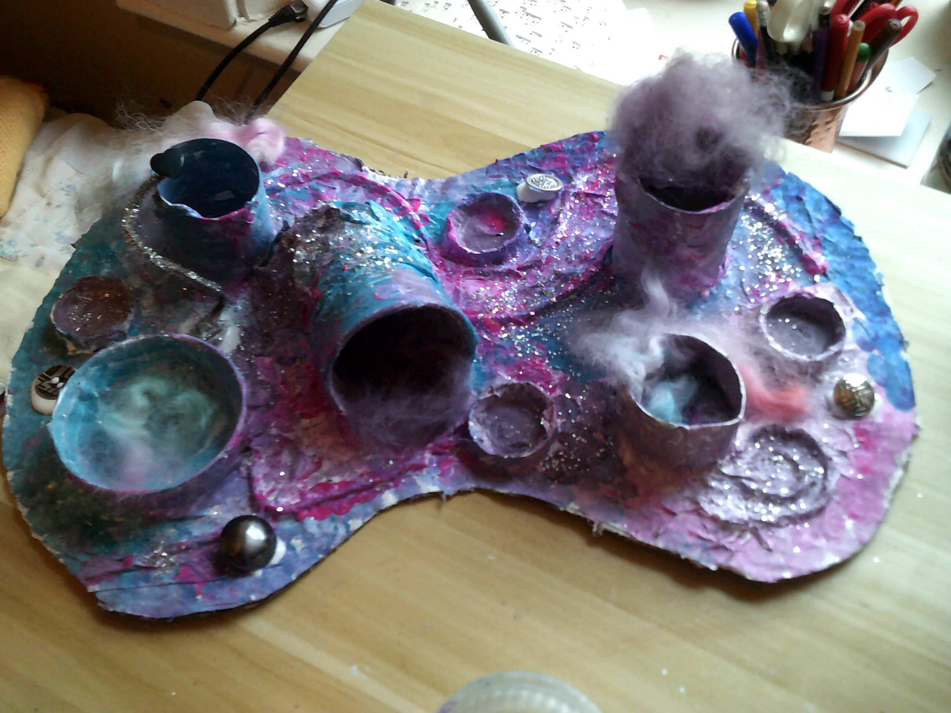
Collage for effect
To create more texture add odd pieces of fabric; fur, felt, velvet.
Add other materials which do not require paint: buttons, pipe cleaners, polystyrene packaging, bubble wrap, plastic lids.
Glue these in place.
Leave everything to dry.

Slide 4
Please send a photo to me via seesaw.
I’m looking forward to seeing your 2D planet sketches come to life as a 3D sculpture.
Thank you,
Mrs Coulston

