Slide 1
Computing- Thursday 14.1.21
LO- Novel use of the count tool for Literacy

Slide 2
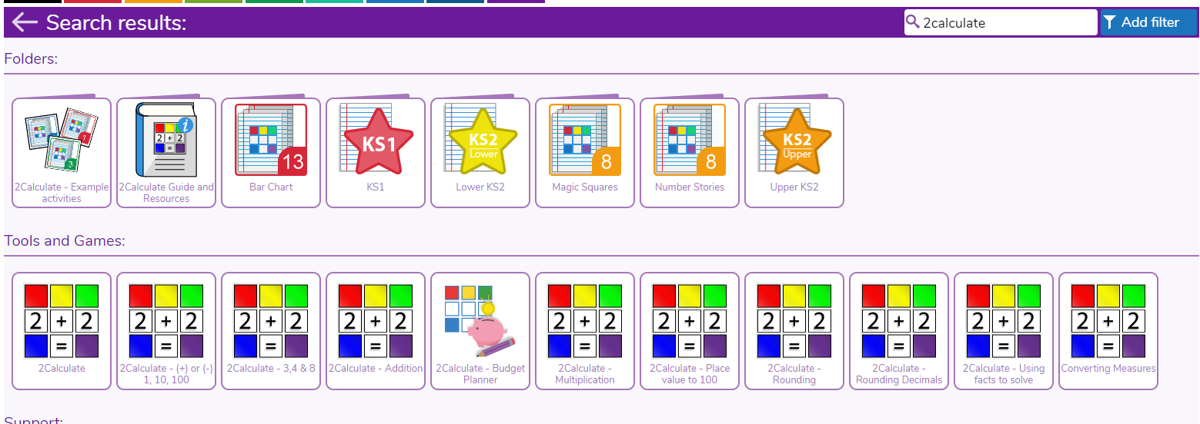
Log onto purple mash and search 2calculate

Slide 3
You will have an empty grid. Click the icon in the circle and it will bring up numbers and letters across the grid. This will make it advanced mode.

Slide 4
You can use the addition and subtraction buttons to make the grids bigger and smaller.

Slide 5
Produce this layout on your spreadsheet.

Slide 6
Make sure to click on each vowel when using the ‘How many’ tool.

Slide 8
Here are some examples of sentences to use to count the most popular vowel/consonants

Slide 9
Challenge

