Slide 1
Pumpkin Pages Booklet
To complete the pumpkin pages
Look at the pictures on the two pumpkins on the pumpkin pages’ sheet.
On the second pumpkin, add the missing letters in the gaps for the feelings and emotions.
Draw a line from each French sentence to the matching picture of the feeling or emotion.
Read in your heads the emotions and feelings.
Which other emotions and feelings do you know in French? Write a favourite in the empty green box.
To make the booklet.
You will need the pumpkin pages’ sheet to create the inside of your booklet
Cut along the black line with a pair of scissors.
Fold along the red dotted line to create a booklet.
The pumpkin pages are now the inside pages of your booklet.
Draw a pumpkin face expressing one of the emotions on the empty front cover.
Write the emotion in French.
Use the French sentence prompts below to create a written personality for your pumpkin face.
Bonjour,je m’appelle …..
J’habite à…………
J’aime…………, car……………
J’ai ….ans.
Je n’aime pas……,car…………
@Primary Languages Network 2020
Pumpkin Pages Booklet

Slide 2
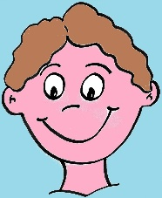
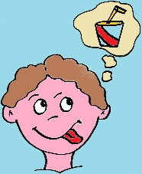
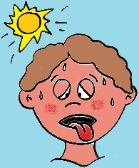
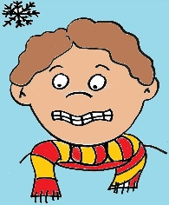
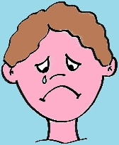
Pumpkin Pages Sheet
a
b
c
1.J’ai f _ _ m.
2. Je suis tr _ _ te.
3. Je suis h _ _r_ _ x.
e
4. J’ai ch _ _ d
d
5. J’ai fr _ _ d
@Primary Languages Network 2020
Pumpkin Pages Booklet

Slide 3
Pumpkin Pages Booklet – Answer Sheet
A – 3. Je suis heureux
B- 1. J’ai faim
C - 4. J’ai chaud
D - 2. Je suis triste
E - 5. J’ai froid
@Primary Languages Network 2020
Pumpkin Pages Booklet

