Slide 1
October 2020
Hello Year 6!
I hope you’re all still feeling happy and well, even though you have to stay at home for another week.
We’re still missing you here! (More than ever).
Thank you for all the fabulous artwork you created last week – I’m very impressed.
This week we will continue the Shakespeare theme…read on!

Slide 2
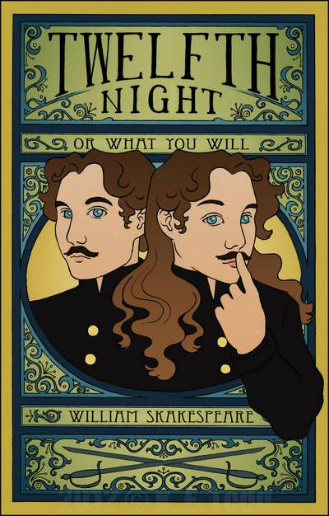
Thinking back to drawing portraits, use your skills to create a poster to advertise our
Shakespearean play.
Twelfth Night
By William Shakespeare

Slide 3
Twelfth Night
Think about size and proportion of the characters faces.
Think about size and proportion of the lettering
Use a ruler as a guide - create bubble writing or
write in script
If you prefer you can use ICT to create a poster on word or paint.net.

Slide 4
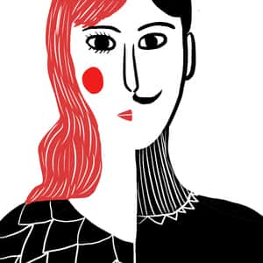
Although the time and date are yet to be confirmed you will need to provide some information to help the audience :
Date: November 2020
Venue: – School Hall
Year Group: Year 6
School: Grimsargh St Michael’s C of E School (you could include the badge)
Actors and characters names (don’t worry if you can’t remember everyone’s part).
Include a quote or line from the play – especially if you have a line you enjoy acting or speaking.

Slide 5
Remember to begin with a rough sketch then transfer to paper or computer screen.
I’m looking forward to seeing your fabulous advertisement posters.
Send them to school in the usual way.
Finally – have fun!!
See you all soon – Mrs Coulston

