Slide 1
Hello everyone, As you’re all working from home right now, I thought I could share some ideas for you to create your own ‘Lockdown Artwork’.
I know you all have your own creative style and technique,
and enjoy the work of many different artists.
I too have my favourites…here are a few!
I’ve included some ideas for you to create and share your work with everyone.

Slide 2
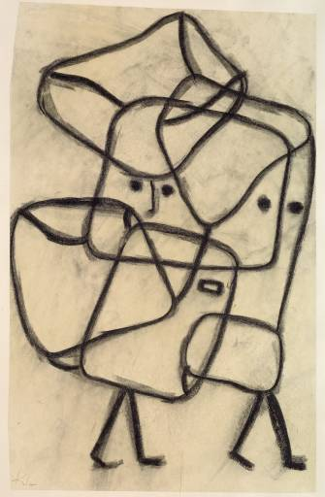
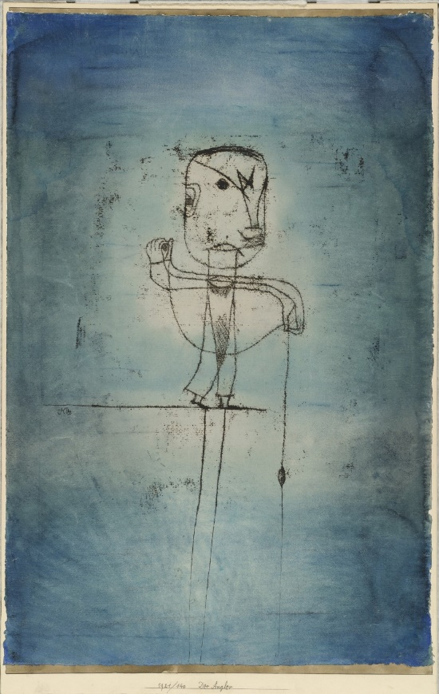
Paul Klee ‘Take a line for a walk’
You can create sketchy drawings from lines that emerge when you move your pencil across the paper.
To start with think about movement and flow rather than about an image - just see what evolves.
Fill any spaces with pattern and colour or fill in the background or draw on coloured paper.
Use a computer program (paint.net or purplemash) if you prefer.

Slide 3
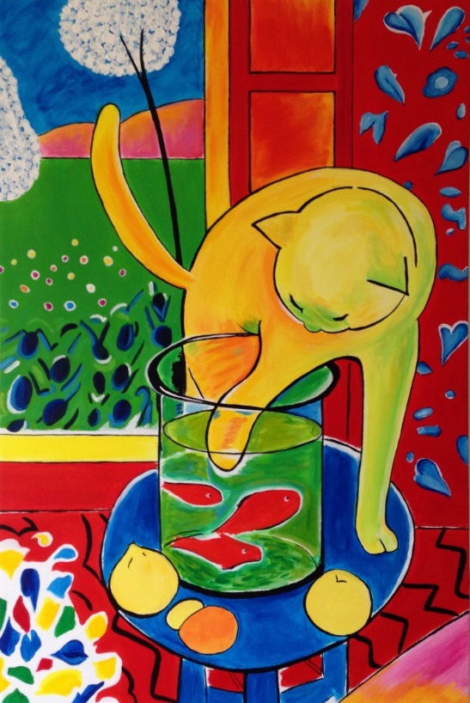
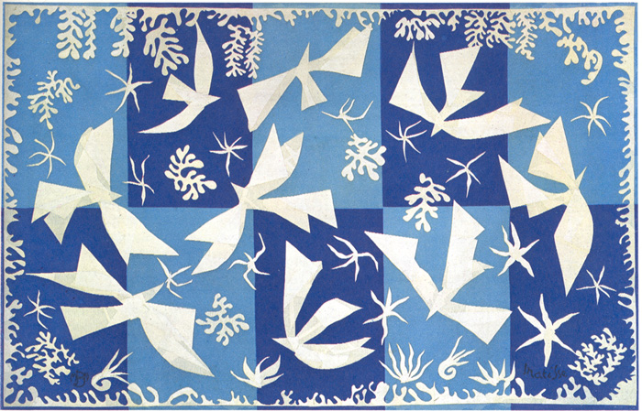
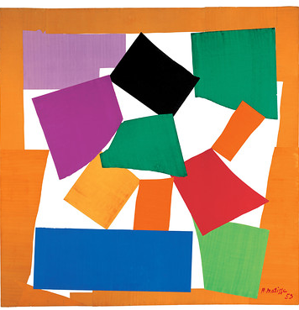
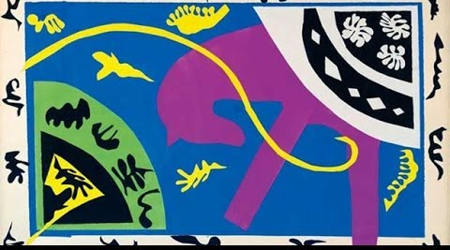
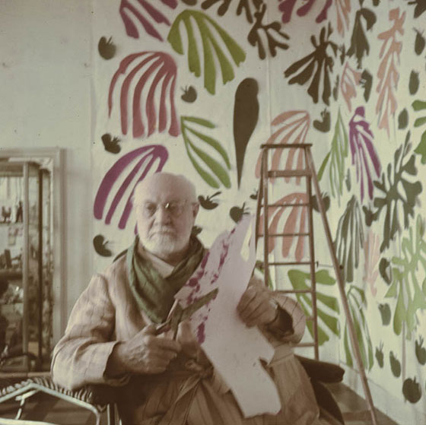
Henri Matisse https://www.youtube.com/watch?v=kRkdY8VQx1c
As a young man Matisse created many still life paintings, portraits and landscapes in bright bold colours.
As he grew older and his health declined, Matisse created some of his best and most famous work in collage –
‘the cut-outs’.
You can create a painting of your garden, house, room, an object or a landscape you’ve seen whilst out walking.
You can create a collage in the style of Matisse, by cutting and layering coloured paper (or paper you’ve painted), to make patterns or images of birds, flowers and animals.

Slide 4
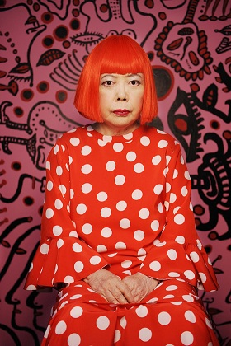
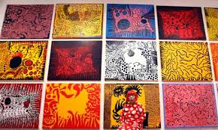
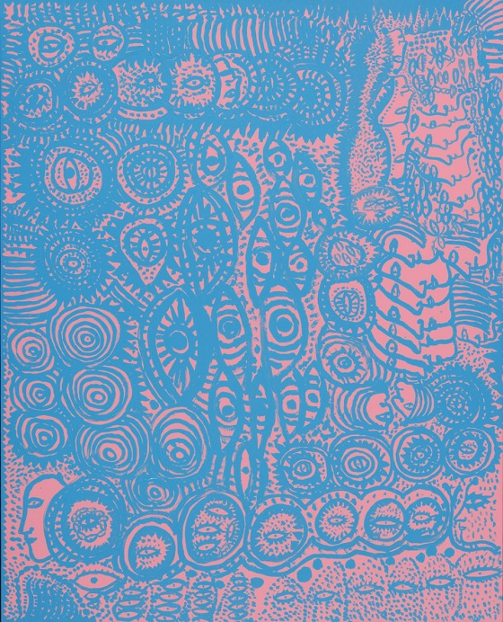
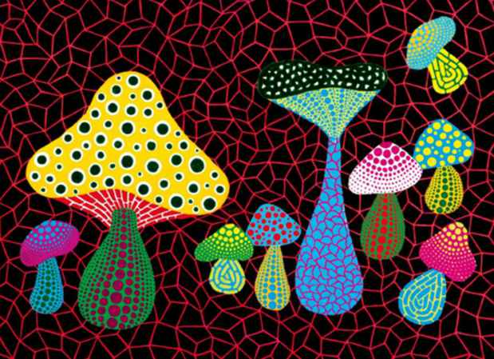
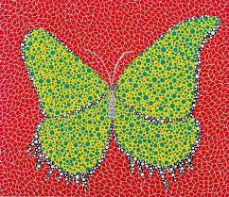
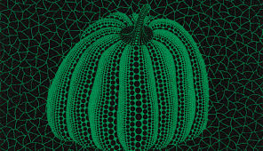
Yayoi Kusama This Japanese artist just loves pattern – but especially dots! You can create images in her style by going wild with dots and circles. Use very bright colours to make you work ‘pop’ out from the page!

Slide 5
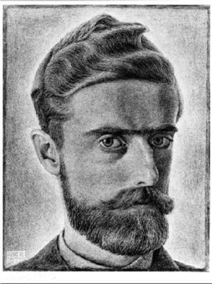
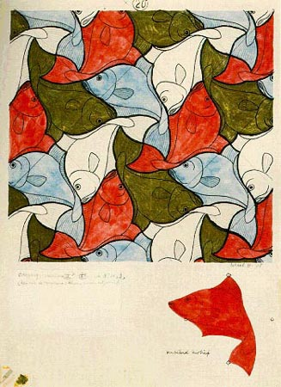
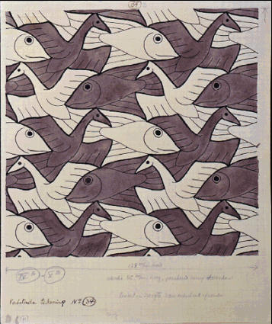
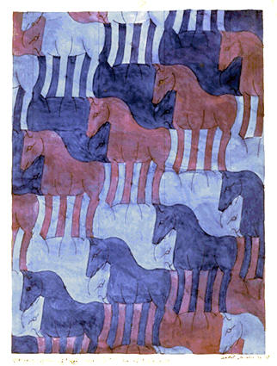
Maurits Cornelis Escher (1898 – 1972) Born in Leeuwarden the Netherlands (Holland), lived in Arnhem. Talented in drawing Escher created some of the most mind bending images in art. He used techniques such as tessellation to repeat patterns which evolved into new images and drawings in which he switched perspective to show life from different angles.
Escher
Tessellation - You can create a template and repeat the pattern, but make sure there are no gaps; the shapes have to fit snugly together.

Slide 6
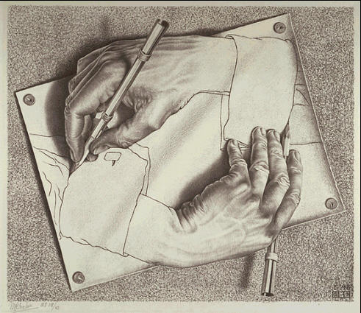
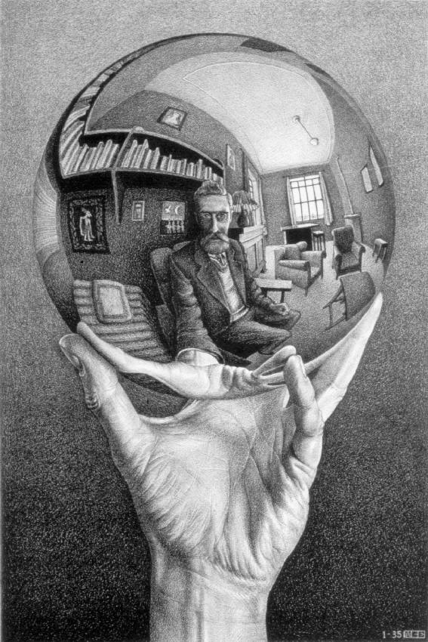
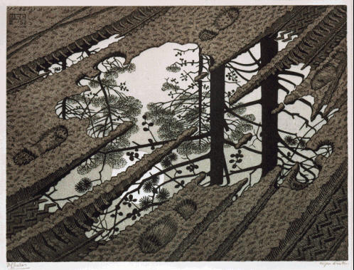
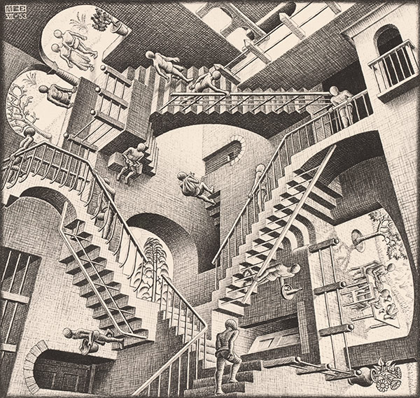
Escher
Drawing – you can create an image of an object, turn the paper and recreate the image upside down.
Play with size, form and perspective.
Look into a mirror and draw what you can see behind you.
Create monotone colours with pencils, biros or fine liner pens.

Slide 7
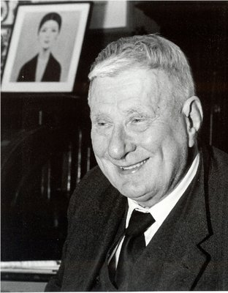
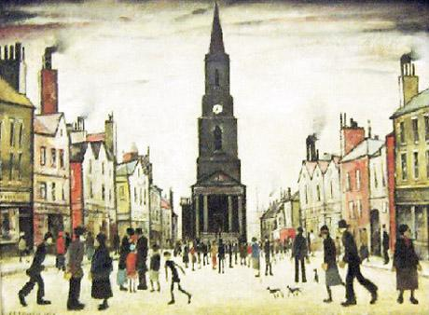
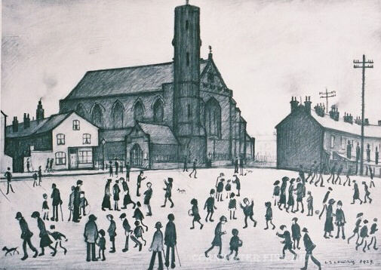
L.S Lowry 1887-1976
Famous for his urban landscapes, Lowry painted just what he saw, his images of people, animals and places have atmosphere and movement.
They make you feel like you are there, and even though at the moment you have to stay at home – you can use a photo of a holiday or a memory of a time you were out in a crowded place.
You can create an image like Lowry by including small amounts of detail; he’s famous for painting ‘matchstalk men and matchstalk cats and dogs!

Slide 8
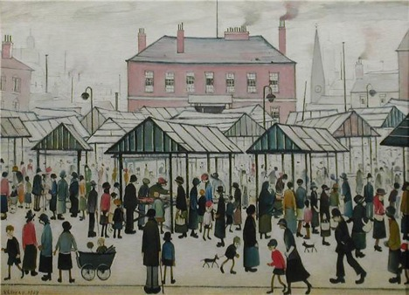
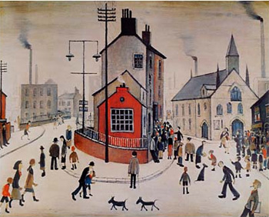
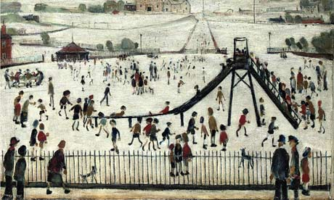
L S Lowry
Town scenes like these will return again once Lockdown is over.

Slide 9
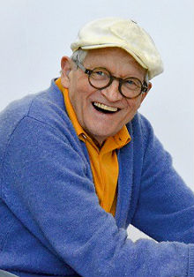
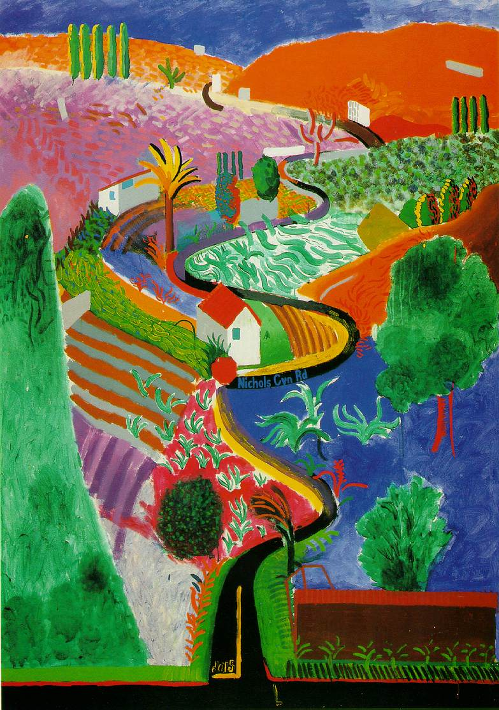
David Hockney born 9 July 1937 This British artist is famous for painting in a ‘pop art’ style using bright colours and bold images of landscapes. You can create a Lockdown piece of art by looking through your window and drawing images of what you see. Use paints, pastels, wax crayons or chalks in many bright, alternative colours.

Slide 10
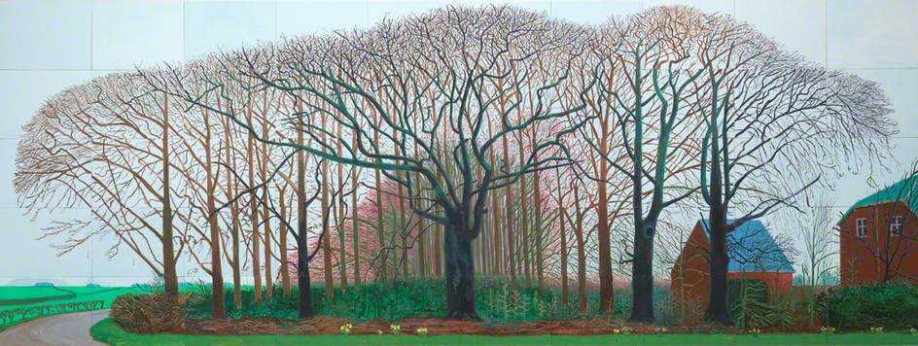
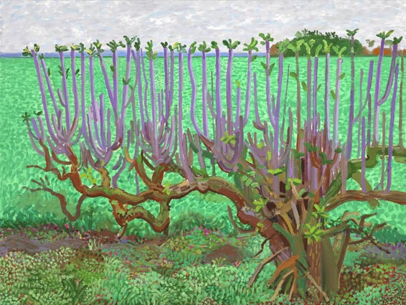
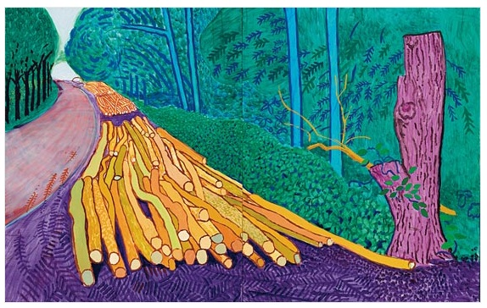
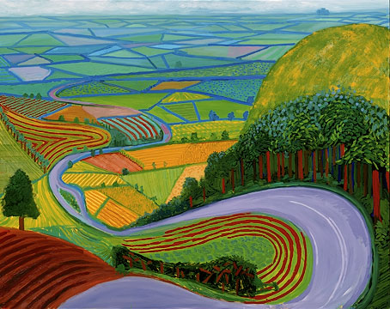
David Hockney – Bright, bold landscapes

Slide 11
Everywhere you look there are images of HOPE in the form of a Rainbow. Your lockdown artwork could depict a rainbow. I love patterns in artwork so you might add pattern and detail into the bands of the arc. Make sure it’s big, bright and colourful!

Slide 12
Lockdown artwork I’ve shown you a small selection of the hundreds of fabulous artists in world. You can create your artwork in any form: drawing, painting, collage, textiles, sculpture, printing. If you prefer you can find an artists style you really like and create your own artwork in their style, use books or the internet to help you research artists. Be creative and ENJOY!
Please send a copy (photograph or computer generated image) to your class page or teachers’ email address.
They will forward it onto me.
You can also send your original piece of artwork into school by post, or pop it through the letter box.
I will print and display your work in school ready for when we return.
Keep Safe, Stay Home and be creative.
I look forward to seeing your fantastic work – from Mrs Coulston

